Slide 1


Discovery of the Vertical Distribution of Ozone in the Stratosphere
Guy P. Brasseur
Max Planck Institute for Meteorology, Hamburg, Germany
and
National Center for Atmospheric Research. Boulder, Colorado

Slide 2
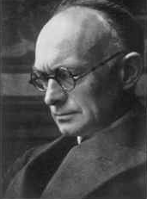
The Royal Meteorological Institute: a leading research center for meteorology
Jules Jaumotte, Director of Royal Meteorological Institute from 1919 to 1940, introduced in Belgium the concept of frontology and the modern methods of dynamic and synoptic meteorology.

Slide 3
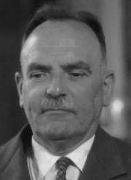
Considerable developments in dynamic meteorology, atmospheric energetics and atmospheric chemistry occurs in the 1950’s and 1960’s
Jacques van Mieghem, Director of the Royal Meteorological Institute from 1962 to 1970, creates a section on atmospheric chemistry and radioactivity and establishes regular ozone soundings in Uccle.

Slide 4
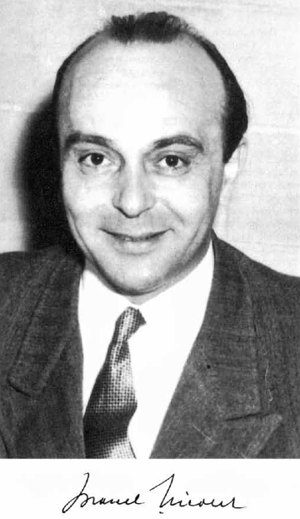
Belgium puts the field of aeronomy and atmospheric photochemistry at the forefront
Marcel Nicolet, first at he Royal Meteorological Institute, established in 1964, the Belgian Institute for Space Aeronomy. He focused on the physics and chemistry of the atmosphere of the Earth and other planets, and of outer space.

Slide 5
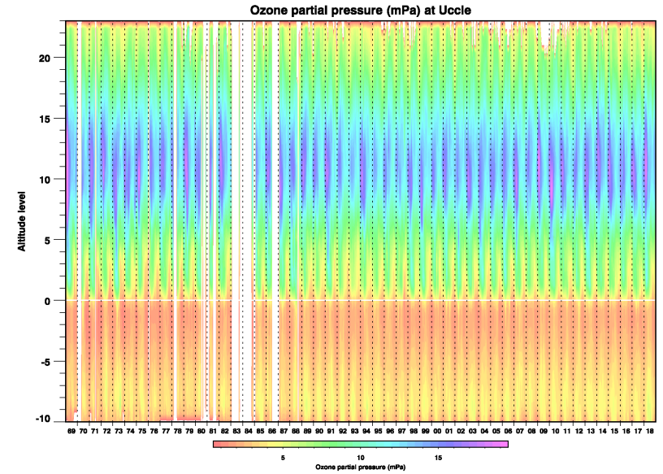
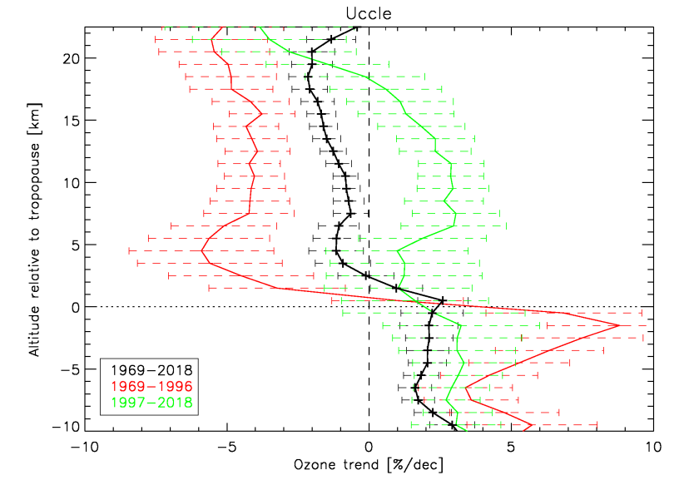
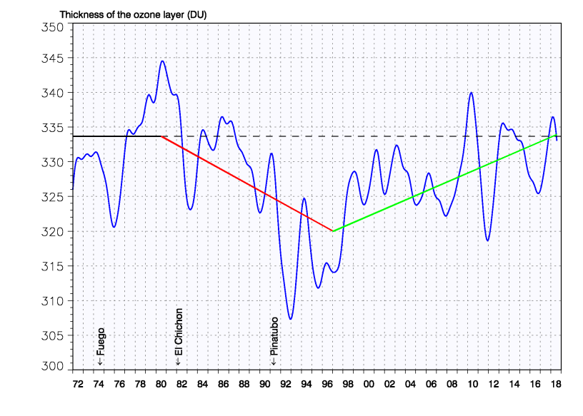
Very active ozone research activities in the last 50 years

Slide 6
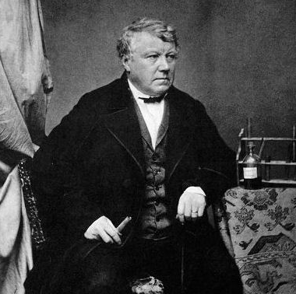
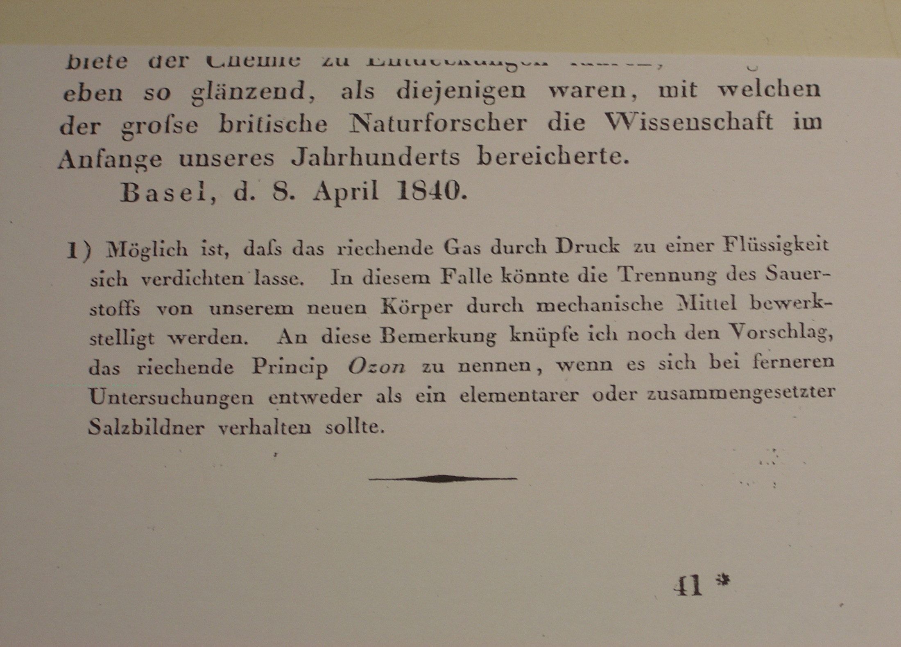
The Discovery of Ozone
On March 13, 1839, Christian Fredrich Schönbein (1799-1868) a German Professor at the University of Basel reports to the local Naturforschung Gesellschaft in Basel that the electrolysis of acidulated water produces an odor at the positive electrode , which was the same odor produced by an arc between electrodes.
Recherches sur la Nature de l’odeur qui se manifeste dans certaines actions chimiques, Compt. Rendus de l’Academie des Sciences, 27 April, 1840, Paris

Slide 7
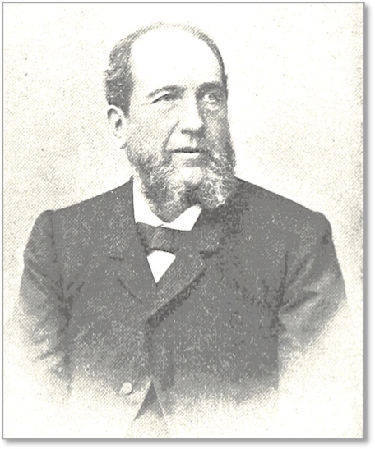
Identification of the ozone molecule: O₃
There are a lot of speculations about the nature of the odor reported by Schönbein. In 1868 (29 years after the discovery of Schönbein and the year of his death), the swiss chemist and physicist, Jean-Louis Soret, using an ingenious method based on Graham's diffusion law, proves that ozone is composed of 3 oxygen atoms
Soret

Slide 8
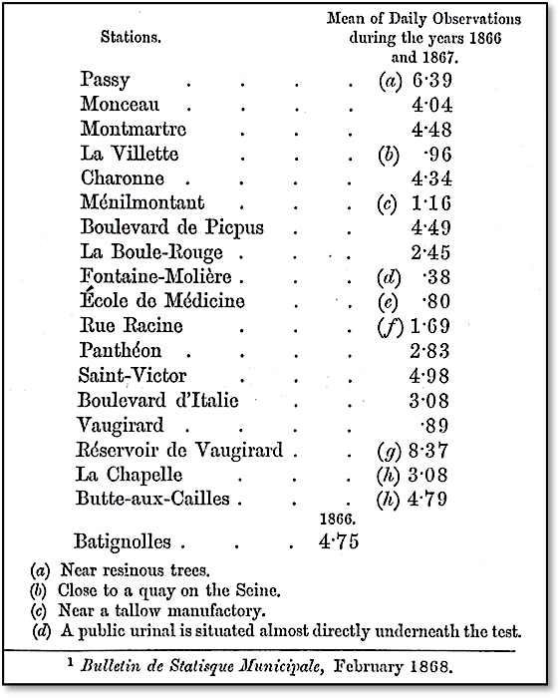
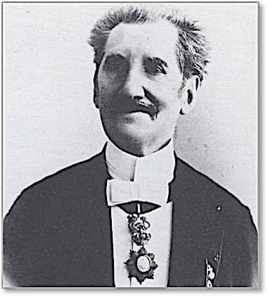
Ozone: A Permanent Gas of the Atmosphere
First measurements of ozone in Paris
1866-1867
[Schönbein scale]
In 1858, Agronomist Jean Auguste Houzeau (Rouen, France) showed that ozone is a permanent chemical constituent of the atmosphere.

Slide 9
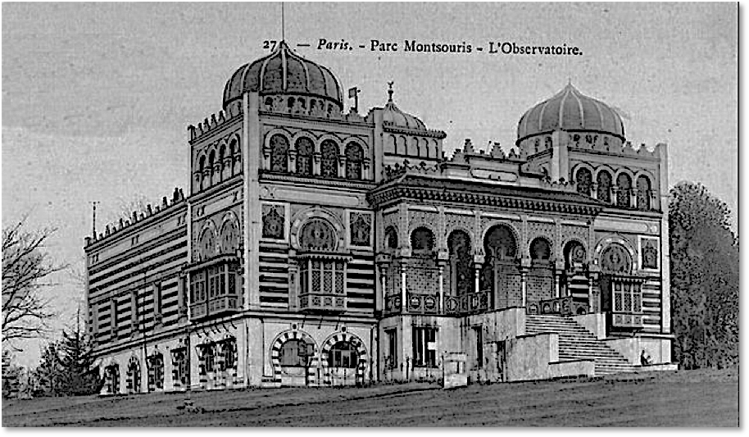
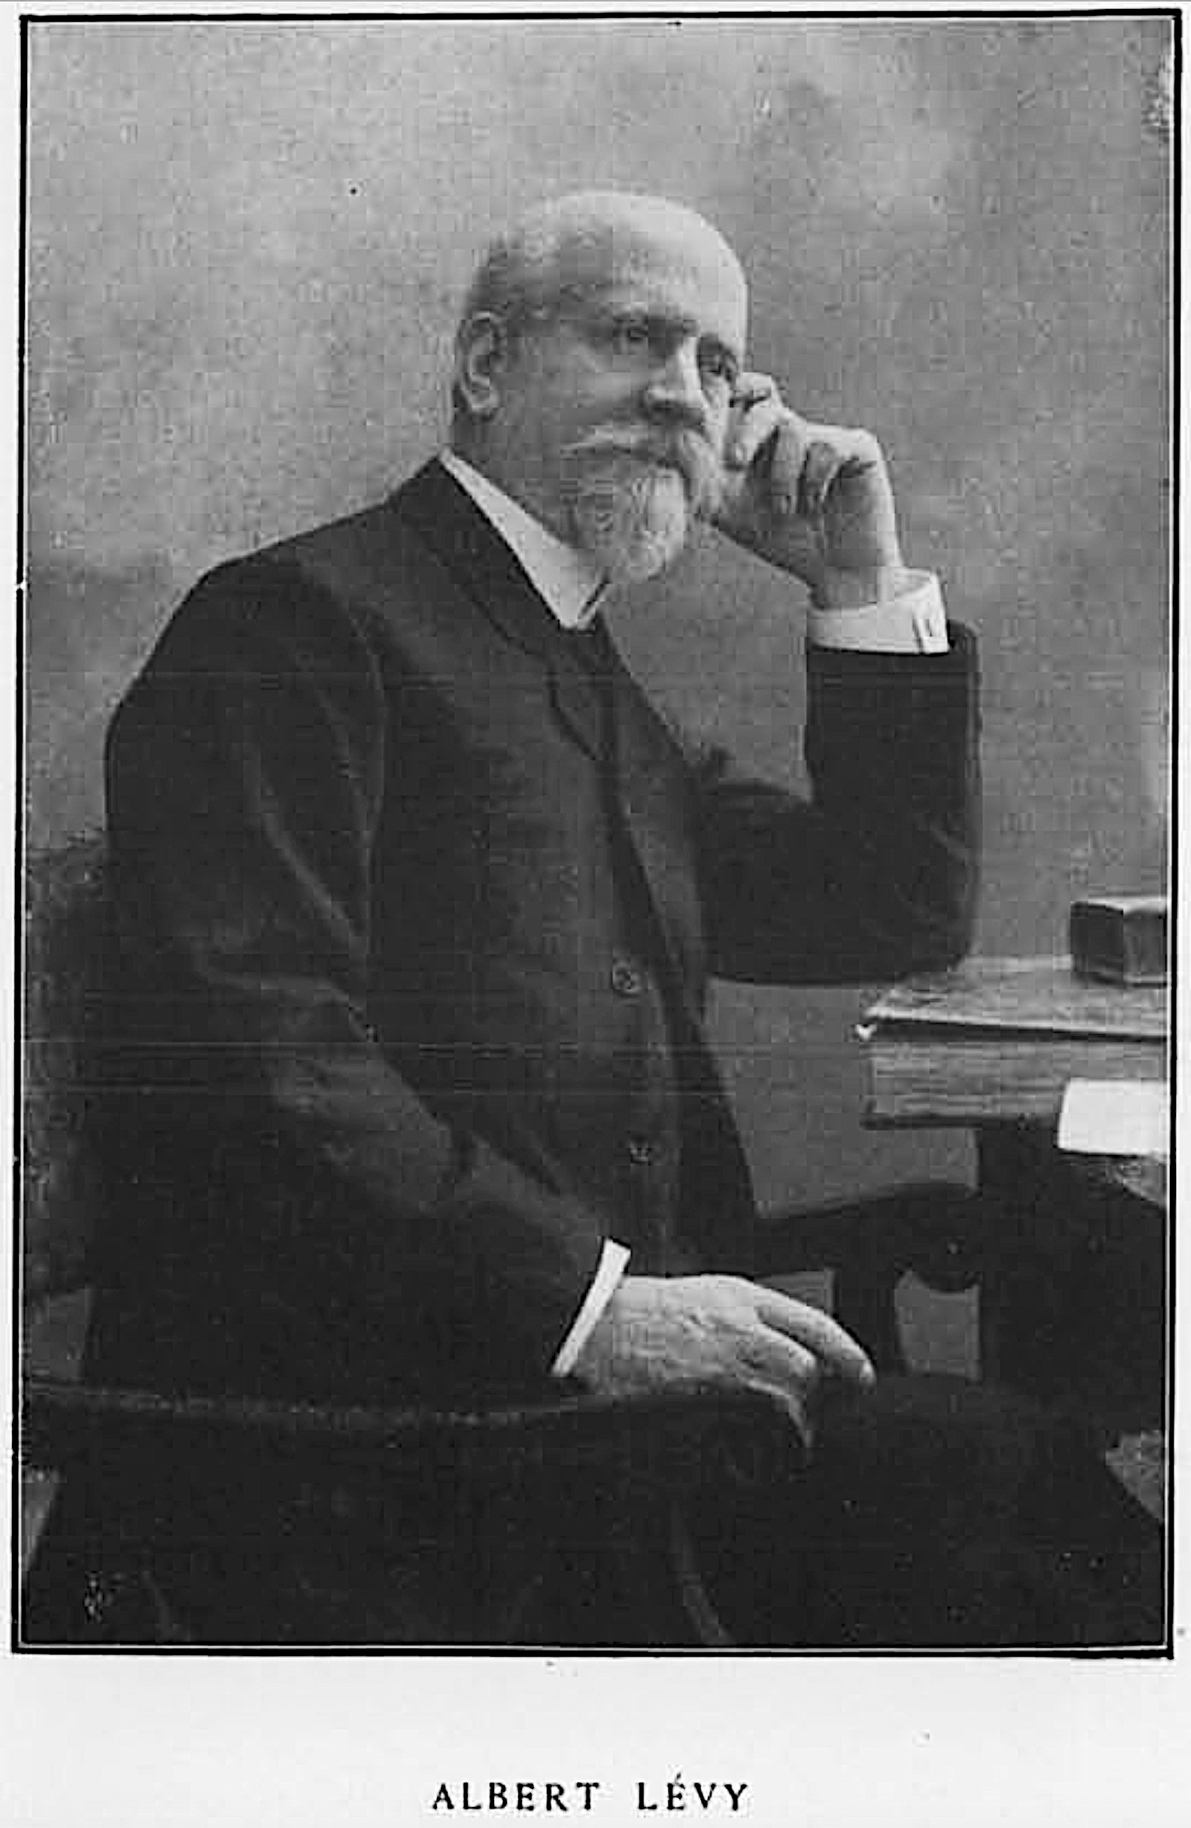
Surface ozone measurements at Parc Montsouris in Paris
Between 1860 and 1910, ozone became routinely measured in 300 sites in Europe and the United States, because ozone was believed to reduce epidemics (cholera).
Albert Levy makes systematic measurements of ozone at the Municipal Observatory in the Parc Montsouris in Paris between 1877 and 1907. Typical observed values of 10 ppbv are now believed to represent an underestimation.
Albert Levy

Slide 10
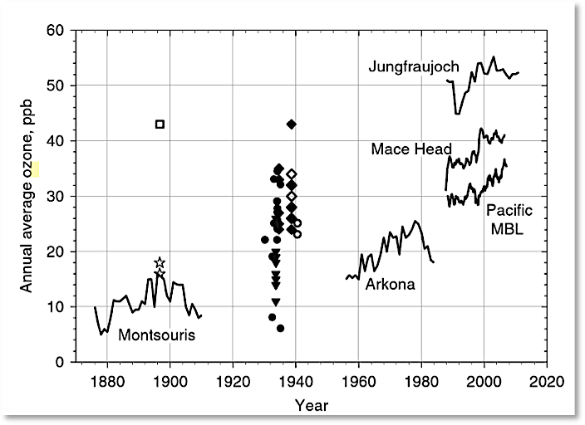

Slide 11
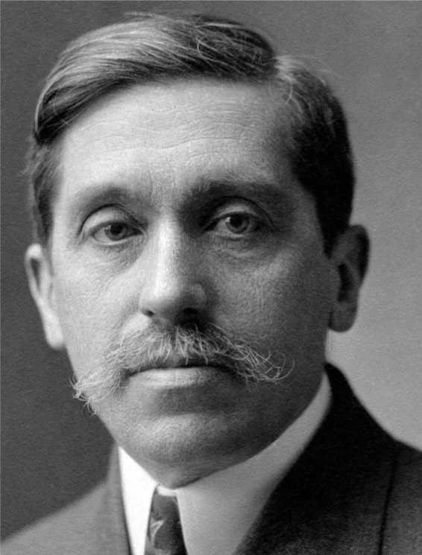
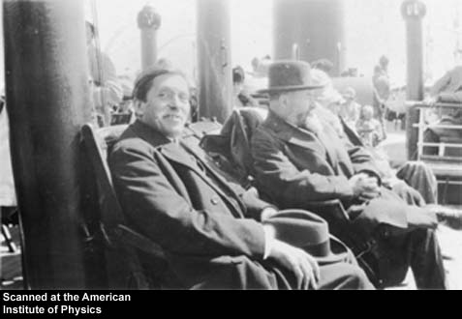
Fabry & Buisson
French spectroscopists Charles Fabry and Henri Buisson made precise measurements of the ozone absorption coefficients in 1912.
Based on these measurements, they derive for the ozone column a thickness of only 5 mm.
In 1920 they designed a spectrograph with 2 dispersion systems at right angle to each other and made the first systematic observations at two differently absorbed wavelengths (300/340 nm). They conclude that the thickness of the ozone layer is 3 mm.
Fabry
Fabry and Buisson on a ship to the USA
« L’hypothèse la plus probable est que l’ozone existe seulement dans la très haute atmosphère, où il serait produit par la partie extrême du rayonnement ultra-violet solaire, qui, étant fortement absorbé par l’oxygène, ne peut agir que sur les couches les plus élevées de l’atmosphère »
« The most probable hypothesis is that ozone is present only in the very high atmosphere where it would be produced by the extreme part of the solar ultraviolet radiation, which, being strongly absorbed by oxygen, can only act on the upper layers of the atmosphere. »

Slide 12
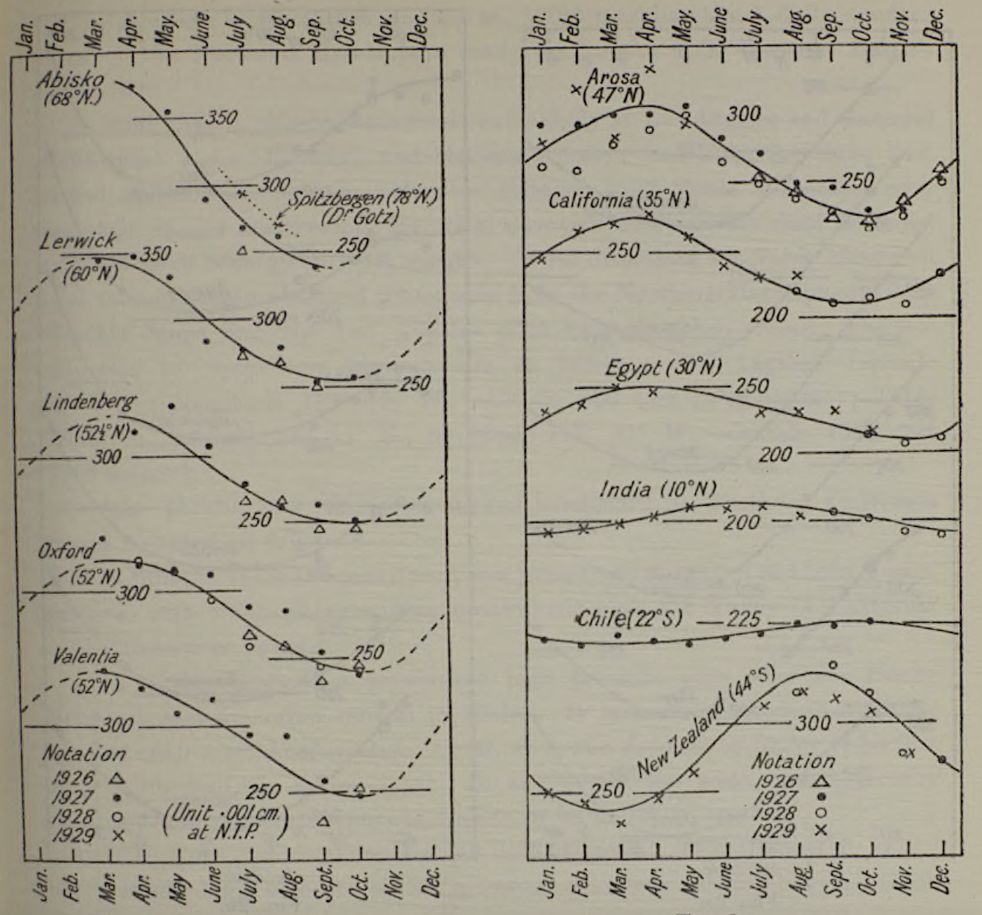
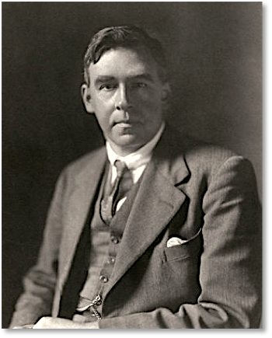
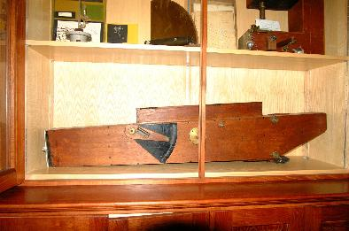
The Dobson Ozone Photographic Spectrometer
Dobson
1930: Dobson discovers the seasonal variation in the ozone column: large at high latitudes, small in the tropics and delayed by 6 months in the southern hemisphere.

Slide 13
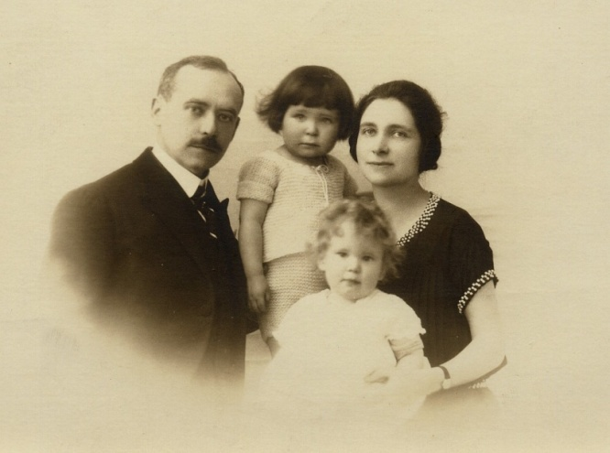
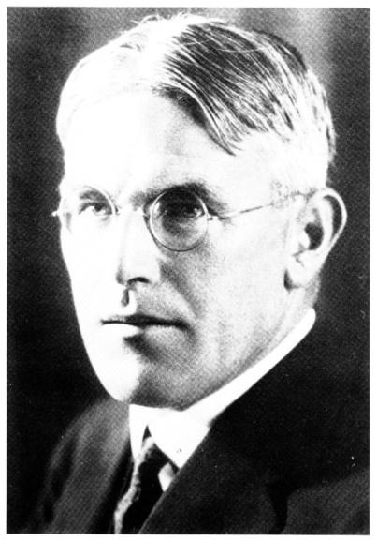
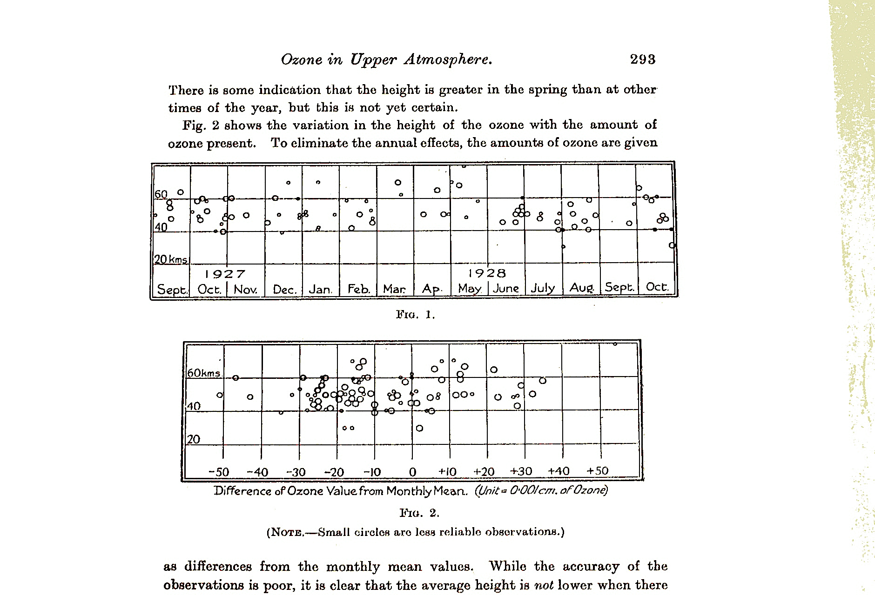
Determination of the Height of the Ozone Layer
In 1928, Jean Cabannes and Jean Dufay (who work in the Laboratory of Fabry in Marseilles) in France note that the 300 DU of ozone observed by Dobson can only be explained if there is an ozone layer in the upper atmosphere. From the measurement of ozone absorption at 3 different wavelengths, they locate this layer near 50 km altitude.
In 1927-1928, Paul Götz and Gordon Dobson first confirm from measurements made in Arosa that this layer is located near 40-50 km.
Cabannes and his family
Götz

Slide 14
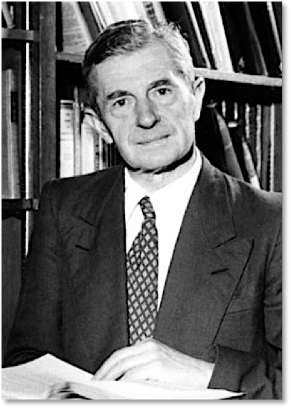
The First Photochemical Theory:
A pure Oxygen Atmosphere
In 1929, Sydney Chapman rejects the idea that ozone could be produced by corpuscular particles, which had been invoked to explain the higher ozone concentrations observed at high latitudes.
Rather, he introduces the first scheme that describes the photochemistry of ozone:
O₂ + UV → O + O
O + O + M → O₂ + M
O + O₂ + M → O₃ + M
O₃ + UV → O + O₂
O + O₃ → 2 O₂
S. Chapman

Slide 15
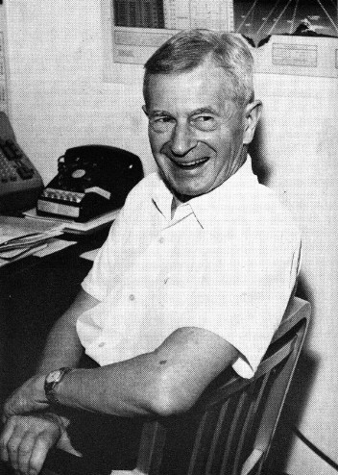
The First Ozone Conference in Paris (1929)
At the first ozone conference in Paris, Sydney Chapman presents the first photochemical theory of ozone.
On the basis of the photochemical parameters available at that time, he suggests that the ozone layer is located near 40 km altitude. This confirms observational data at that time.
At this time, the absorption or radiation by O₂ at wavelengths larger than 200 nm is not known.

Slide 16
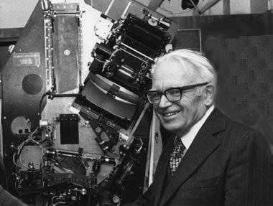
Ozone Production in the Stratosphere
G. Herzberg
It is only in 1953, P. Brix and G. Herzberg show that the photolysis of oxygen (and therefore the photochemical production of ozone) is possible for radiation beyond 200 nm, and is therefore taking place down to the lower stratosphere.

Slide 17
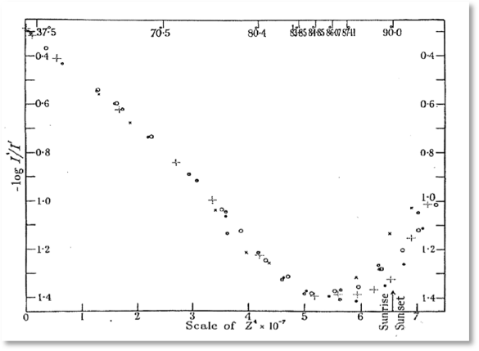
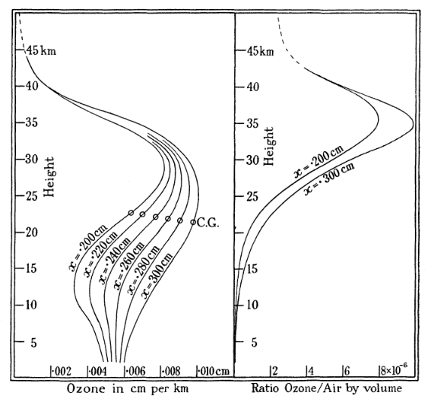
Determination of the height of the ozone layer:
The Umkehr Effect
Götz
During a Spitzbergen expedition in 1929, Paul Götz (by inverting measurements at 2 wavelengths of the blue sky radiation at the zenith for low solar elevations) shows that the maximum ozone concentration is located near 25 km altitude.

Slide 18
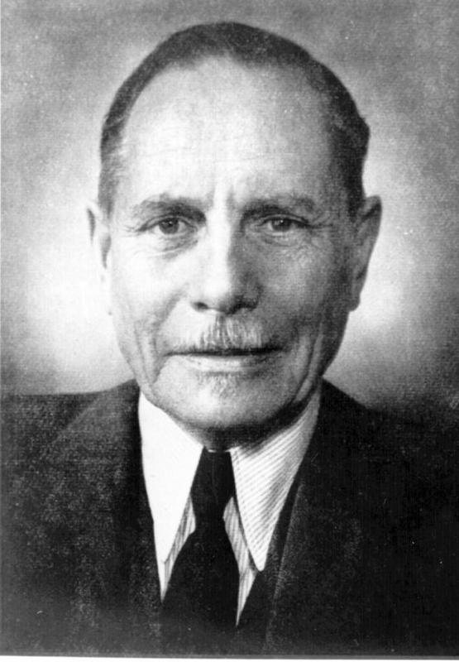
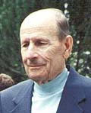
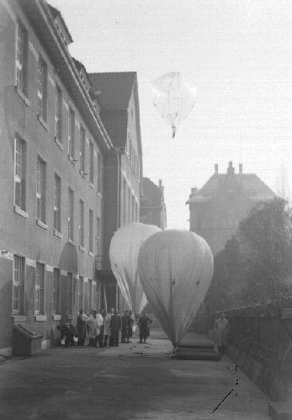
Height of the Ozone Layer
Erich Regener
1881-1955
Victor Regener
1913-2006
In 1934, Erich Regener and his son Victor who measure the solar ultraviolet absorption from a stratospheric balloon launched from Stuttgart, show that the ozone maximum is located near 25 km.

Slide 19
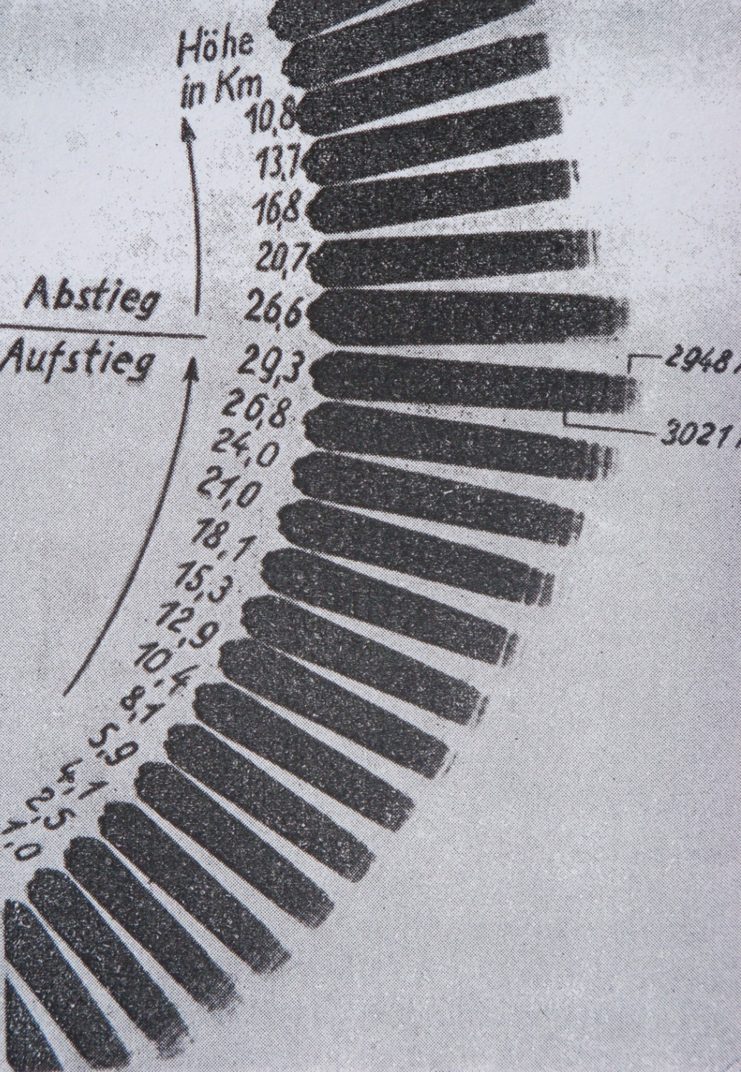
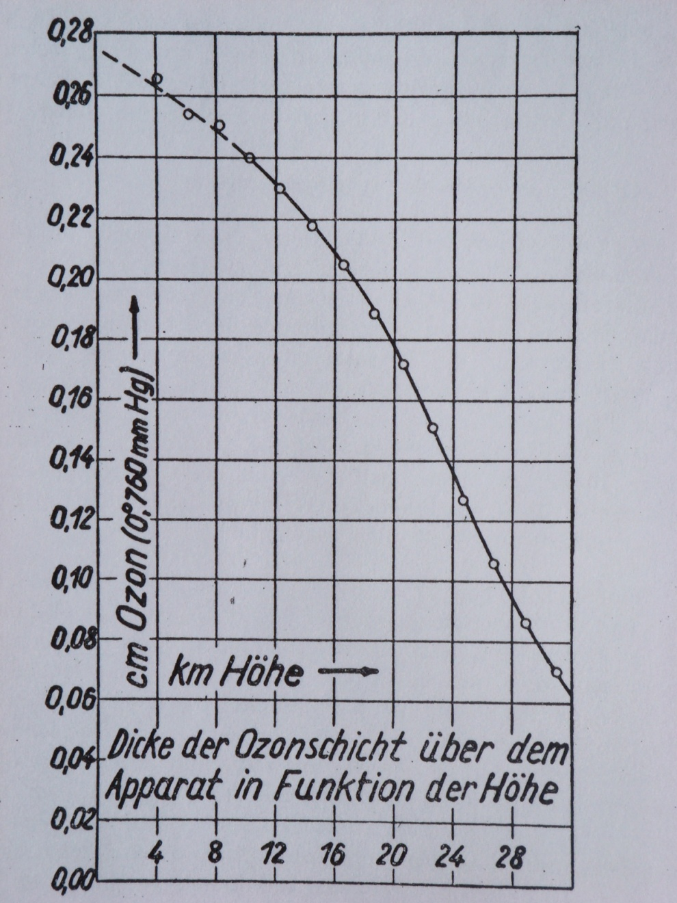
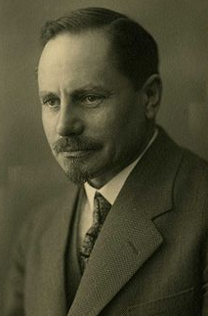
Regener’s Data

Slide 20
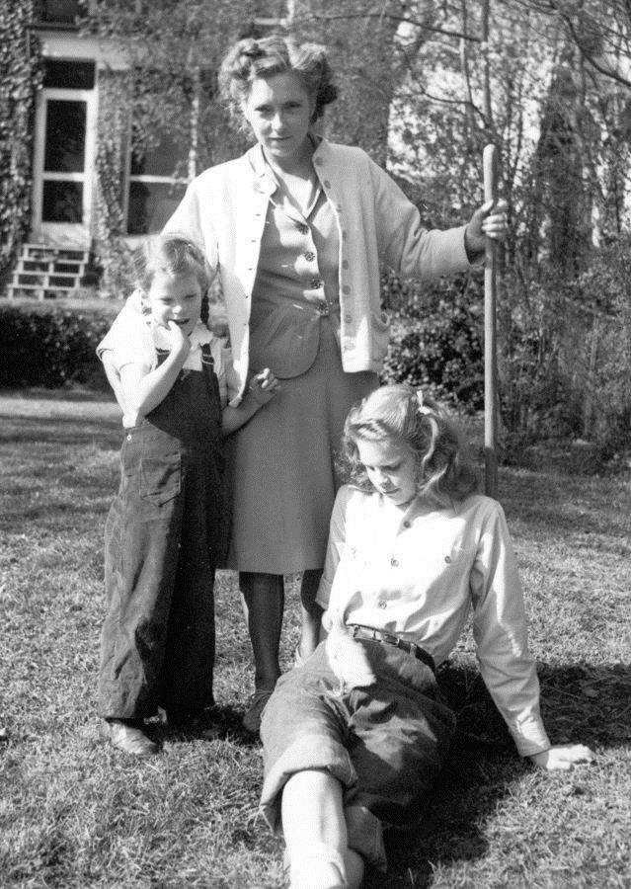
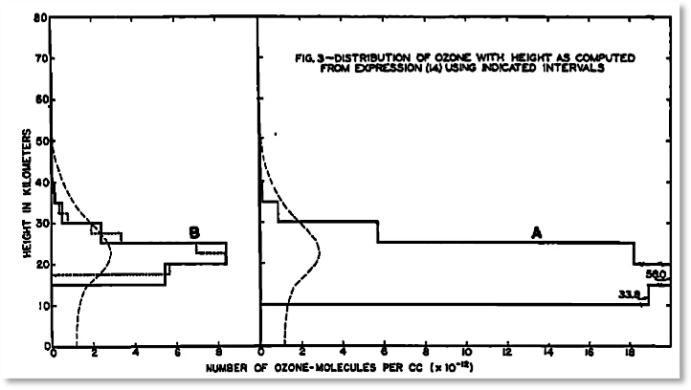
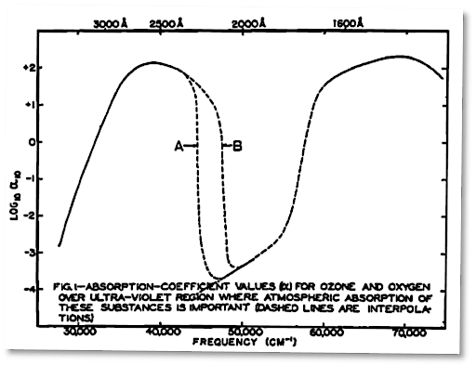
The first model of the vertical distribution of ozone
In 1936, Oliver R. Wulf and Lola S. Deming, working at the Bureau of Chemistry and Soils of the United States Department of Agriculture, produce the first numerical model of the vertical distribution of ozone in the stratosphere
Lola Deming and her 2 daughters

Slide 21
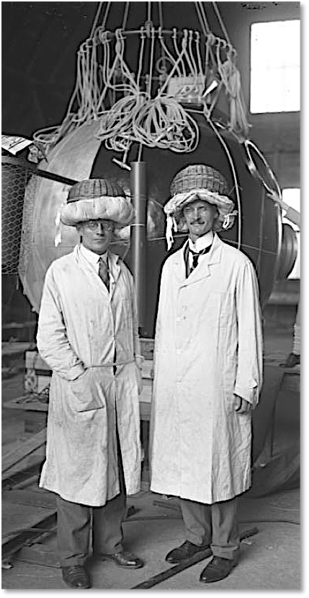
Auguste Piccard and Paul Kipfer
On 27 May 1931, the two swiss scientists, who had received support from the FNRS in Belgium, reached for the first time the stratosphere (51,790 feet or 15.781 km) with a hydrogen-filled balloon.

Slide 22
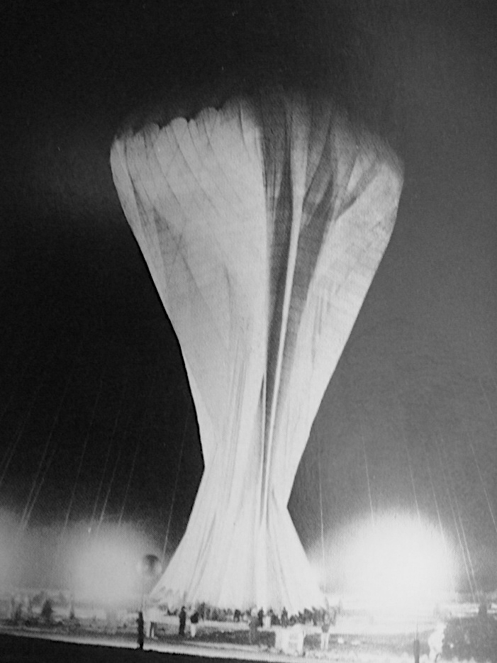
Explorer I
With funding from the National Geographic Society, Explorer I was launched on July, 28 1934 from Iowa to explore the stratosphere, and to measure the penetration of cosmic rays and ultraviolet solar radiation. This provided an opportunity to derive the vertical ozone profile.

Slide 23
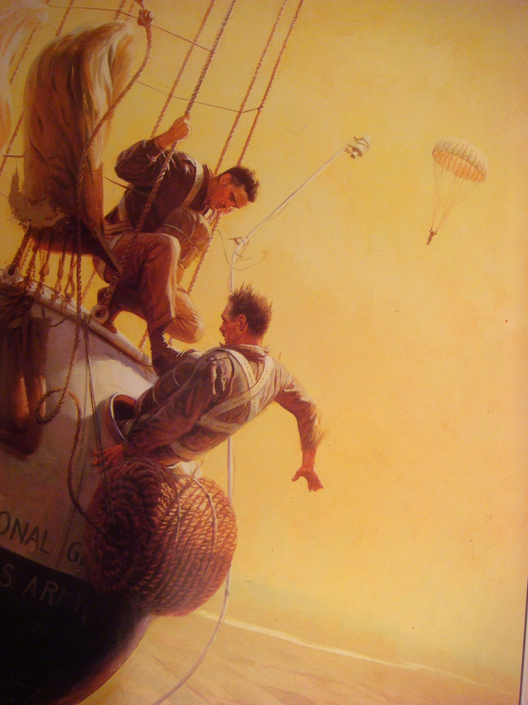
Explorer I
The Explorer I flight ended in disaster when the balloon ripped and its hydrogen mixed with air exploded. After a harrowing few moments while Stevens had trouble escaping through the manhole, he and his two fellow aeronauts parachuted to safety.

Slide 24
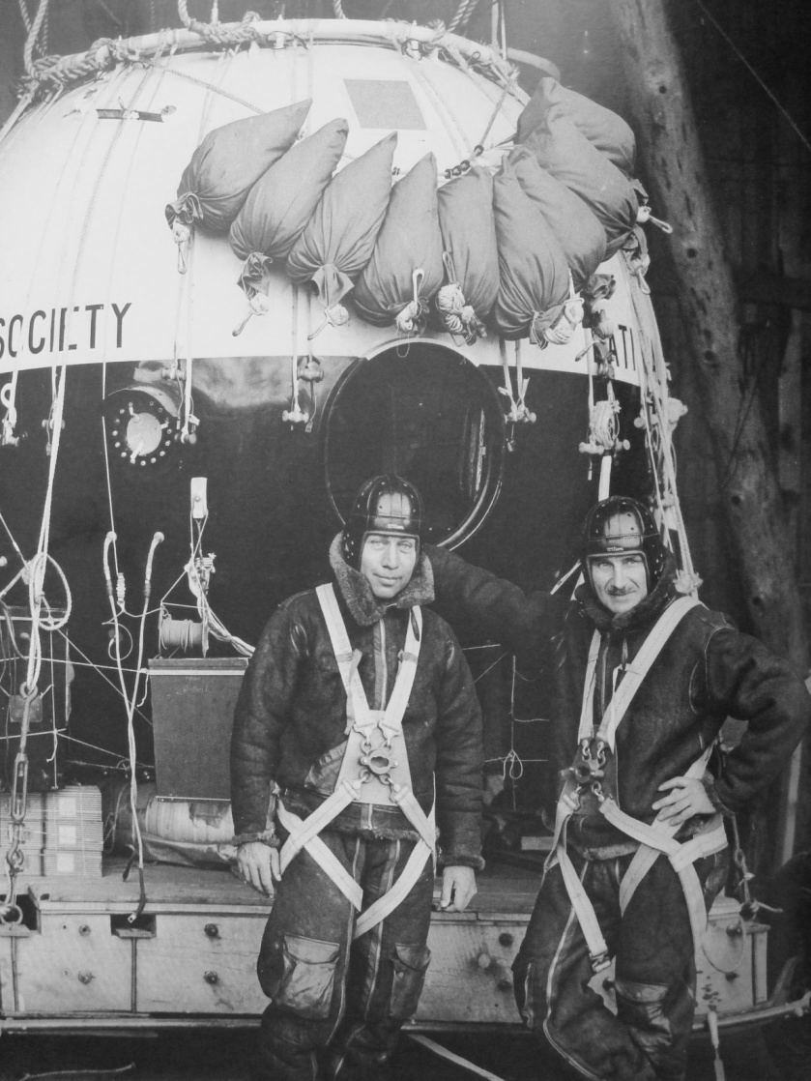
Explorer II
Launched on November 11, 1935, from the Stratobowl near Rapid City, South Dakota, Explorer II carried Captain Albert Stevens, Captain Orvil Anderson, and an assortment of instruments to a world record altitude of 22,066 kilometers (72,395 feet).

Slide 25
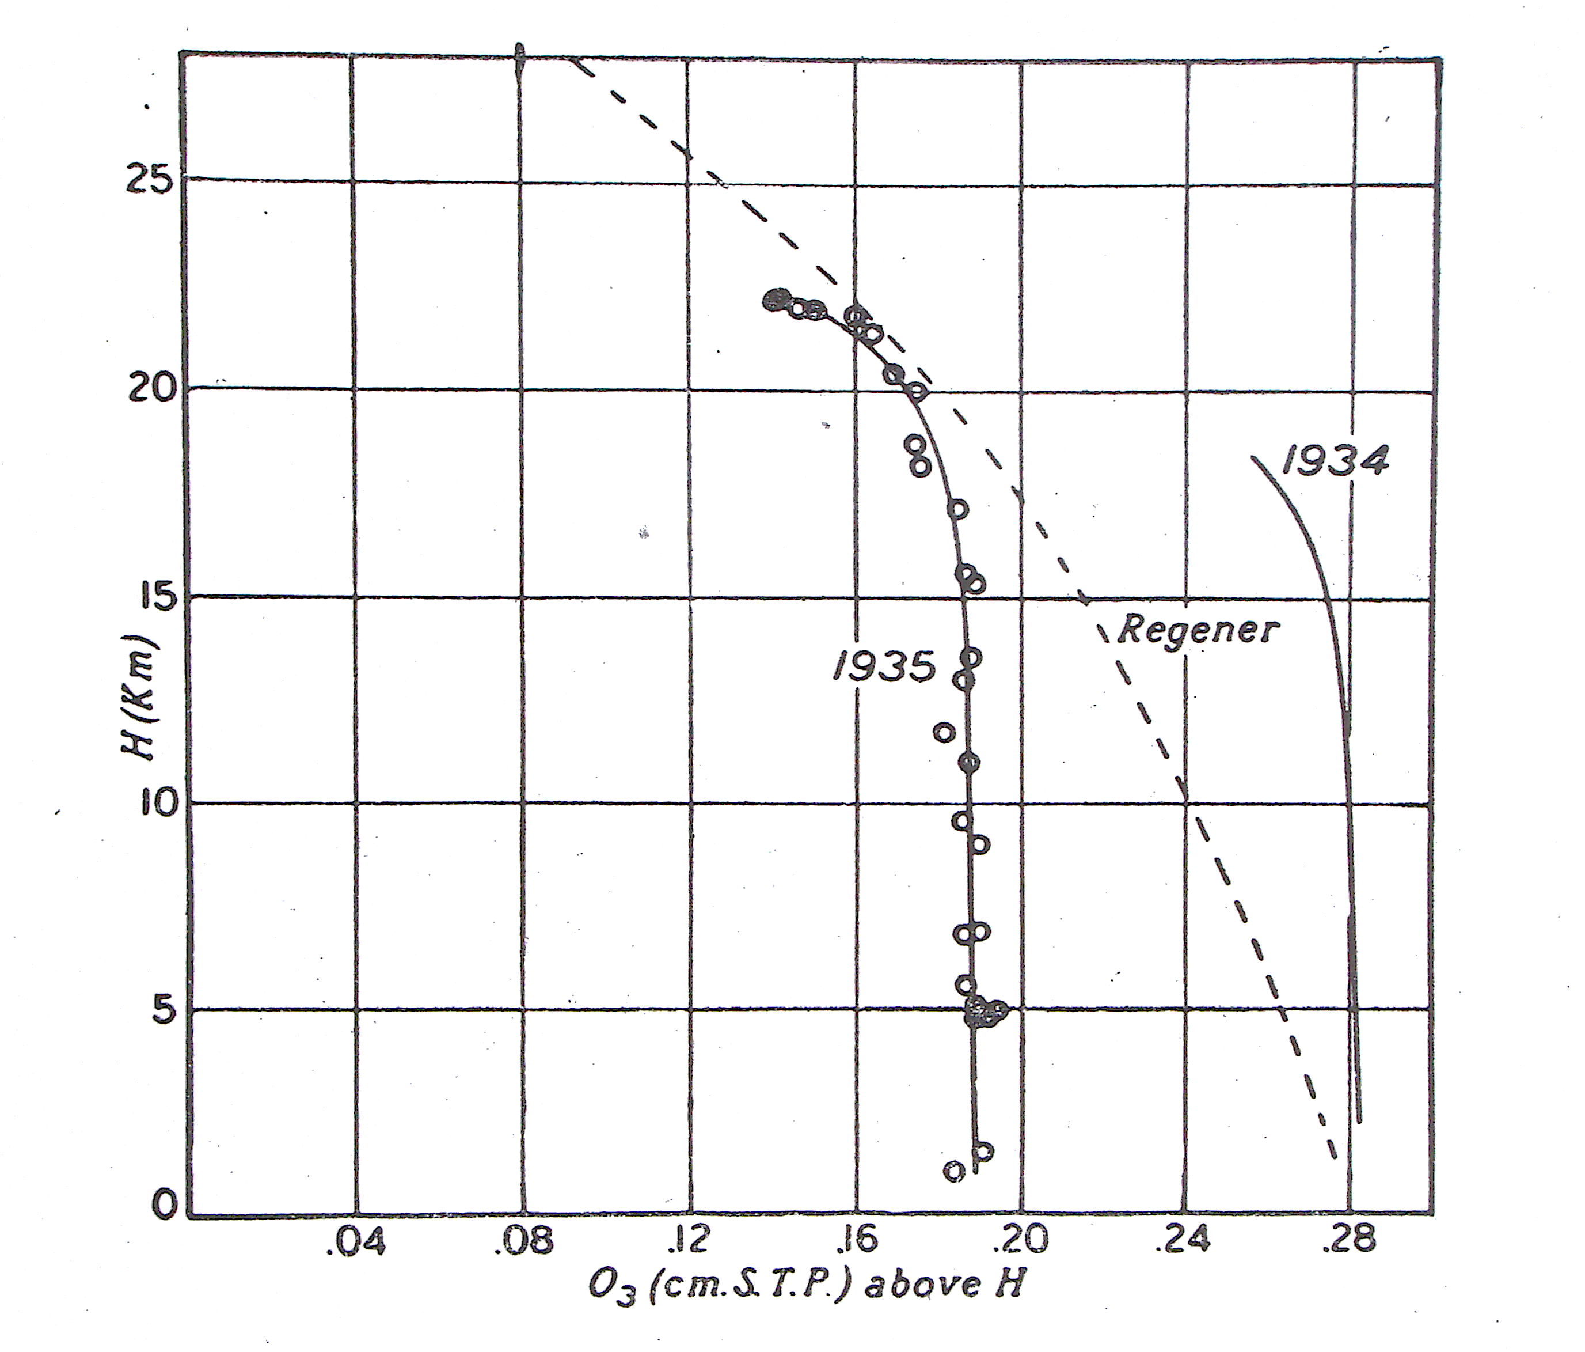
Ozone column
The ozone column above the balloon derived during the Explorer I (1934) and II (1935) experiments is compared to the column derived by Regener in Germany.

Slide 26
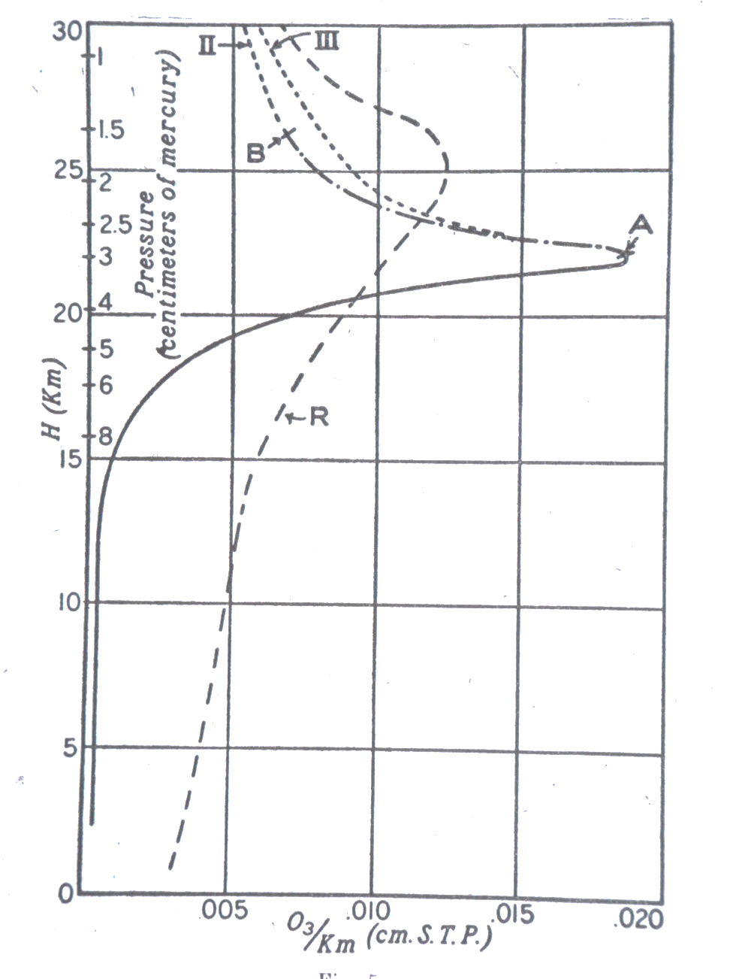
Vertical Ozone Profile
The vertical ozone profiles deduced from the measurements of solar ultraviolet radiation during the Explorer experiment (A and B) showed a maximum in the ozone concentration near 22 km, and were different from the profile (R) retrieved by Regener in Germany.

Slide 27
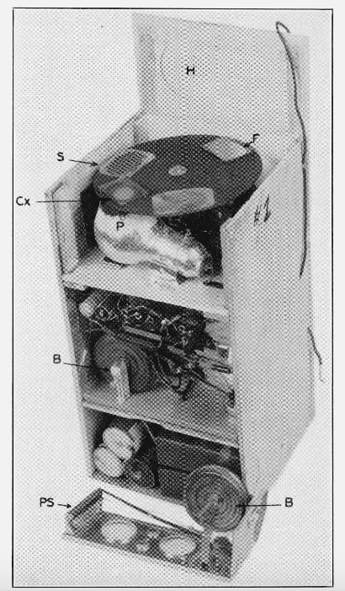
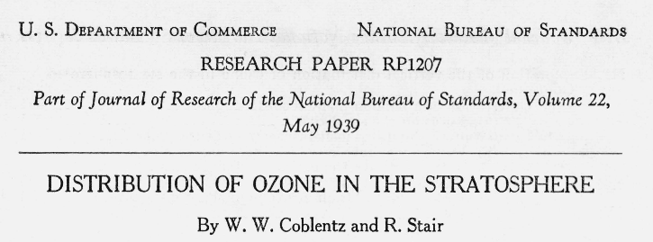
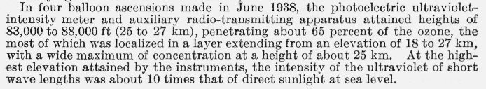
Observations by Coblentz and Stair
National Bureau of Standards
(1938)

Slide 28
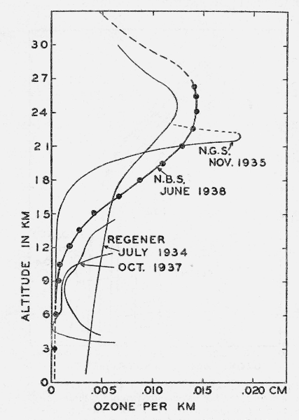
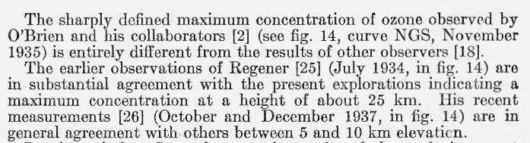
Vertical Profile of Ozone
(1938)

Slide 29
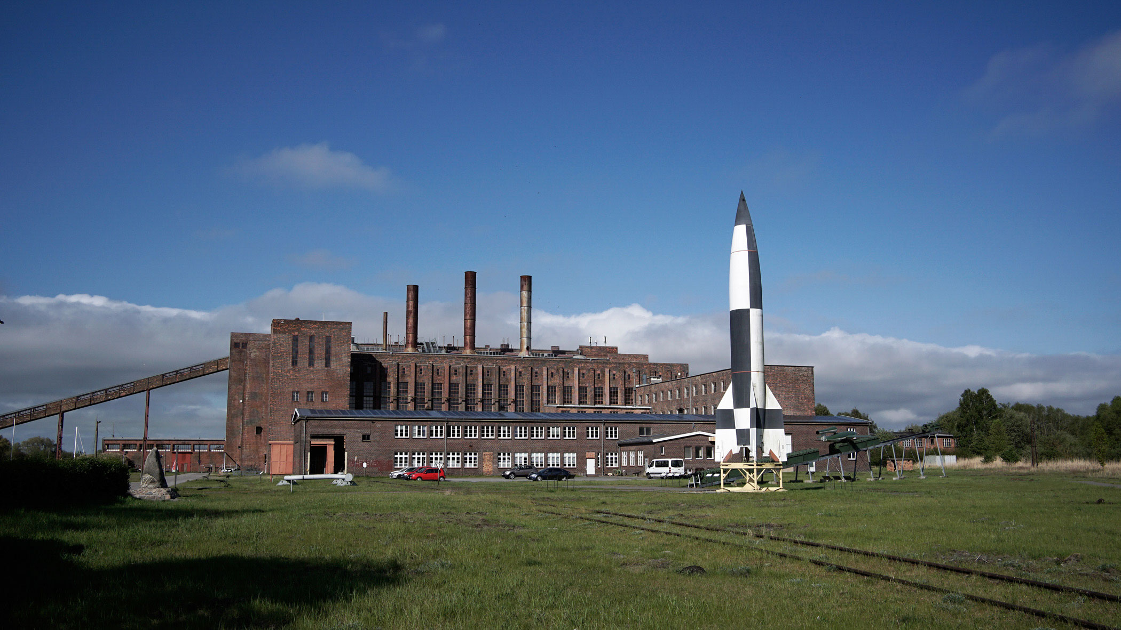
During World War II, Regener attempts to use a V-2 rocket to measure ozone up to 70 km altitude
Erich Regener, who has been fired from the University of Stuttgart because his wife had Jewish ancestors, convinced Wernher von Braun, Director of the German Rocket Research Center in Peenemünde to use a V-2 rocket to measure ozone up to the mesosphere. He built an instrument called “Regener Tonne” to be launched, but the military authorities decide that the rockets needed to be used for the war effort.
At the end of the war, the “Regener Tonne” disappeared. It was found a few months later in the US.

Slide 30
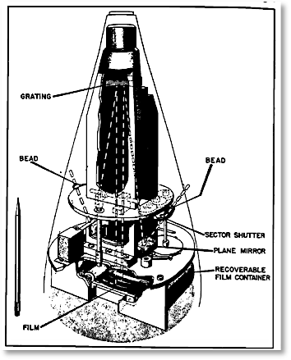
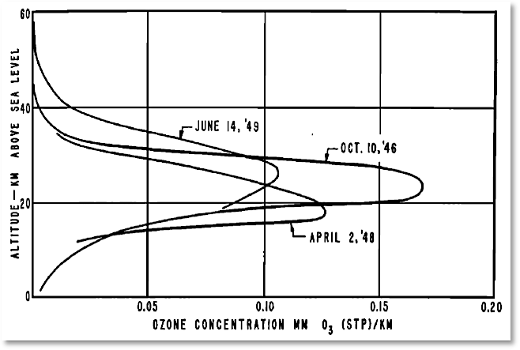


Mesurement of the vertical profile of ozone using a spectrometer on board a V2 rocket over New Mexico
1948-1949

Slide 31



The First Ozone Observations
from Space
Sat
Sun
Vanksteswaran
In 1960, S. V. Venkateswaran (UCLA) et al. perform the first observation of ozone by satellite photometry by measuring the solar light reflected by the Iota I communication satellite near sunrise/sunset.
In addition to the observed ozone maximum near 25 km, they also identify a secondary ozone maximum at 55 km.
In 1962, Rawcliffe et al. (Aerospace Corporation) measure the vertical distribution of ozone by a radiometer mounted on an Air Force satellite and did not find this maximum.
70
Rocket
Satellite
50
20
0

Slide 32

Satellites provide global distributions of ozone and other chemical species

Slide 33



Improvements in the theory
1950: Bates and Nicolet show that ozone is catalytically destroyed by hydrogen radicals in the mesosphere.
1970: Crutzen shows that the major ozone destruction is due to the catalytic effect of nitrogen oxides.
These two discoveries lead to a much improved agreement between calculated and measured vertical distributions of ozone.

Slide 34
Thank You

