Slide 1
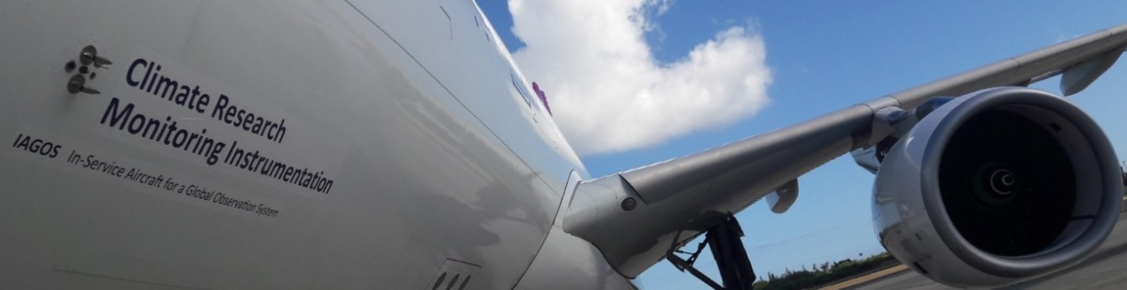



IAGOS : 25 years of tropospheric ozone monitoring
on board of commercial aircraft
Valérie Thouret
Laboratoire d‘Aérologie, Toulouse
Valerie.Thouret@aero.obs-mip.fr or Valerie.Thouret@iagos.org
Celebration event : 50 Years of Ozonesonde launches at Uccle | Uccle | 19 September 2019

Slide 2



In-service Aircraft for a Global Observing System
Association Internationale sans but lucratif
European Research Infrastructure for global observations of atmospheric composition from commercial aircraft. IAGOS combines the expertise of scientific institutions with the infrastructure of civil aviation in order to provide essential data on climate change and air quality at a global scale.
… a Landmark Project of the European Strategy Forum on Research Infrastructures

Slide 3
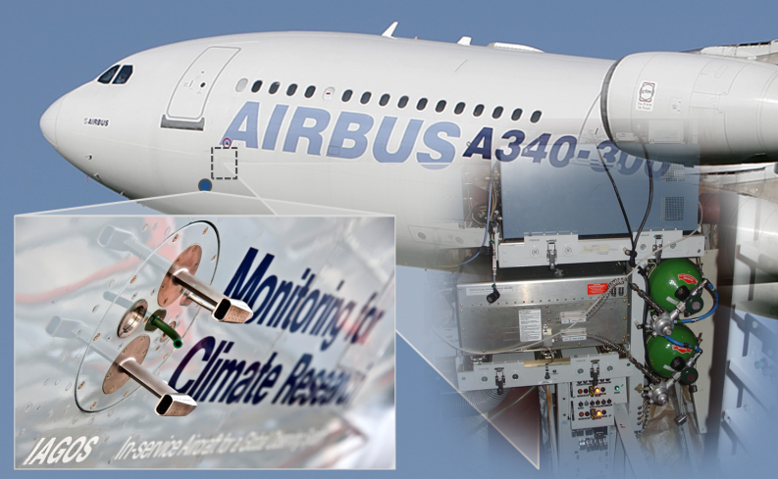
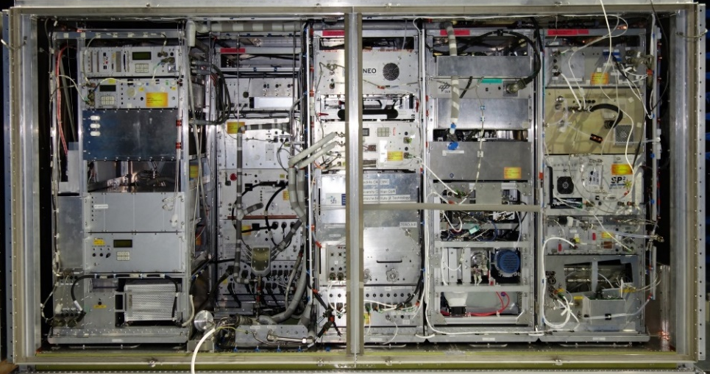
In-service Aircraft for a Global Observing System
Association Internationale sans but lucratif
… a strong Consortium of
Europe’s Leading Atmospheric Research
Institutes and Universities

Slide 4

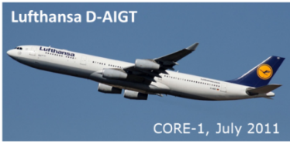




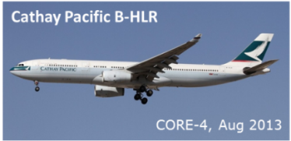










In-service Aircraft for a Global Observing System
Association Internationale sans but lucratif
… a strong Partnership of Airlines

Slide 5











In-service Aircraft for a Global Observing System
Association Internationale sans but lucratif
… a strong Partnership of
Aviation Industry and Funding Agencies

Slide 6
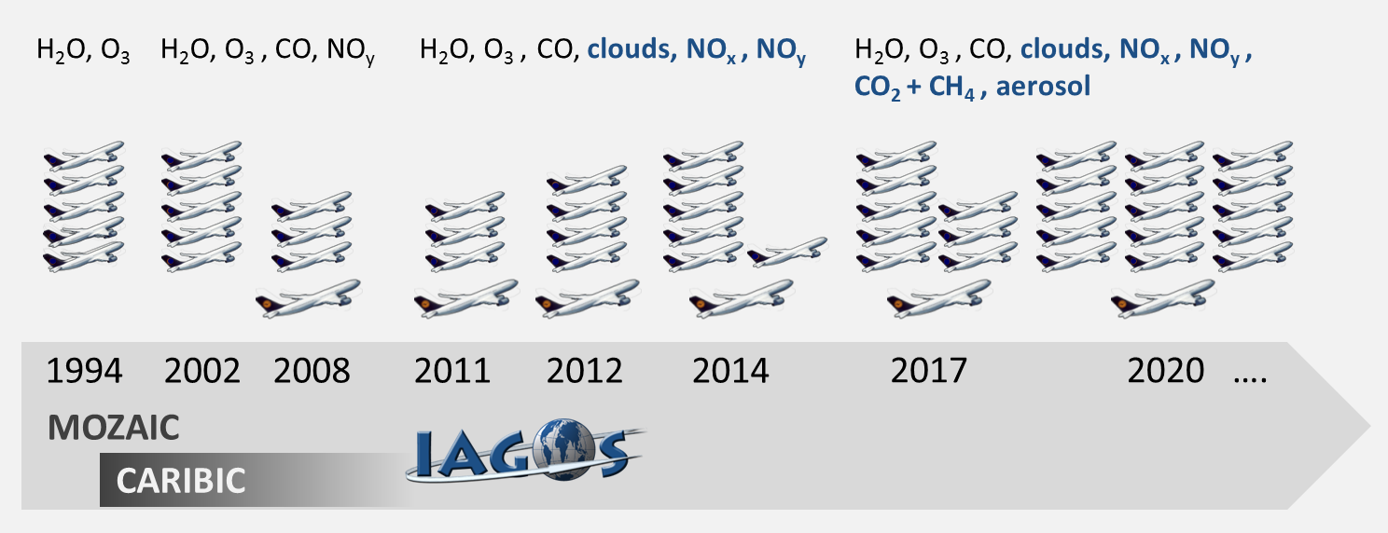
In-service Aircraft for a Global Observing System
Association Internationale sans but lucratif
Complementarity of 2 approaches from predecessor programs :
IAGOS-CORE: Key components on 20 aircraft, every day with quasi-global coverage, 500 flights/ac/yr
IAGOS-CARIBIC: Many species for a deeper understanding on one aircraft, ca. 50 flights/yr

Slide 7
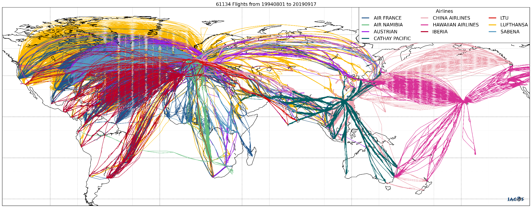
The IAGOS Data Set – Regional Coverage
IAGOS-CORE aircraft schedule:
Approx. 500 flights per aircraft per year
More than 200 airports visited regularly
IAGOS-CARIBIC aircraft schedule:
Flying laboratory on one Lufthansa aircraft
4 consecutive flights per month

Slide 8
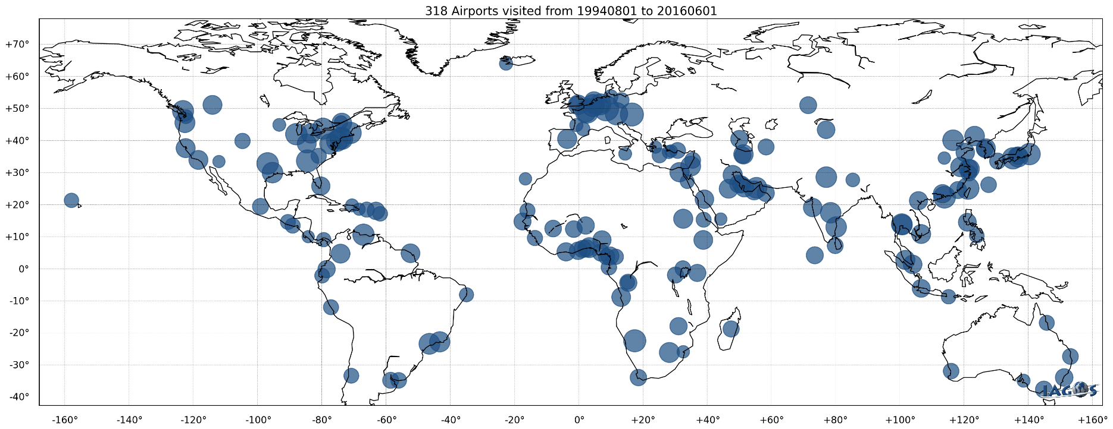
The IAGOS Data Set – Regional Coverage
10 % of data as « Vertical » profiles over different regions from 0 to 12 km :
  O3, CO, H20, P, T, winds along with Cloud particles and
  optional packages on only 1 aircraft so far for NOx and CO2&CH4, and Aerosols in a near future.

Slide 9
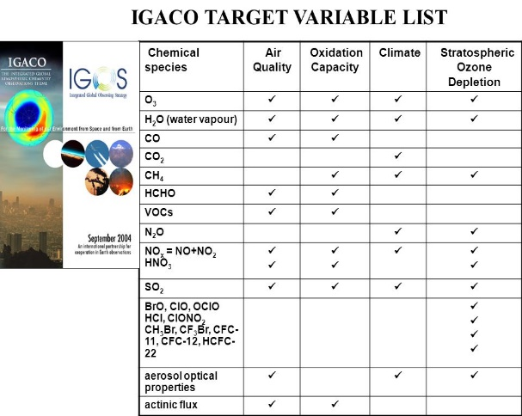
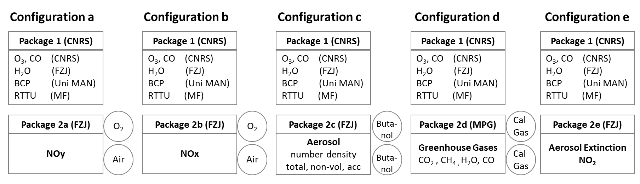
The IAGOS – CORE System
IAGOS objective is to provide scientific instrumentation for
atmospheric monitoring, to be operated on commercial aircraft
on a routine basis over decades
➔ Technical development is a balance between :
Scientific needs:
Relevant measurements
Existing research/industrial technologies
High level performances (precision …)
Long periods operation, stable calibration
Aeronautic requirement:
Aircraft environment
Fully automatic, low maintenance
Certification on commercial aircraft
Future option under development

Slide 10
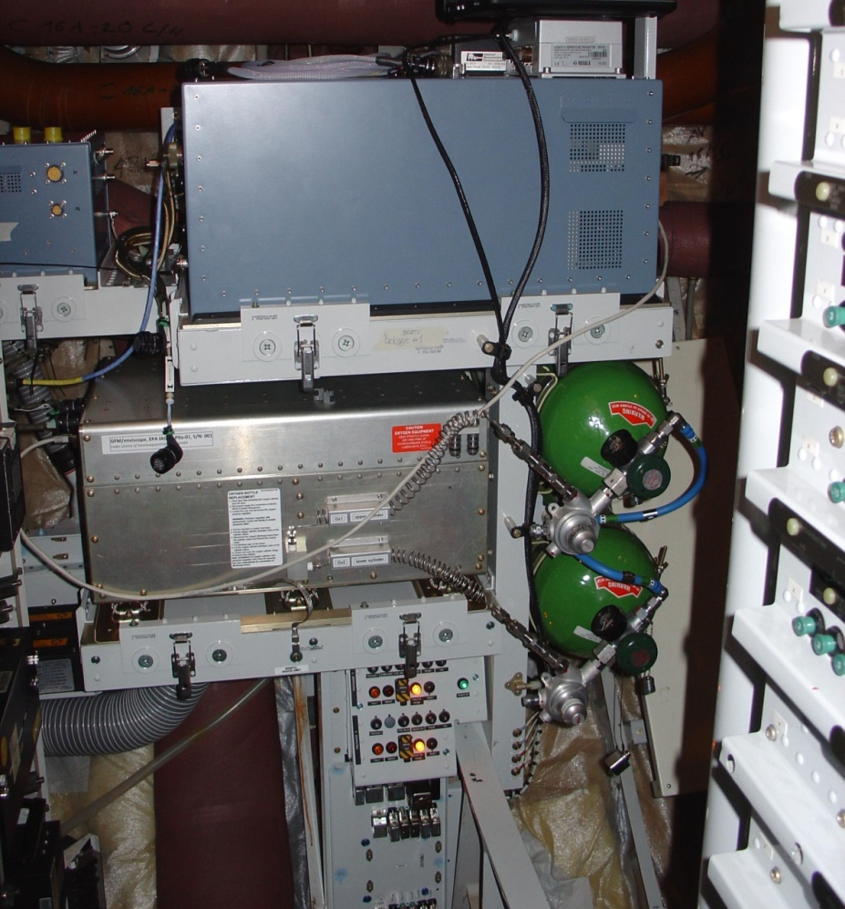

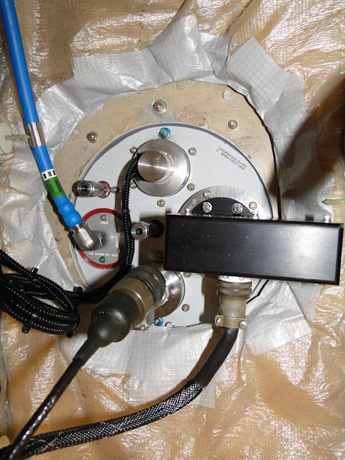
The IAGOS – CORE System
H₂O
Cloud Det.
Pump
O₃
CO
DAS/Modem
Pitot tube
for O3,CO
Instrument:
NO_{x} or NO_{y}
CO₂ , CH₄
or Aerosol
O₂
Synth. Air
Ventilation
Smoke Det.
Safety Panel
Breaker

Slide 11
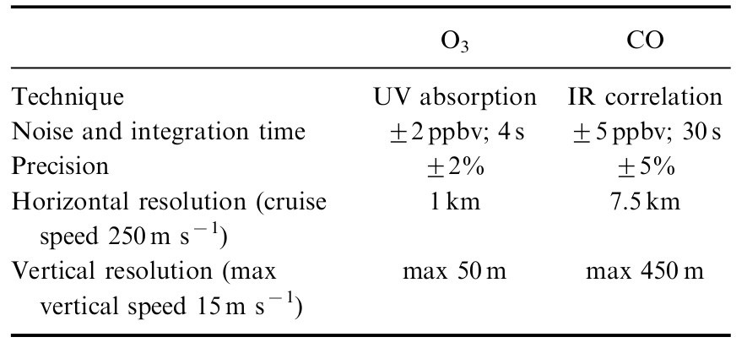
IAGOS-CORE Ozone and CO measurements
Since 1994 : robust instrumentation, same standard operating procedures, regular QA/QC
➔ High quality and consistent data set over decades
MOZAIC : 1994-2014 (max 5 aircraft; CO from 2001 to 2014)
O3 analyser by UV absorption (Thermo Scientific Model 49),
CO analyser by IR correlation (Thermo Scientific Model 48 Trace Level) : but highly improved for operations and sensitivity (Temp. regulated optimized IR detector, the cell pressurisation, air drying and frequent zeroing).
IAGOS : from July 2011 on (11 already equipped, objective 15-20 aircraft)
Package 1 = O3 & CO combined (P1 smaller and lighter but with the same performances)
Thouret et al., 1998; Nédélec et al.,2003, 2015.

Slide 12
The IAGOS – CORE Standard Operating Procedures
1- Pre-flight & Post-flight calibrations :
Comparison with a reference instrument Thermo Env. Model 49PS, at several levels of O3 to check the linearity of the instrument within 1% : 0, 50, 100, 200, 300, 500 and 800 ppb.
It is sent twice a year to French Laboratoire National d'Essais (LNE) for comparison with a NIST standard instrument.
2- In-flight calibration :
For Ozone :
Internal O3 generator,very 2 hours (takes 5 min) for calibration check with O3 levels of 0, 100 and 500 ppb.
For CO :
Regular zeroing, 10 minutes after take-off and every 20 minutes (takes 2 min).
3: IAGOS-QA/QC evaluation
Courtesy of H. Smit

Slide 13
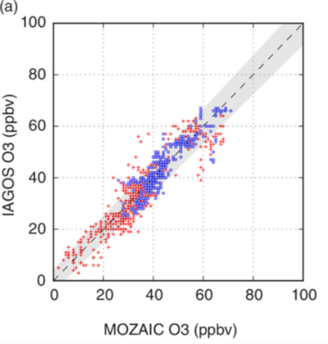
IAGOS_Ozone : Internal Consistency since 1994
Automatic detection of «coincident» profiles within 1 hour ➔ Individual Quicklooks comparing 2 profiles :
  Since 1994 : Flight Period is the time a package 1 unit or an O3 MOZAIC unit spent on the aircraft before replacement for maintenance. Usually 6 to 12 months.
  2011-2014 : MOZAIC / IAGOS overlap : 4 IAGOS and 3 MOZAIC
➔Internal consistency performance is computed as the mean bias of all the profile intercomparisons found with other aircraft during the instrument operational Flight Period.
Nedelec et al., 2015

Slide 14
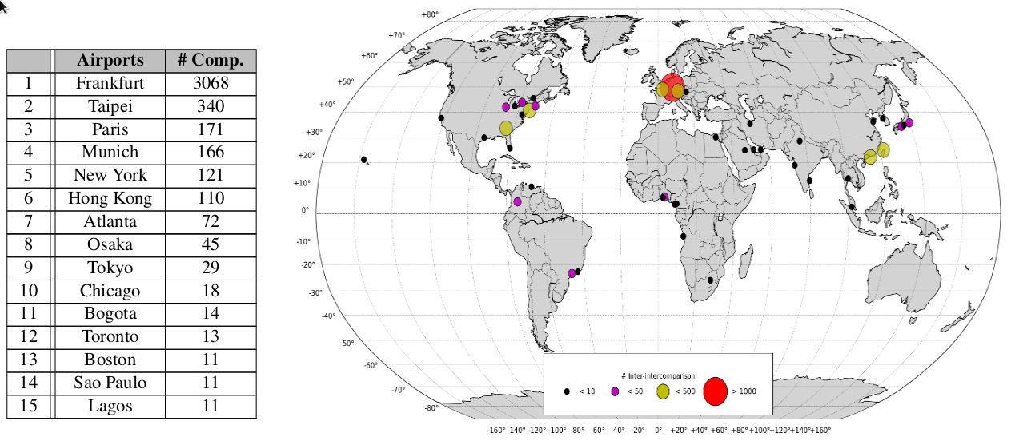
IAGOS_Ozone : Internal Consistency since 1994
Total number of profil intercomparisons worldwide since 1994
Blot et al., in prep.

Slide 15
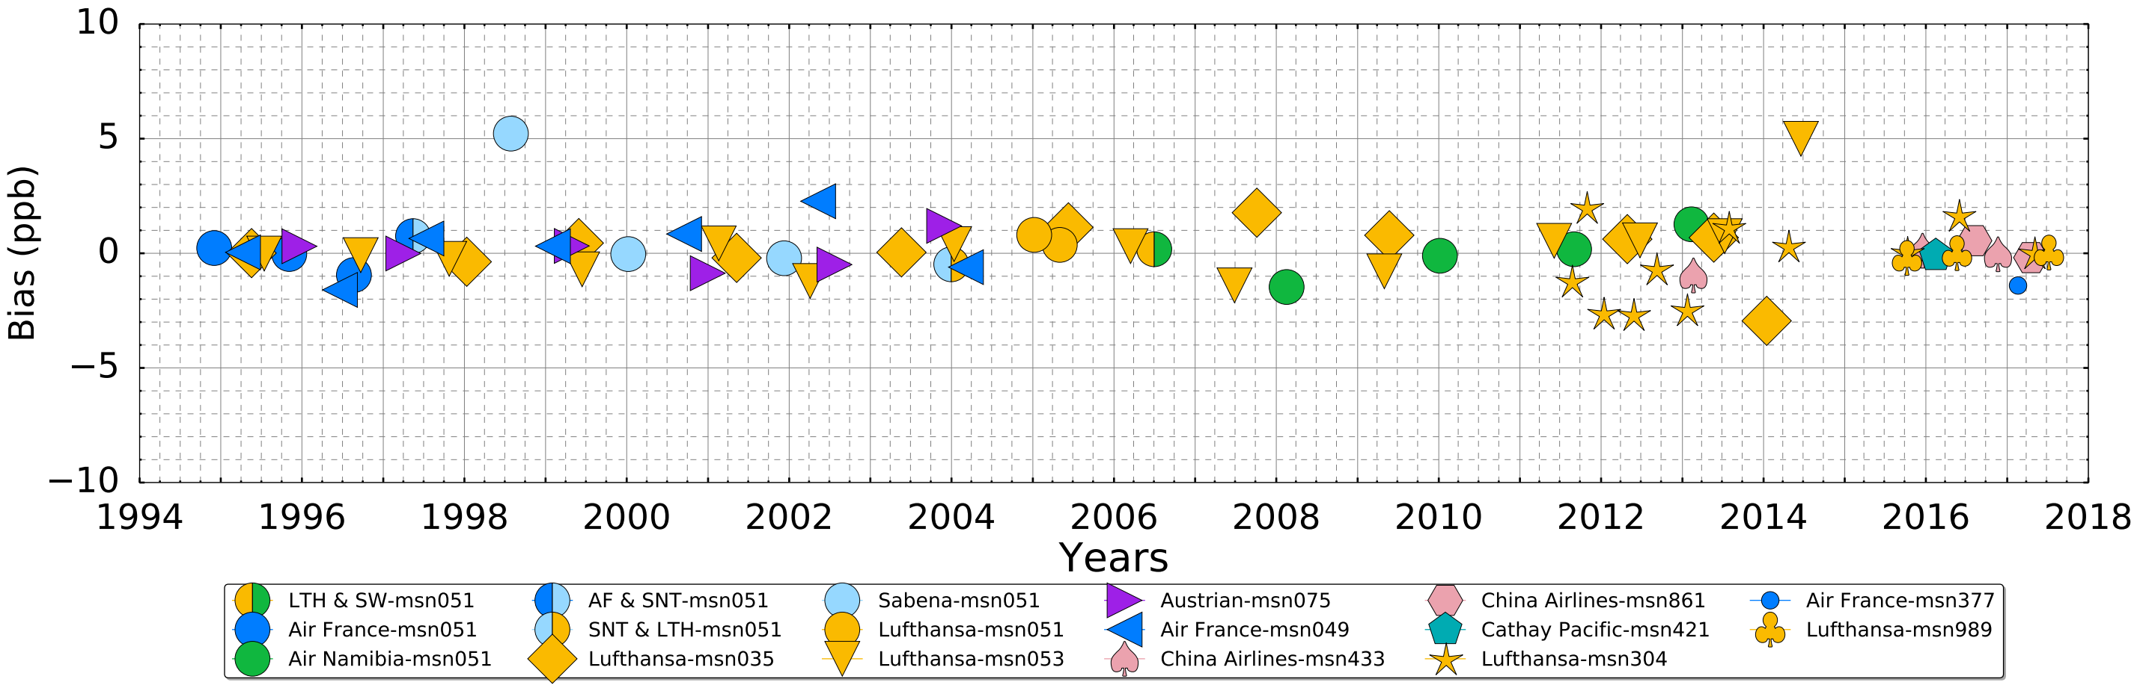
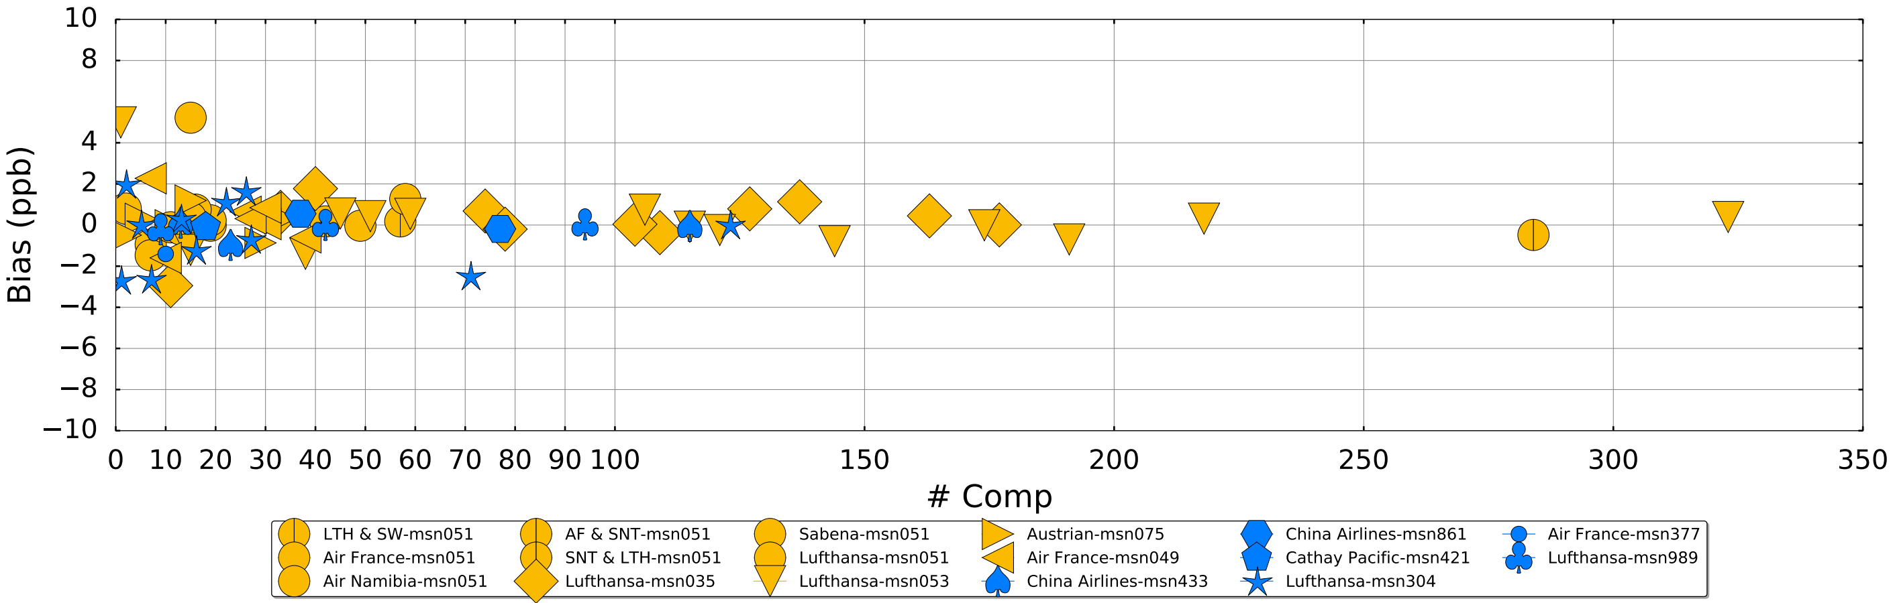
IAGOS_Ozone : Internal Consistency since 1994
Different flight periods ➔
Long-term stability of the IAGOS dataset
MOZAIC = IAGOS
Higher biases at
lower statistics
➔
IAGOS strategy :
2 aircraft/airline
Blot et al., in prep.

Slide 16



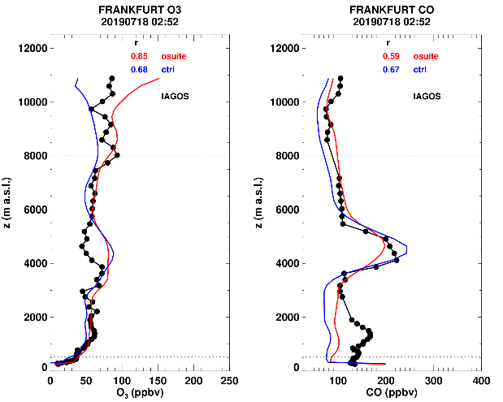
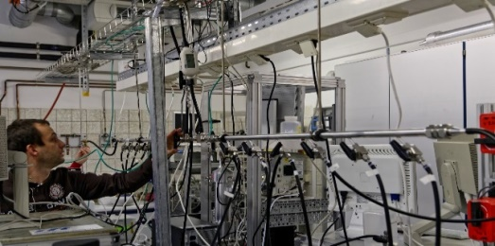
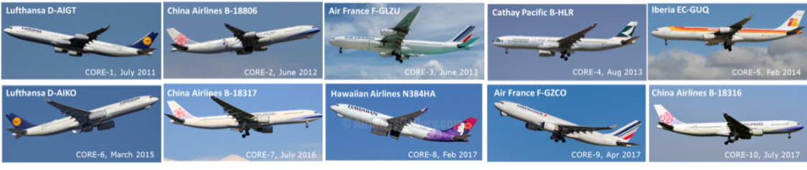

IAGOS – The Data Services
IAGOS Data Services
Recorded data: O₃, CO, H₂O, Cloud Index, NO_{x}/NO₂, CO2/CH4 (soon)
Ancillary data: ECMWF param. (PV, …)
Added-value prod: CO contribution, etc…
http://www.iagos-data.fr/cams
IAGOS data products
Calibration Centres
IAGOS Data Centre
hosted by AERIS (CNES-CNRS/INSU)
in Toulouse
near real
time data
for Copernicus
model validation
calibration data
meta data
calibration
maintenance
data

Slide 17




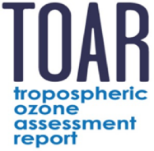
What is IAGOS-CORE providing ? What for ?
25 years of O3, H2O
18 years of CO
5 years of NOy, NOx, 7 years of BCP
Quasi-global scale
High resolution and high frequency in the UTLS
High frequency of vertical profiles (0-12 km)
Regions poorly or never sampled by other means :
  Pacific
  Africa
  Middle-East
  South-East Asia
    More and more on Climatologies and Trends (stat. significance)
    Air quality, Long-range transport of pollution
    Unique data set for checking consistency (Assessment Reports)
    Added-Value for model and satellite (process-oriented) validation

Slide 18
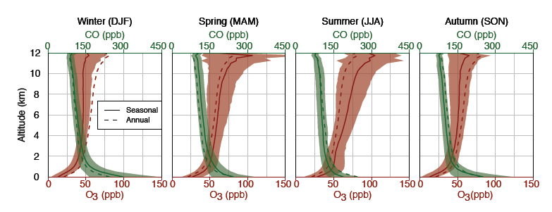
Climatologies for Ozone & CO
Frankfurt : Densest dataset in the world (21 600 flights, around 75 profiles/month)
Data record over Frankfurt/Munich covers 20 yrs of O₃ and 12 yrs of CO profiles.
Climatological vertical profiles, seasonal cycles of O₃ and CO mixing ratios above Frankfurt/Munich per season.
Petetin et al., ACP 2016

Slide 19

The IAGOS Data Set – UTLS (Vertical Coordinates)
IAGOS provides essential information on long-term changes around the tropopause (10-13 km) :
Different monthly mean seasonal cycles and regional characteristics over northern mid-latitudes.
Increasing trends in O3 (1994-2013) in the UT and decreasing trends in CO (2002-2013)
Thouret et al., ACP 2006, Cohen et al., ACP 2018

Slide 20
The IAGOS Data Set – UT (Trends of Tropospheric Ozone)
1994-2013
Global increase of O3 : 0.25 to 0.45 ppb/yr
Cohen et al., ACP 2018

Slide 21
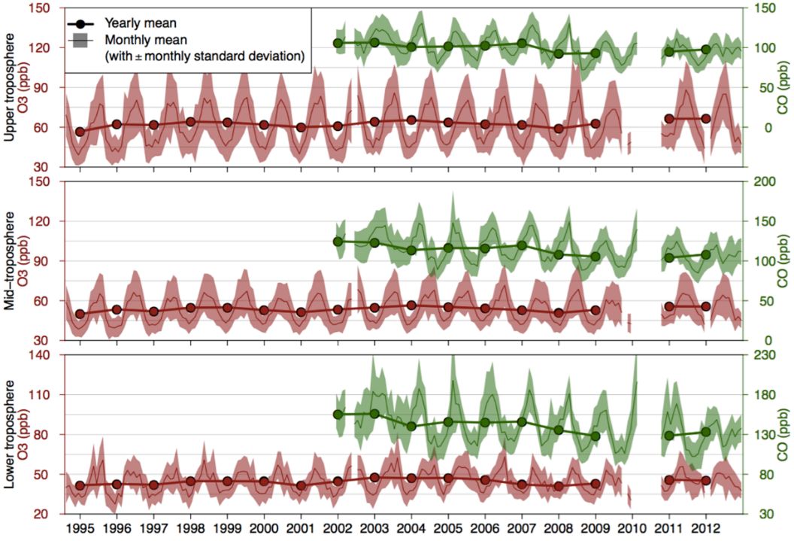
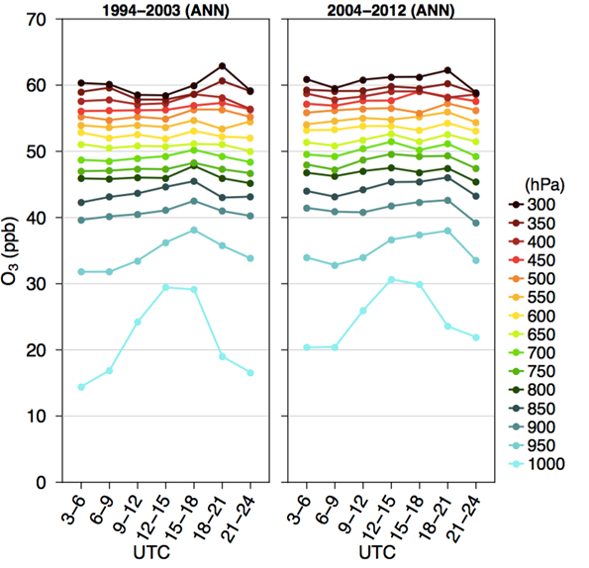
Trends of Ozone and CO over Frankfurt : Implications
Frankfurt : Densest dataset in the world (21 600 flights, around 75 profiles/month)
➔Ozone diurnal/seasonal is changing :
Seasonal cycle moves toward lower amplitude and earlier maxima
Over Europe, CO concentrations decreased significantly, while ozone remained relatively constant.
Petetin et al., ACP 2016
Petetin et al., Elementa 2016

Slide 22
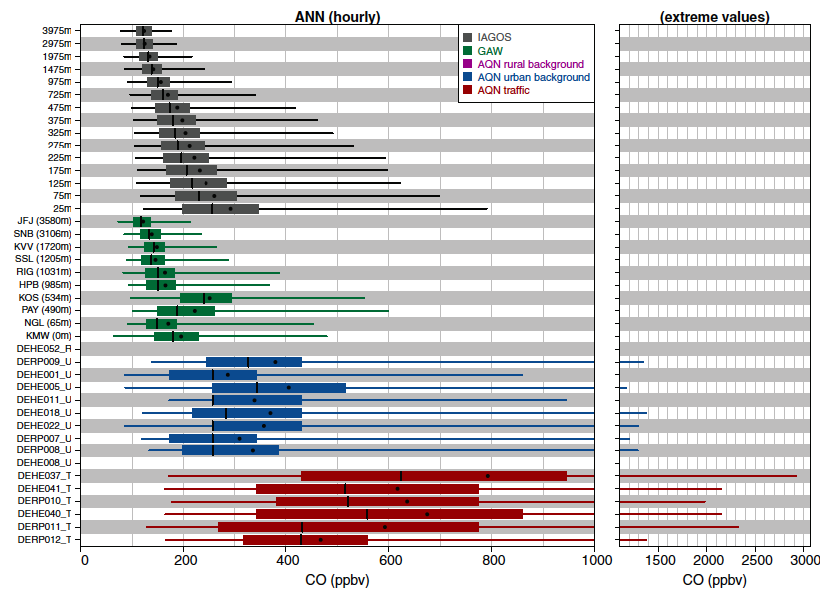
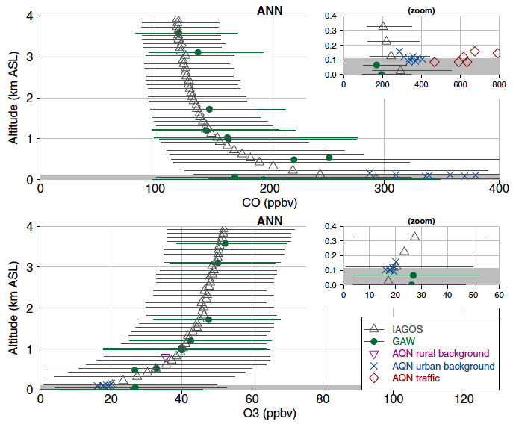
Representativeness of IAGOS in the Lower Troposphere
Question : Are IAGOS observations in lowermost troposphere strongly impacted by airport emissions?
Method : At main European airports, over 1994-2012 : detailed comparison between IAGOS (at different altitudes) and surface stations (of different types)
IAGOS (at different altitudes)
Regional background stations
Urban background stations
Trafic stations
Petetin et al., Elementa 2018

Slide 23
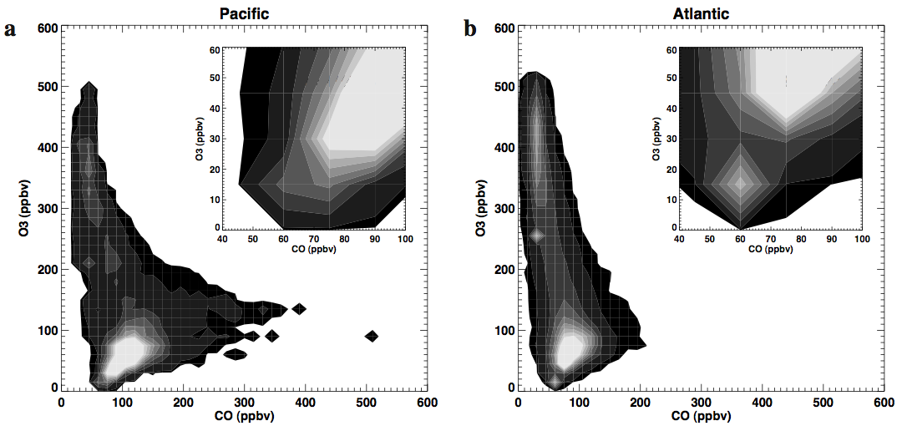
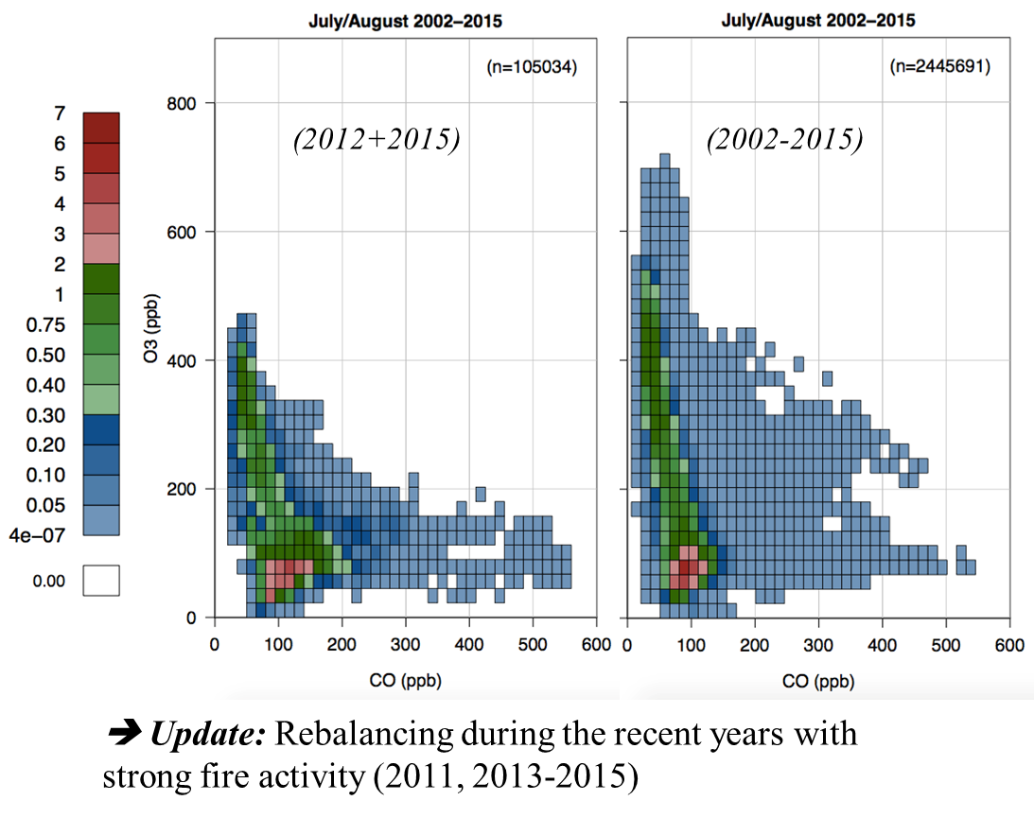

First Observations in the UTLS above North Pacific
Clark et al., 2015, Tellus B
Results points :
Strong pollution exports form Asia
Frequent uplifts of air masses from tropical boundary layer
Differences in the climatological position of the tropopause and storm tracks between the two bassins
In upper troposphere, higher CO and lower O₃ concentrations above Pacific compared to Atlantic

Slide 24
TOAR : Consistency for past, present-day Distributions and Trends ?
Trends of Tropospheric Ozone columns from
6 products : 5 satellites + TOST (sondes) ➔ consistency over SE Asia
Trends of Tropospheric Ozone profiles from IAGOS :
3 regions; 2 periods 1994-2004 vs 2005-2014 ➔ significant increase
Gaudel et al., 2018; Tarasick et al., 2019 in press; & others on the TOAR Special Feature

Slide 25
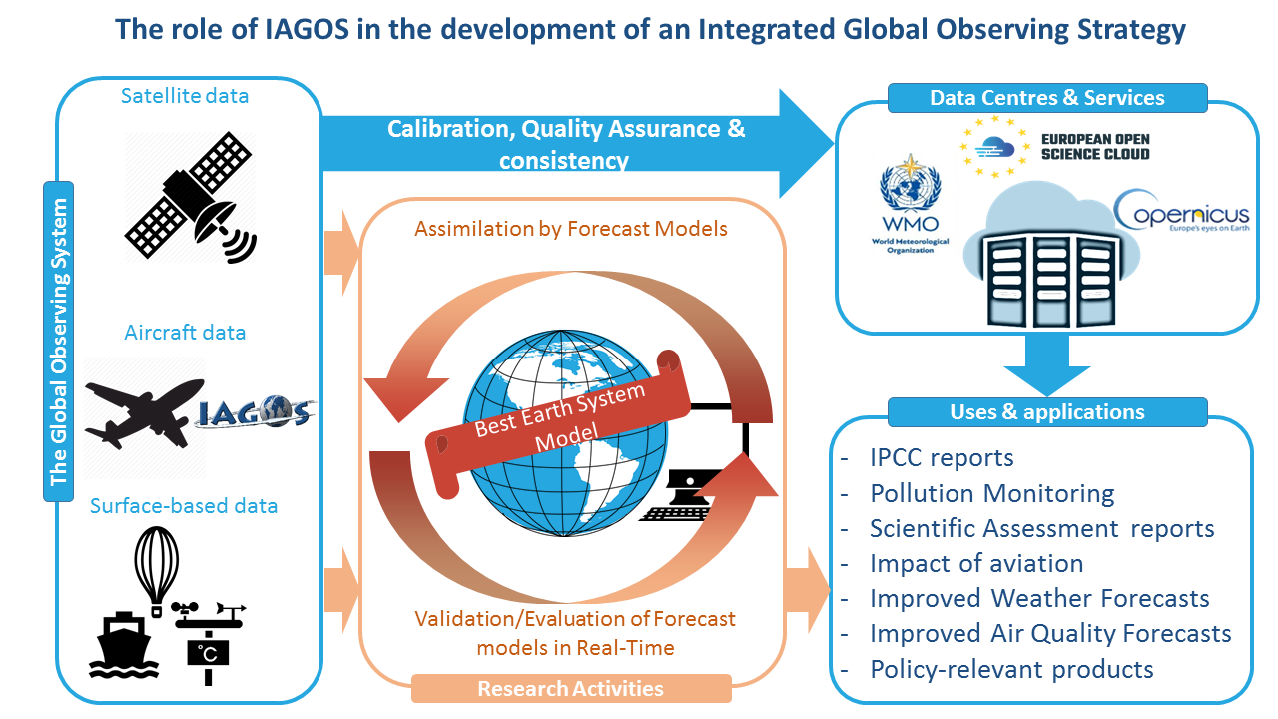


… As a Take-Home Message
Complementarity of in-situ observing networks for long-term operations.
More info :
IAGOS movie
info@iagos.org
@IAGOS_RI

Slide 26






The IAGOS Data Set - Coordinates
Acknowledgements
IAGOS gratefully acknowledges financial support over 25 years from
the European Commission in FP6, FP7 and H2020 projects,
national research programmes in Germany (BMBF), France (INSU-CNRS, MESRI, CNES) and UK (NERC),
institutional resources in Germany (Helmholtz Association, Max-Planck-Society, Leibniz Association), France (Université de Toulouse, Météo-France) and UK (University of Manchester, University of Cambridge), and
Invaluable engagement of all partner airlines.

Slide 28
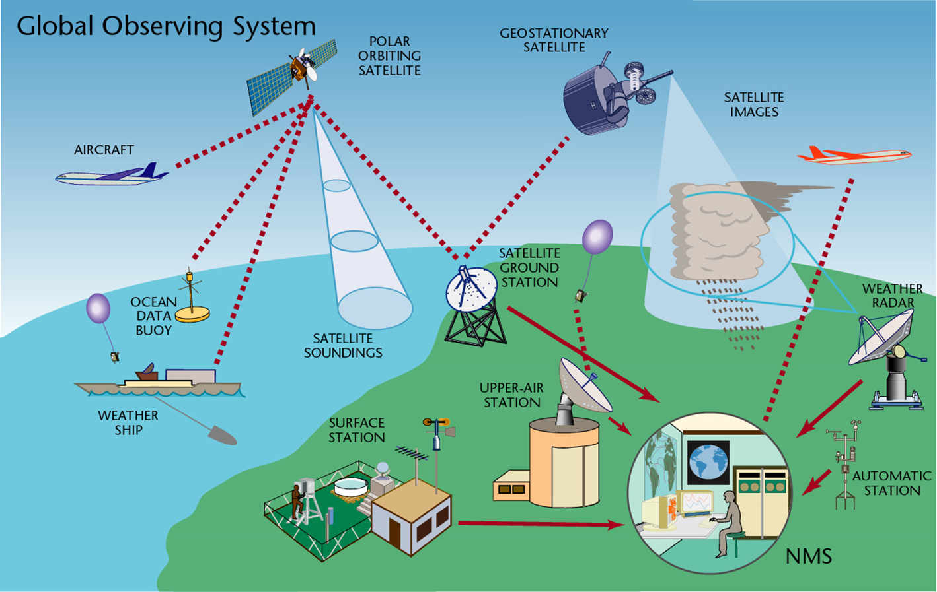
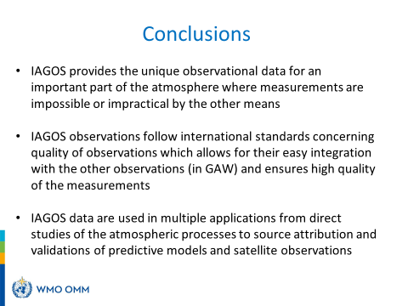



« Take-home » message
IAGOS
IAGOS : IR unique, mature, une « success
story », … à consolider, à faire évoluer!

Slide 29
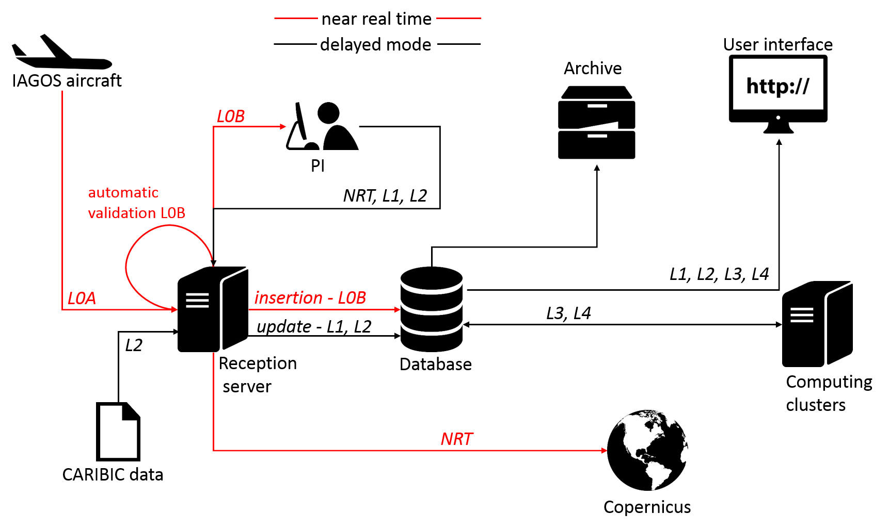
4 - IAGOS – The Data Work Flow

Slide 30
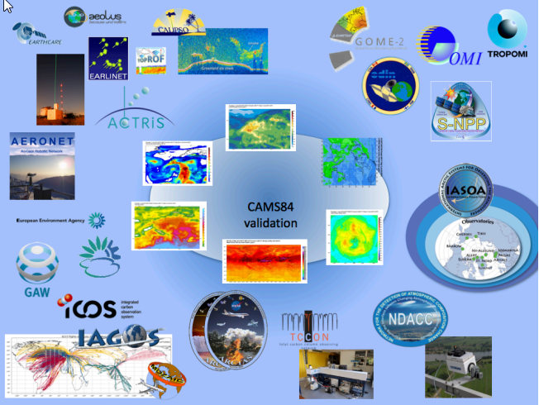
Copernicus Activities – model Validation
Copernicus Atmosphere Monitoring Service uses data from ACTRIS, ICOS and IAGOS for global and regional a posteriori validation
Importance of IAGOS for CAMS validation
Vertical profile information
Operational, with real-time data delivery, Multiple airplanes, multiple profiles per day, coverage
Flights to/from Europe: evaluation regional AQ models
Long time series : MOZAIC-IAGOS-CARIBIC Evaluation of the CAMS reanalysis
CO, ozone are key species targeted by CAMS. Extensions to CO2, CH4, H2O, NOx, aerosols
KNMI is coordinating CAMS 84
IAGOS sub-contractor to KNMI is CNRS
New from 2017 on – regional comparison on the IAGOS CAMS website

Slide 31

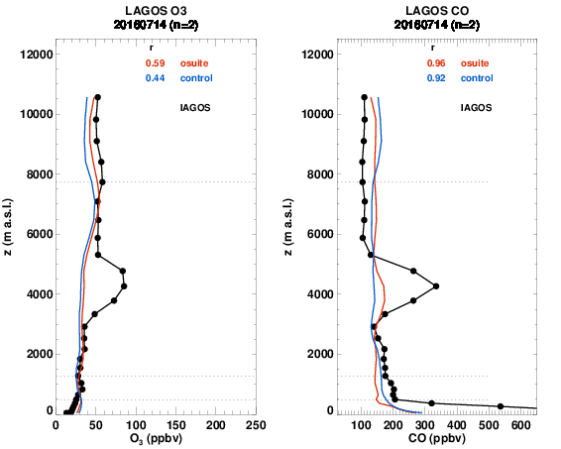
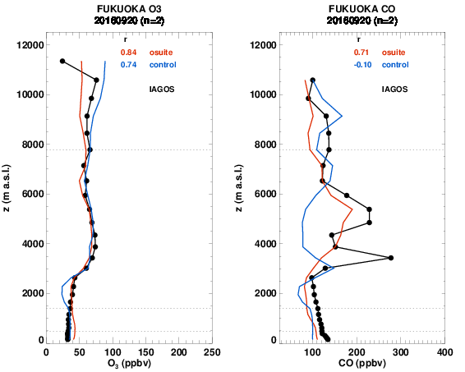
IAGOS in CAMS
IAGOS data = in-situ data set at global scale,
- Evaluation of forecast runs with NRT data ; Global and Regional
(Air quality purposes, special events) ➔ http://www.iagos-data.fr/cams
- Evaluation of Global Reanalysis (from 2003)
(UTLS and trends assessment) ➔ Gaudel et al., Tellus-B 2015; Wagner, Bennouna et al., in prep.
O3
CO
O3
CO
O3
CO
-- control run -- osuite (inc. assimilation) -- IAGOS

Slide 32
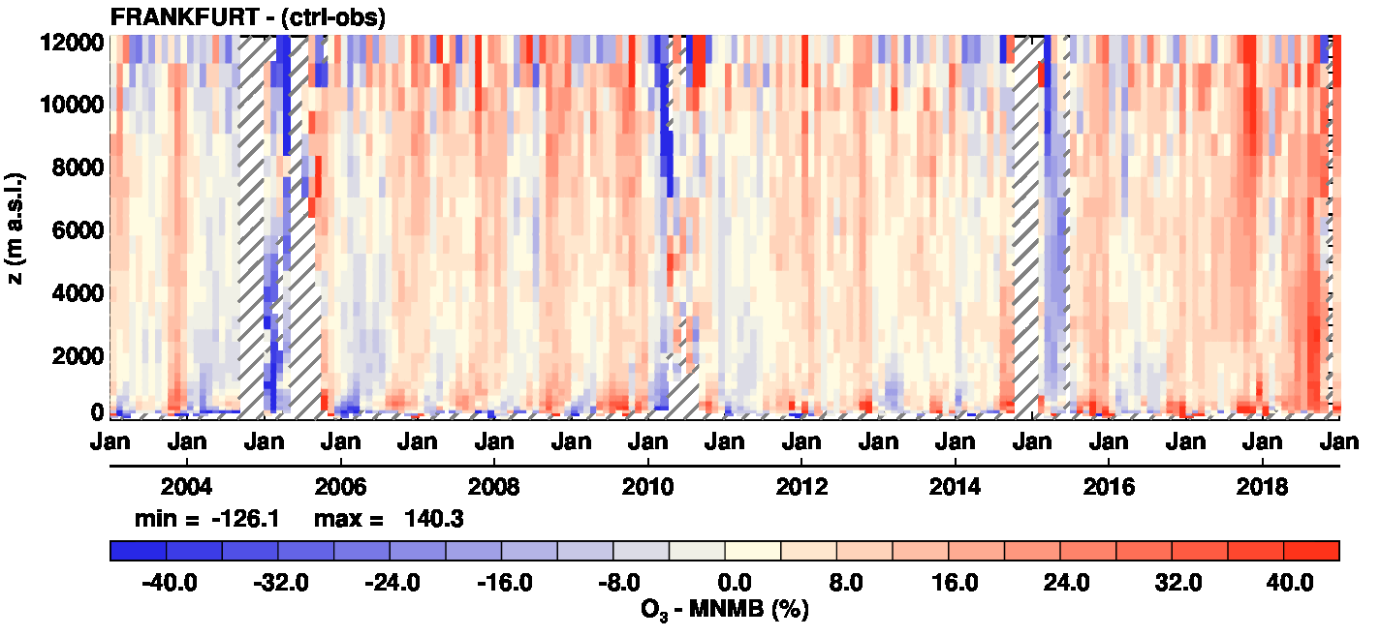
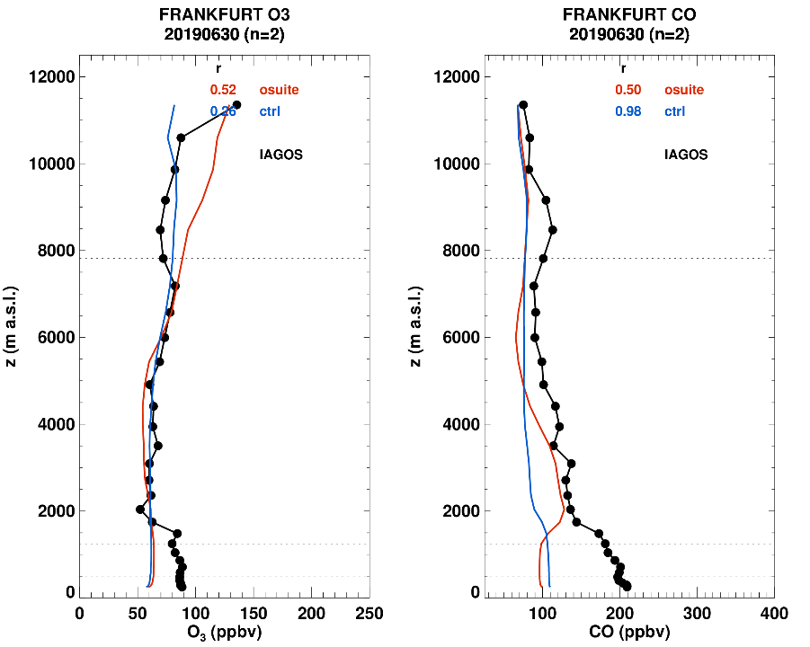
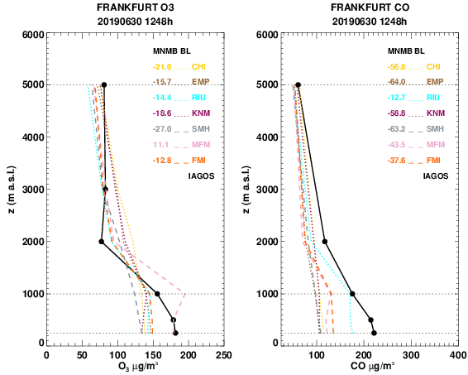
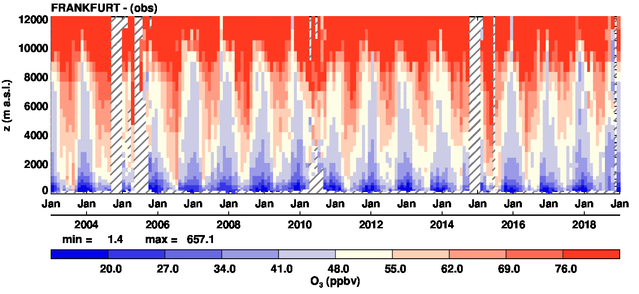
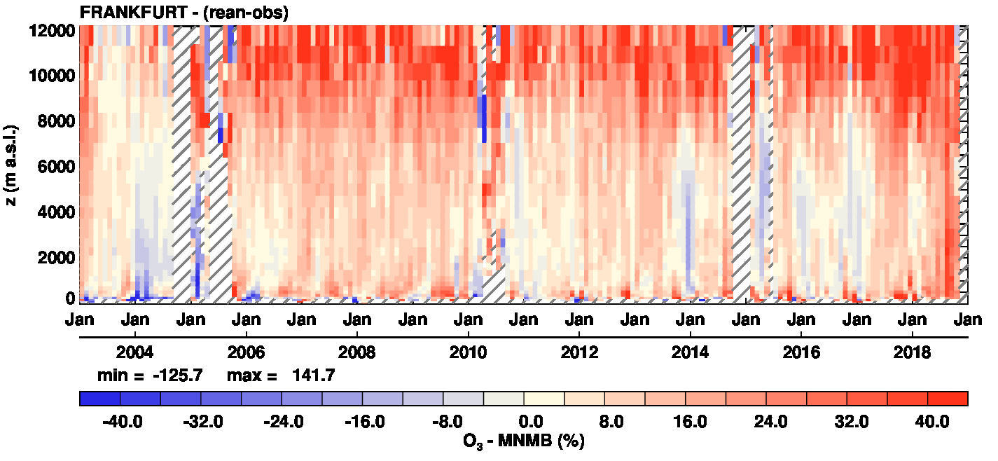
IAGOS : evaluation of the CAMS Reanalysis
IAGOS, O3, Frankfurt : 2003-2018
Wagner, Bennouna et al., in prep.

Slide 33
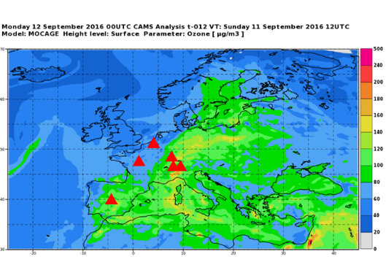
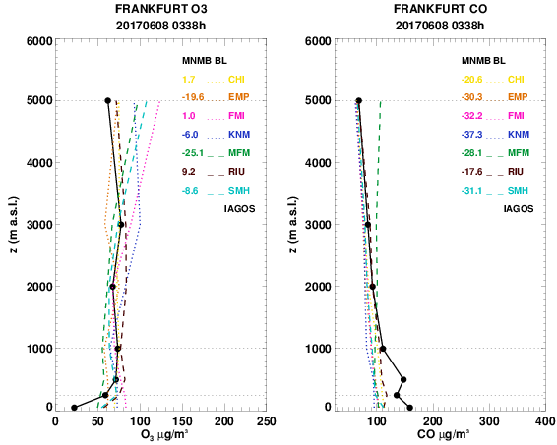
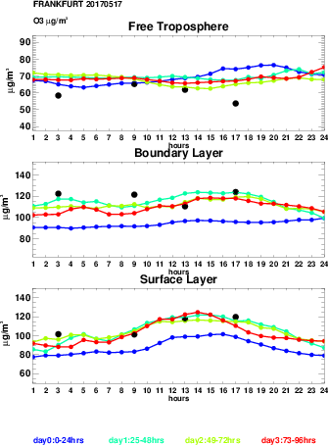
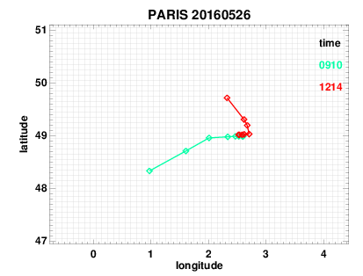
IAGOS in CAMS –
Monitoring Air Quality in Europe
6 regularly visited European airports:
Paris, Frankfurt, Dusseldorf, Amsterdam, Vienna, Madrid
7 regional models and Ensemble:
CHIMERE (INERIS), EMEP (MetNO), EURAD (Uni Cologne), LOTOS_EUROS (KNMI), MATCH (Sweden), MOCAGE (MF), SILAM (FMI).
Levels: Surface, 50, 250, 500, 1000, 2000, 3000, 5000 m

Slide 34
IAGOS : Technical and scientific objectives
Technical Goals
Equipping 20 long-haul aircraft with scientific instruments for:
  atmospheric chemical composition
  (H2O, O3, CO, NOx, NOy , CO2, CH4)
  aerosol and cloud particles
Deploy the CARIBIC Container (flying laboratory)
  Large number of species, including those above plus VOCs, CFCs, aerosol chem. composition, H₂ isotopes, SO₂
Long-term deployment (20 years)
Global coverage
Open data policy (CAMS/GEO/GEOSS)
Near real time to real time data provision
Scientific Objectives
Changes in the Tropopause Region
  ozone background and trend
  water vapour background and trend
Validation of Atmospheric Models
and Satellite Retrievals
  tropospheric profiles of
  H₂O, O₃, CO, CO2, CH4 , NOx, aerosol
Global Air Quality
  influence of developing regions
  long-range transport of air pollutants
  biomass burning, climate change, ...
International Transfer Standards
  same systems deployed globally

