Slide 1

A literature survey on Integrated Water Vapour (IWV) intercomparison studies
Royal Meteorological
Institute of Belgium
Solar-Terrestrial Centre of Excellence
Roeland Van Malderen
(and input from Olivier Bock)

Slide 2

Outline
Introduction
Intercomparison data and methods
“The medal ceromony” Some examples from a mini-survey of the literature
Spatio-temporal variations
Conclusions
GNSS4SWEC workshop München 26-28 Feb. 2014

Slide 3
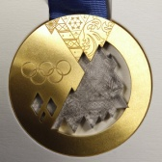
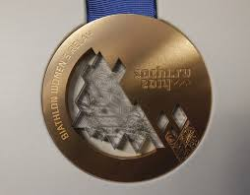
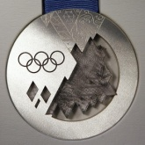
Introduction
Data and methods
The medal ceremony
Spatio-temporal variations
Conclusions
A literature survey …
-------------------------→ HOW ???
starting point = IWV intercomparison inventory made within GNSS4SWEC WG3
thank you for your contributions!
here: focus on literature inventory
  far from being complete! → roeland@meteo.be
  1997-2014
  contains 44 studies that include GPS
 | RS | MWR | VLBI | DORIS | ☼ photometer | FTIR | LIDAR | sat. | models
GPS | 33 | 15 | 2 | 2 | 15 | 3 | 3 | 14 | 17
GNSS4SWEC workshop München 26-28 Feb. 2014

Slide 4
Introduction
Data and methods
The medal ceremony
Spatio-temporal variations
Conclusions
A literature survey …
-------------------------→ WHAT ???
Can we distillate some general findings? Of course, taking into account that those studies cover different instruments, sites, periods, methodologies, etc.
OR
“A literature survey reveals that reported systematic differences between different techniques are study-dependent and show no overall consistent pattern.” Buehler et al., ACP, 2012 “The GEWEX Data and Assessments Panel (GDAP) has found that assessment activities should not be viewed as static but rather as dynamic activities that need to be repeated every 5-10 years.”
GNSS4SWEC workshop München 26-28 Feb. 2014

Slide 5
Introduction
Data and methods
The medal ceremony
Spatio-temporal variations
Conclusions
A literature survey …
-------------------------→ WHAT ???
Can we distillate some general findings? Of course, taking into account that those studies cover different instruments, sites, periods, methodologies, etc.
OR
“A literature survey reveals that reported systematic differences between different techniques are study-dependent and show no overall consistent pattern.” Buehler et al., ACP, 2012 “The GEWEX Data and Assessments Panel (GDAP) has found that assessment activities should not be viewed as static but rather as dynamic activities that need to be repeated every 5-10 years.”
GNSS4SWEC workshop München 26-28 Feb. 2014

Slide 6
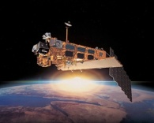
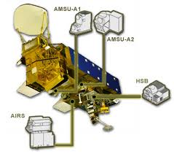
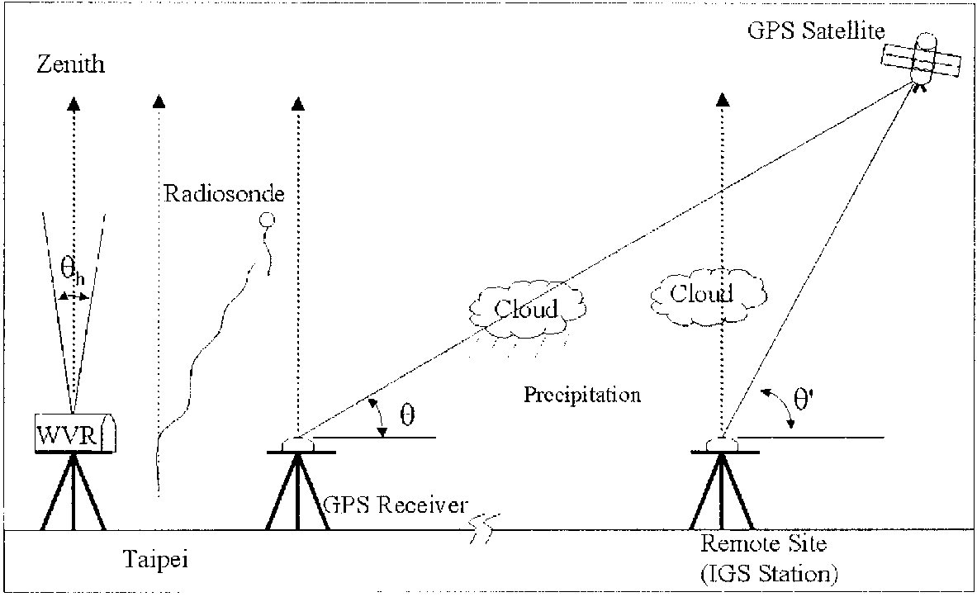
Introduction
Data and methods
The medal ceremony
Spatio-temporal variations
Conclusions
Intercomparison data and methods
different variables: IWV, ZWD, ZTD (different ZTD → IWV)
different instruments: RS vs. GPS ≠ MWR vs. GPS ≠ SPM vs. GPS
sun photometer (SPM)
Liou et al., J. Appl. Meteor., 2001
GNSS4SWEC workshop München 26-28 Feb. 2014
  different horizontal representativeness
  different temporal samplings
  “weather bias” for some instruments

Slide 7
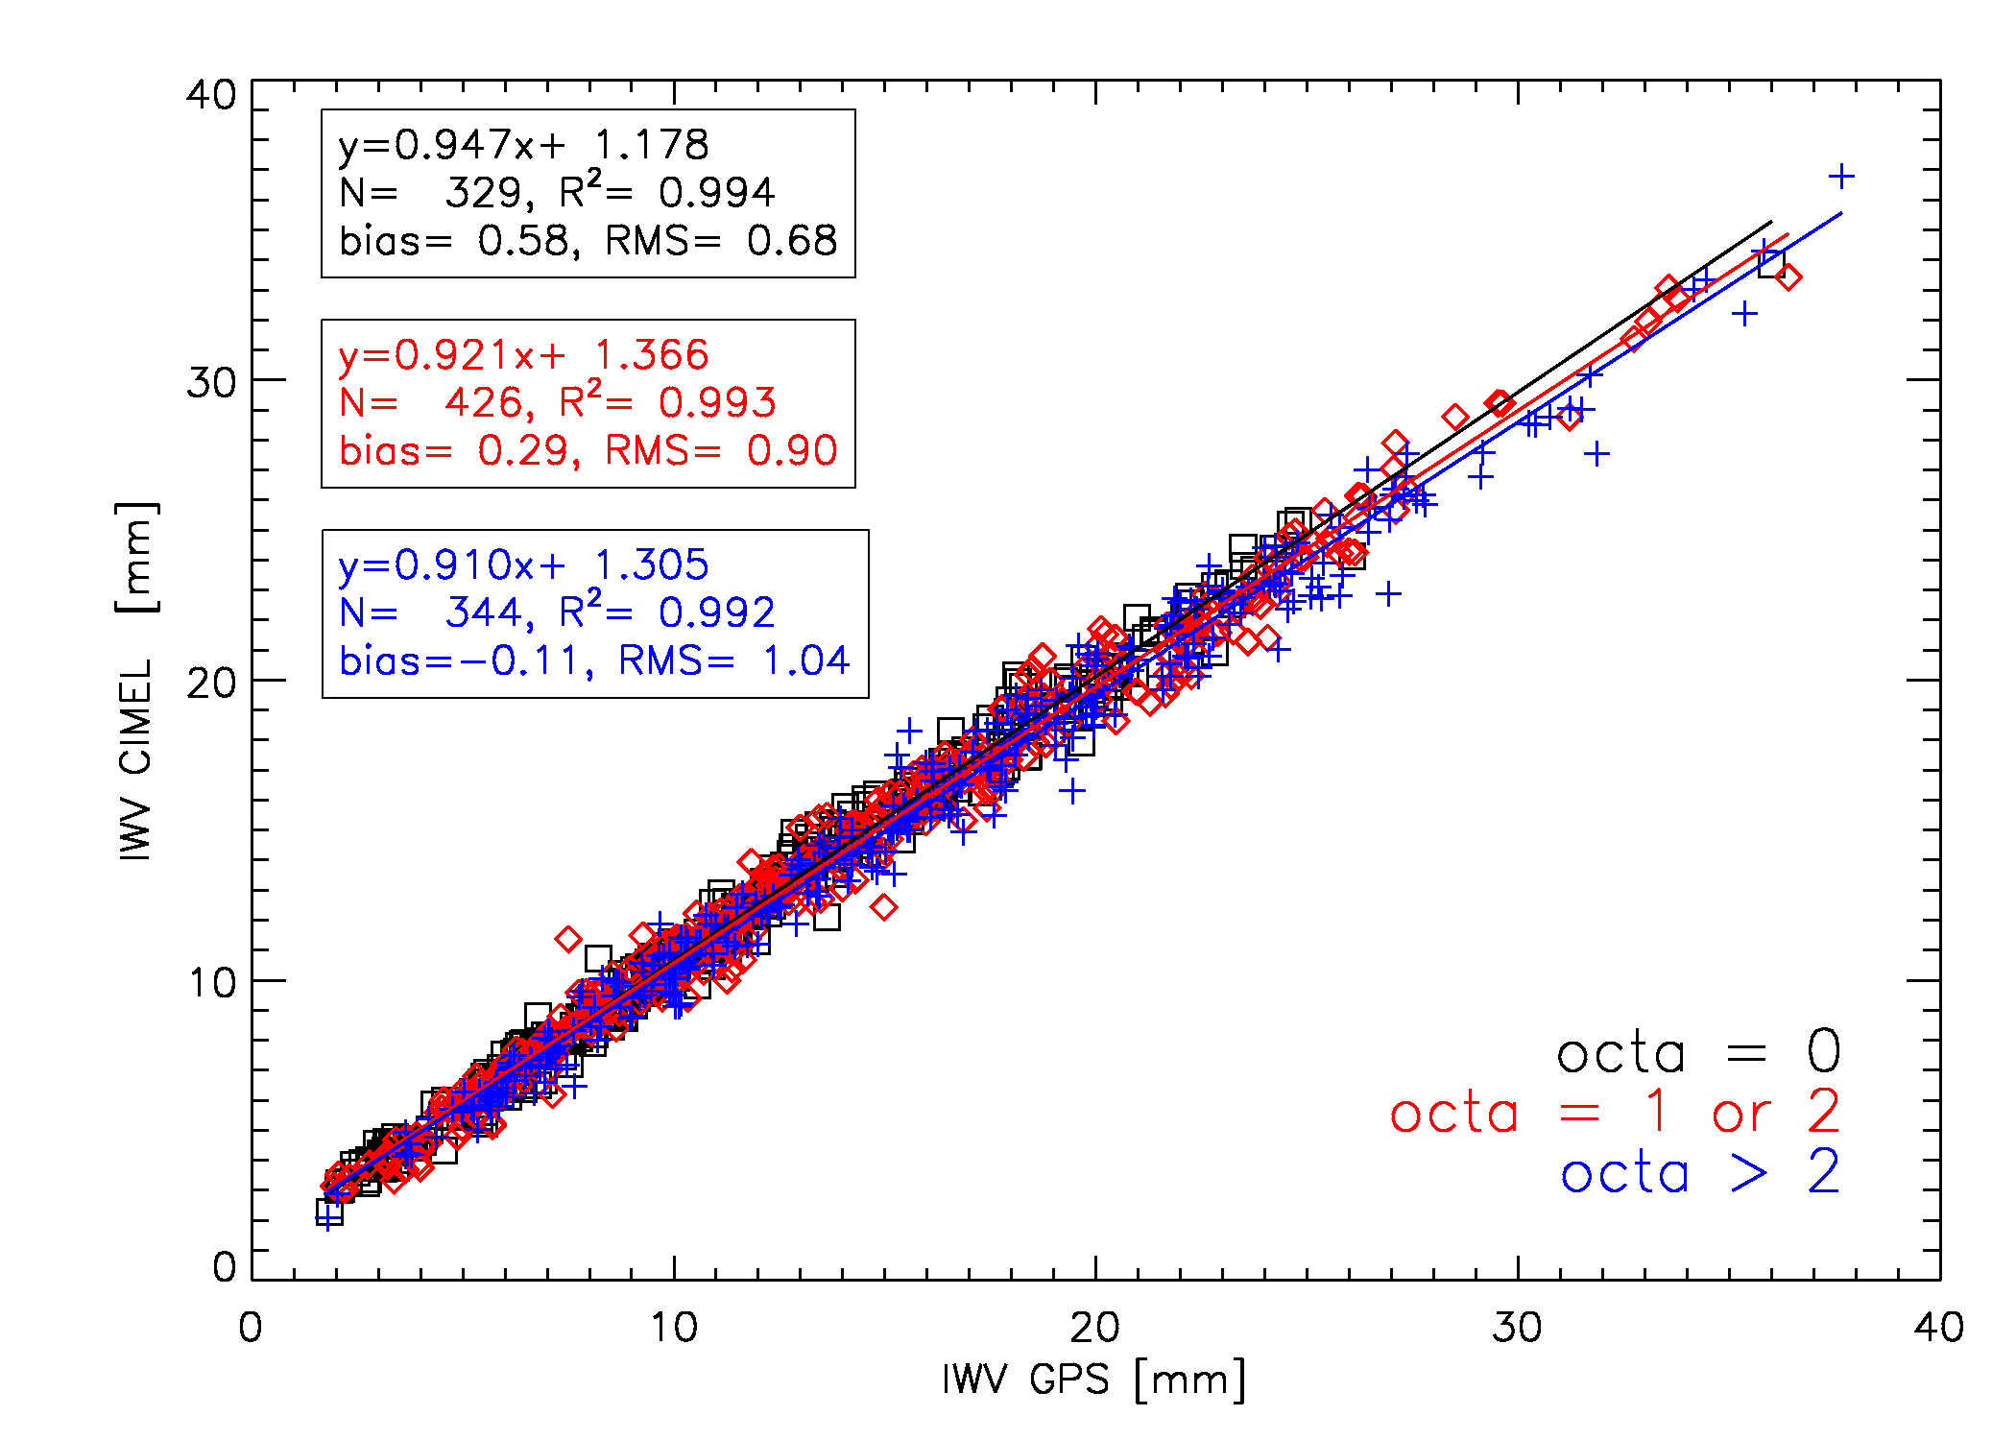
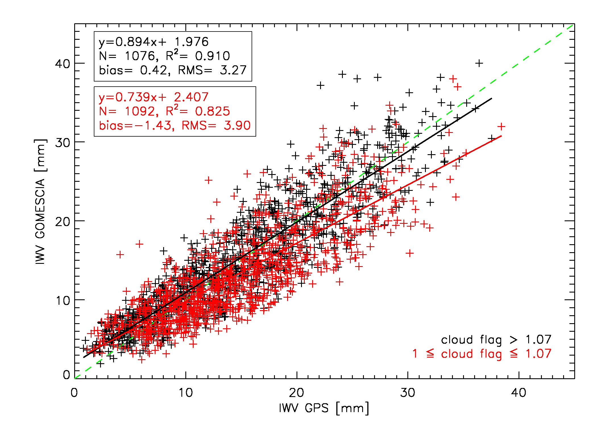
Introduction
Data and methods
The medal ceremony
Spatio-temporal variations
Conclusions
Intercomparison data and methods
GPS-SPM
GPS-GOMESCIA
GPS-CIMEL
Brussels
octa = 0 : clear sky
octa = 8 : sky fully covered
cloud flag ↗ → O₂ column density ↗ → clearer sky
cloud cover ↗ → correlation coefficients ↘, bias ↘ (overestimation → underestimation), RMS ↗, regression slope ↘
GNSS4SWEC workshop München 26-28 Feb. 2014
Van Malderen, Brenot, Pottiaux et al., AMTD, 2014

Slide 8
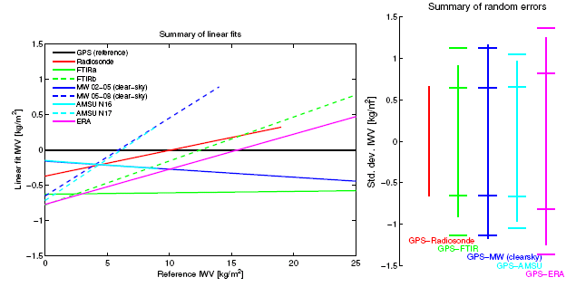
Introduction
Data and methods
The medal ceremony
Spatio-temporal variations
Conclusions
Intercomparison data and methods
different variables: IWV, ZWD, ZTD (different ZTD → IWV)
different instruments: RS vs. GPS ≠ MWR vs. GPS ≠ SPM vs. GPS
  different horizontal representativeness
  different temporal samplings
  “weather bias” for some instruments
  other issues related to the performance of the instrument
Kiruna, SE
large differences in regression lines, even between similar instruments at one site!
also GPS IWV retrieval is susceptible to error sources (e.g. antenna phase variations and multipath effects)
GNSS4SWEC workshop München 26-28 Feb. 2014
Buehler et al., ACP, 2012

Slide 9
Introduction
Data and methods
The medal ceremony
Spatio-temporal variations
Conclusions
Intercomparison data and methods
different variables: IWV, ZWD, ZTD (different ZTD → IWV)
different instruments: RS vs. GPS ≠ MWR vs. GPS ≠ SPM vs. GPS
  different horizontal representativeness
  different temporal samplings
  “weather bias” for some instruments
  other issues related to the performance of the instrument
different coincidence criteria (time averaging)
different co-location criteria
different corrections of altitude offsets between sites
  ΔIWV/IWV = -3.5% per 100 m Δz (Kiruna, Sweden, Buehler et al., ACP, 2012)
  ΔIWV/IWV = -4.0% per 100 m Δz (Africa, Bock et al., Q.J.R. Meteorol. Soc., 2007)
  constant dewpoint depression (Deblonde et al., J. Appl. Meteor., 2005)
  constant relative humidity (Hagemann et al., JGR, 2003)
  …
different definitions of statistical parameters (bias, stdev, RMS, regression slope coefficients)
GNSS4SWEC workshop München 26-28 Feb. 2014

Slide 10

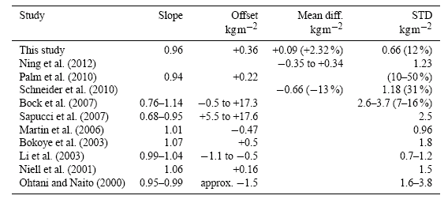
Introduction
Methodologies
The medal ceremony
Spatio-temporal variations
Conclusions
“A literature survey reveals that reported systematic differences between different techniques are study-dependent and show no overall consistent pattern.” Buehler et al., ACP, 2012
GPS vs. RS
Tropics
-3.78 to 8.00
0.21 to 3.87
GNSS4SWEC WG3 literature inventory
GNSS4SWEC workshop München 26-28 Feb. 2014

Slide 11
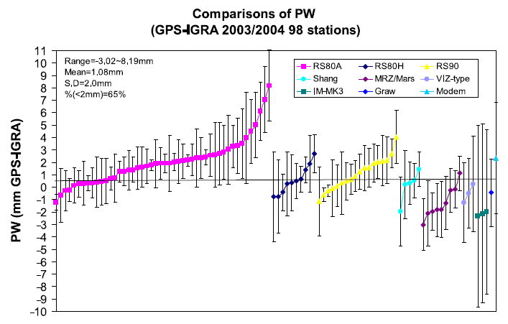
Introduction
Data and methods
The medal ceremony
Spatio-temporal variations
Conclusions
GPS vs. RS
Wang et al., JGR, 2007
within 1 study:
large differences in biases for different RS types → H. Vömel’s talk
large differences in biases within a given RS type
GNSS4SWEC workshop München 26-28 Feb. 2014

Slide 12
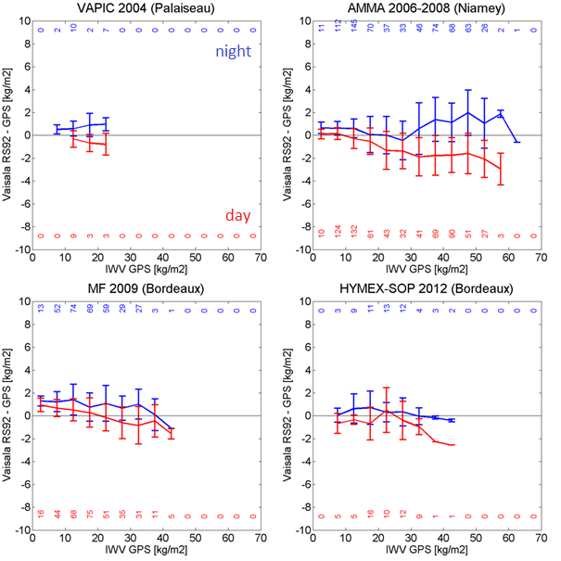
Introduction
Data and methods
The medal ceremony
Spatio-temporal variations
Conclusions
GPS vs. RS
daytime radiation dry bias of RS92 → daytime-nighttime difference of RS-GPS biases.
both (especially daytime) bias and stdev (or RMS) seem to be functions of IWV
GNSS4SWEC workshop München 26-28 Feb. 2014
Courtesy of O. Bock

Slide 13
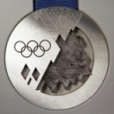
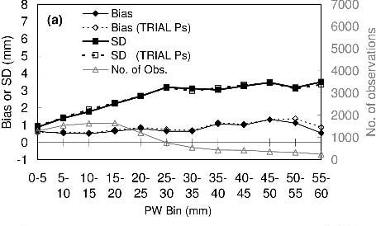
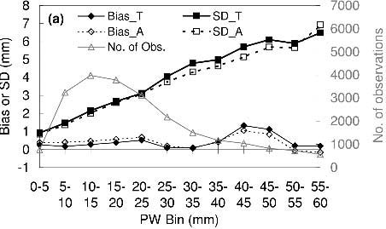
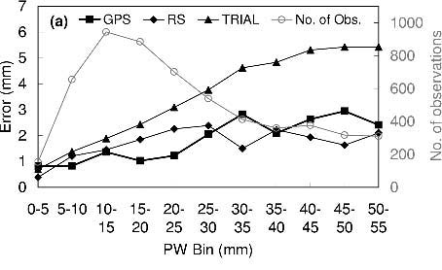
Introduction
Data and methods
The medal ceremony
Spatio-temporal variations
Conclusions
GPS vs. RS
GPS vs. models
Deblonde et al., J. Appl. Meteor., 2005
GNSS4SWEC workshop München 26-28 Feb. 2014

Slide 14
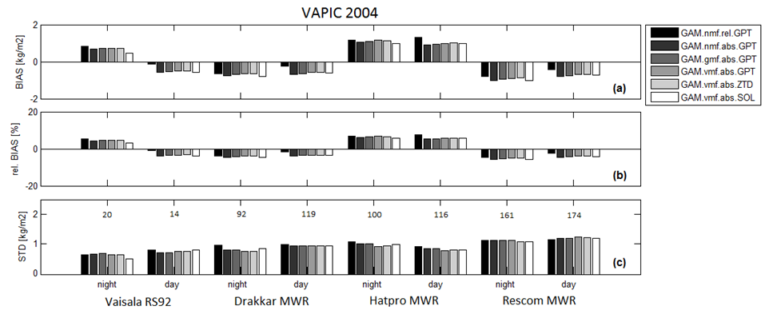
Introduction
Data and methods
The medal ceremony
Spatio-temporal variations
Conclusions
GPS vs. MWR
Courtesy of O. Bock
no day/night bias in MWR-GPS comparison (>< Van Baelen et al., J. Atmos. Oceanic. Technol., 2007)
different biases for similar MWR instruments at one location
small impact of GPS data processing options with GAMIT software
GNSS4SWEC workshop München 26-28 Feb. 2014

Slide 15
Introduction
Data and methods
The medal ceremony
Spatio-temporal variations
Conclusions
GPS – instr = f(IWV)
seasonal behaviour (IWV summer > IWV winter)
  GPS – RS ZTD: Haase et al., J. Applied Meteor., 2003
  GPS –RS/ECMWF/MWR ZWD SD: Ning et al., J. Geod., 2012
  GPS – RS: Ohtani & Naito, JGR, 2000; Basili et al., 2001; Deblonde et al., J. Applied Meteor., 2005; Kwon et al., J. Meteor. Soc. Jap., 2007; Van Malderen, Brenot, Pottiaux et al, AMTD, 2014
  GPS – MWR SD: Basili et al., 2001
  GPS – SPM: Nyeki et al., Geophys. Res. Lett., 2005; Morland et al., JGR, 2006 ; Prasad and Singh, JGR, 2009; Van Malderen, Brenot, Pottiaux et al., AMTD, 2014
  GPS – NCEP: Prasad and Singh, JGR, 2009; Vey et al., J. Clim., 2010
  GPS – AIRS: Prasad and Singh, JGR, 2009; Van Malderen, Brenot, Pottiaux et al., AMTD, 2014
  GPS – MODIS: Prasad and Singh, JGR, 2009
  GPS – GOMESCIA: Van Malderen, Brenot, Pottiaux et al., AMTD, 2014
geographical dependency (IWV low h > IWV high h; IWV low lat > IWV high lat)
  GPS – HIRLAM ZTD: Haase et al., J. Applied Meteor., 2003
  GPS – DORIS ZTD SD: Bock et al., Adv. Space Res., 2010
  GPS – NCEP: Vey et al., J. Clim., 2010
  GPS – RS/SPM/AIRS/GOMESCIA SD: Van Malderen, Brenot, Pottiaux et al., AMTD, 2014
GNSS4SWEC workshop München 26-28 Feb. 2014

Slide 16
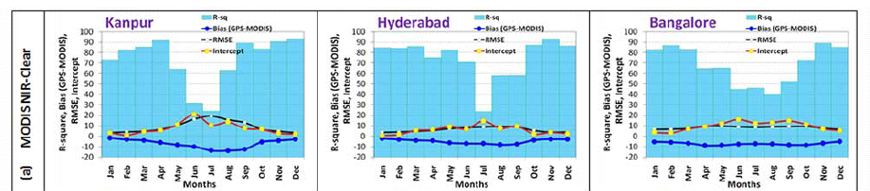
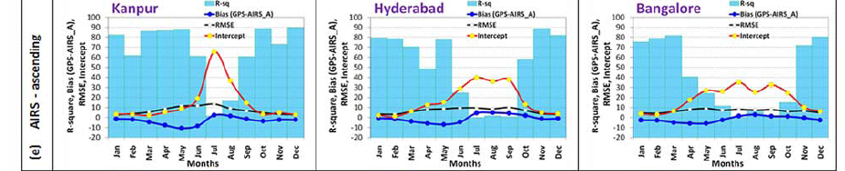
Introduction
Data and methods
The medal ceremony
Spatio-temporal variations
Conclusions
Seasonal variation
Prasad and Singh, JGR, 2009
GNSS4SWEC workshop München 26-28 Feb. 2014

Slide 17
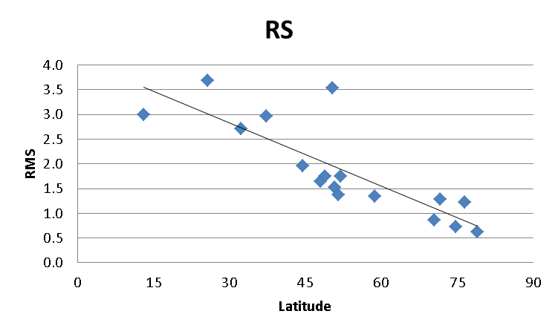
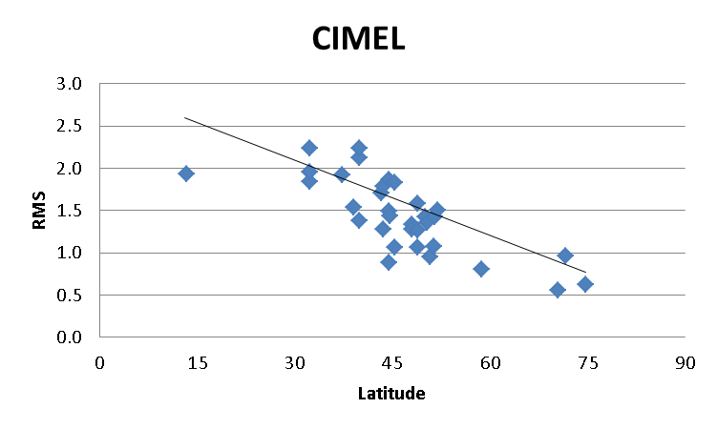
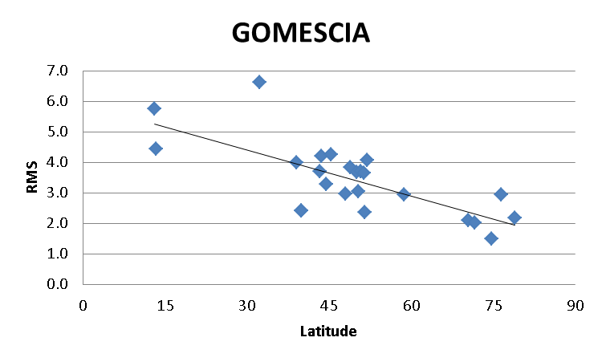
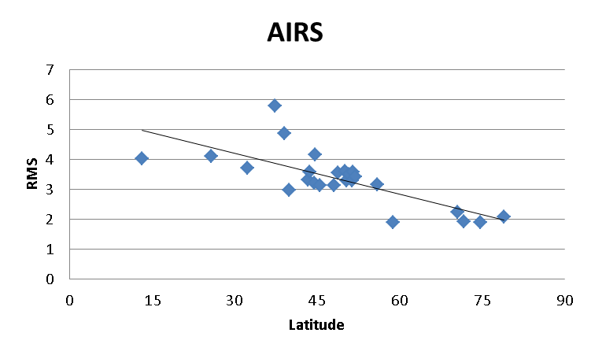
Introduction
Data and methods
The medal ceremony
Spatio-temporal variations
Conclusions
Latitudinal variation
GNSS4SWEC workshop München 26-28 Feb. 2014
Van Malderen, Brenot, Pottiaux et al., AMTD, 2014

Slide 18
Introduction
Data and methods
The medal ceremony
Spatio-temporal variations
Conclusions
GPS – instr = f(IWV): explanations
Bias
Instrumental/Modelling
GPS-RS seasonal bias due to RS day-night humidity bias, which scales with humidity (Haase et al., J. Applied Meteor., 2003; Kwon et al., J. Meteor. Soc. Jap., 2007)
deficiencies in the water vapour modelling due to e.g. assimilation of dry biased radiosondes (Vey et al., J. Clim., 2010) or unsufficient model resolution or physics parameterization (Haase et al., J. Applied Meteor., 2003)
variation of the GPS station position caused by ocean tidal loading (Ohtani & Naito, JGR, 2000) and seasonal change of the mapping function, i.e. ∝ curvature of the atmosphere (Ohtani & Naito, JGR, 2000; Nyeki et al., Geophys. Res. Lett., 2005).
GNSS4SWEC workshop München 26-28 Feb. 2014

Slide 19
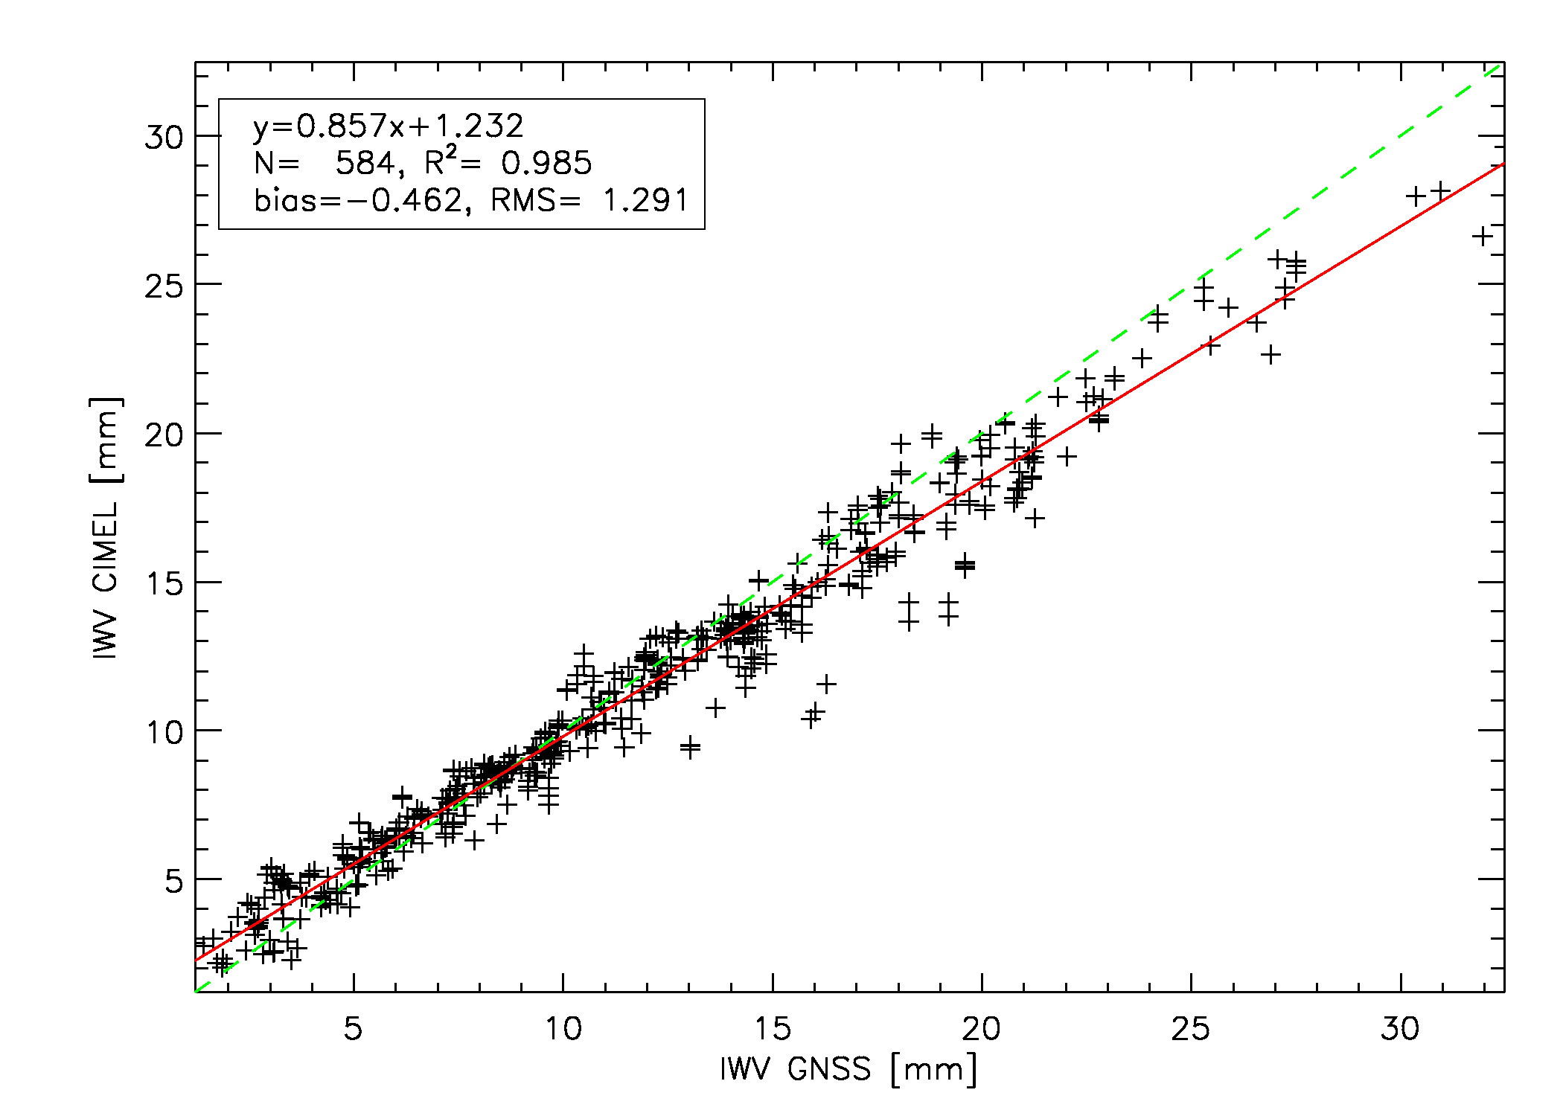
Introduction
Data and methods
The medal ceremony
Spatio-temporal variations
Conclusions
GPS – instr = f(IWV): explanations
Bias
Dependence on weather conditions
different “sensitivities” of GPS and other instruments at the IWV extremes (Wang et al., JGR, 2007; Schneider et al., AMT, 2010) due to e.g. weather observation bias (Prasad and Singh, JGR, 2009; Van Malderen, Brenot, Pottiaux et al., AMTD, 2014)
Munich
GNSS4SWEC workshop München 26-28 Feb. 2014

Slide 20
Introduction
Data and methods
The medal ceremony
Spatio-temporal variations
Conclusions
GPS – instr = f(IWV): explanations
Standard Deviation
Instrumental/Modelling
deficiencies in the water vapour modelling (Haase et al., J. Applied Meteor., 2003) due to e.g. assimilation of dry biased radiosondes (Vey et al., J. Clim., 2010)
The presence of strong horizontal gradients in atmospheric properties can have a negative impact on GPS ZTD accuracy due to a breakdown of the azimuthal symmetry assumption (Ohtani & Naito, JGR, 2000).
  uncertainties of some techniques are dependent on the absolute measured value (e.g. RS accuracy of 4%, Ning et al., J. Geod., 2012)
uncertainties of some techniques are dependent on the number of measurements and the number of satellites simultaneously in view (e.g. for DORIS, Bock et al., Adv. Space Res., 2010)
GNSS4SWEC workshop München 26-28 Feb. 2014

Slide 21
Introduction
Data and methods
The medal ceremony
Spatio-temporal variations
Conclusions
GPS – instr = f(IWV): explanations
Standard Deviation
Impact of spatial/temporal displacements
  in the presence of strong humidity gradients (moister air involved), location and sampling differences might be more significant (Ohtani & Naito, JGR, 2000; Basili et al., 2001; Haase et al., J. Applied Meteor., 2003; Deblonde et al., J. Applied Meteor., 2005)
GNSS4SWEC workshop München 26-28 Feb. 2014

Slide 22
Introduction
Data and methods
The medal ceremony
Spatio-temporal variations
Conclusions
Conclusions I
Instrument | bias | stdev | slope | offset
RS | -3.78 – 8.00 | 0.21 – 3.87 | 0.82 – 1.47 | -25.95 – 11.66
MWR | -1.66 – 0.50 | 1.02 – 4.18 | 0.82 – 1.21 | -1.46 – 4.60
SPM | -3.58 – 5.90 | 0.80 – 2.90 | 0.63 – 1.03 | -3.37 – 5.70
FTIR (3) | -0.09 – 0.61 | 0.73 – 1.02 | 0.95 – 1.06 | -0.78 – 0.40
satellite | -7.05 – 1.50 | 0.35 – 7.04 | 0.75 – 2.33 | -2.92 – 8.89
models | -8.70 – 5.30 | 0.64 – 8.08 | 0.66 – 2.00 | -31.90 – 9.70
wide range of biases (GPS – instr)
high variability in the model vs. GPS parameters
Study-dependent??? Yes, but …
  ranges become narrower when applying uniform methodology for different sites
  all-weather devices have higher minimal regression slope coefficients
  low upper limit of regression slope coefficients for SPM and FTIR due to a “weather observation bias”
GNSS4SWEC workshop München 26-28 Feb. 2014

Slide 23
Introduction
Data and methods
The medal ceremony
Spatio-temporal variations
Conclusions
Conclusions II
Study-dependent??? Yes, but … different studies report on biases and stdev as a function of IWV
  → seasonal and latitudinal variations (+ variation with height)
  Instrumental origin? Which instruments?
  Related to humidity field variability? (→ impact of spatial/temporal displacements and dependence on climate region and weather conditions)
How to proceed within GNSS4SWEC? Subjet of WG3 parallel session, Friday 11:00-11:45
Candidate instruments for climate change analysis?
  Certainly NOT operational RS!
  Impact of “weather observation bias” of some instruments on trends?
GNSS4SWEC workshop München 26-28 Feb. 2014

Slide 24
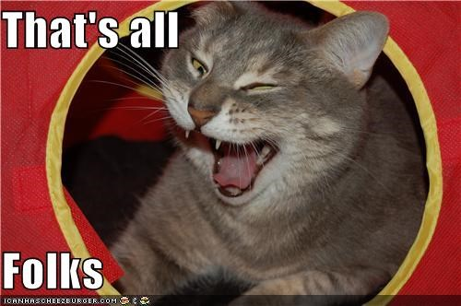
The end
GNSS4SWEC workshop München 26-28 Feb. 2014

