Slide 1
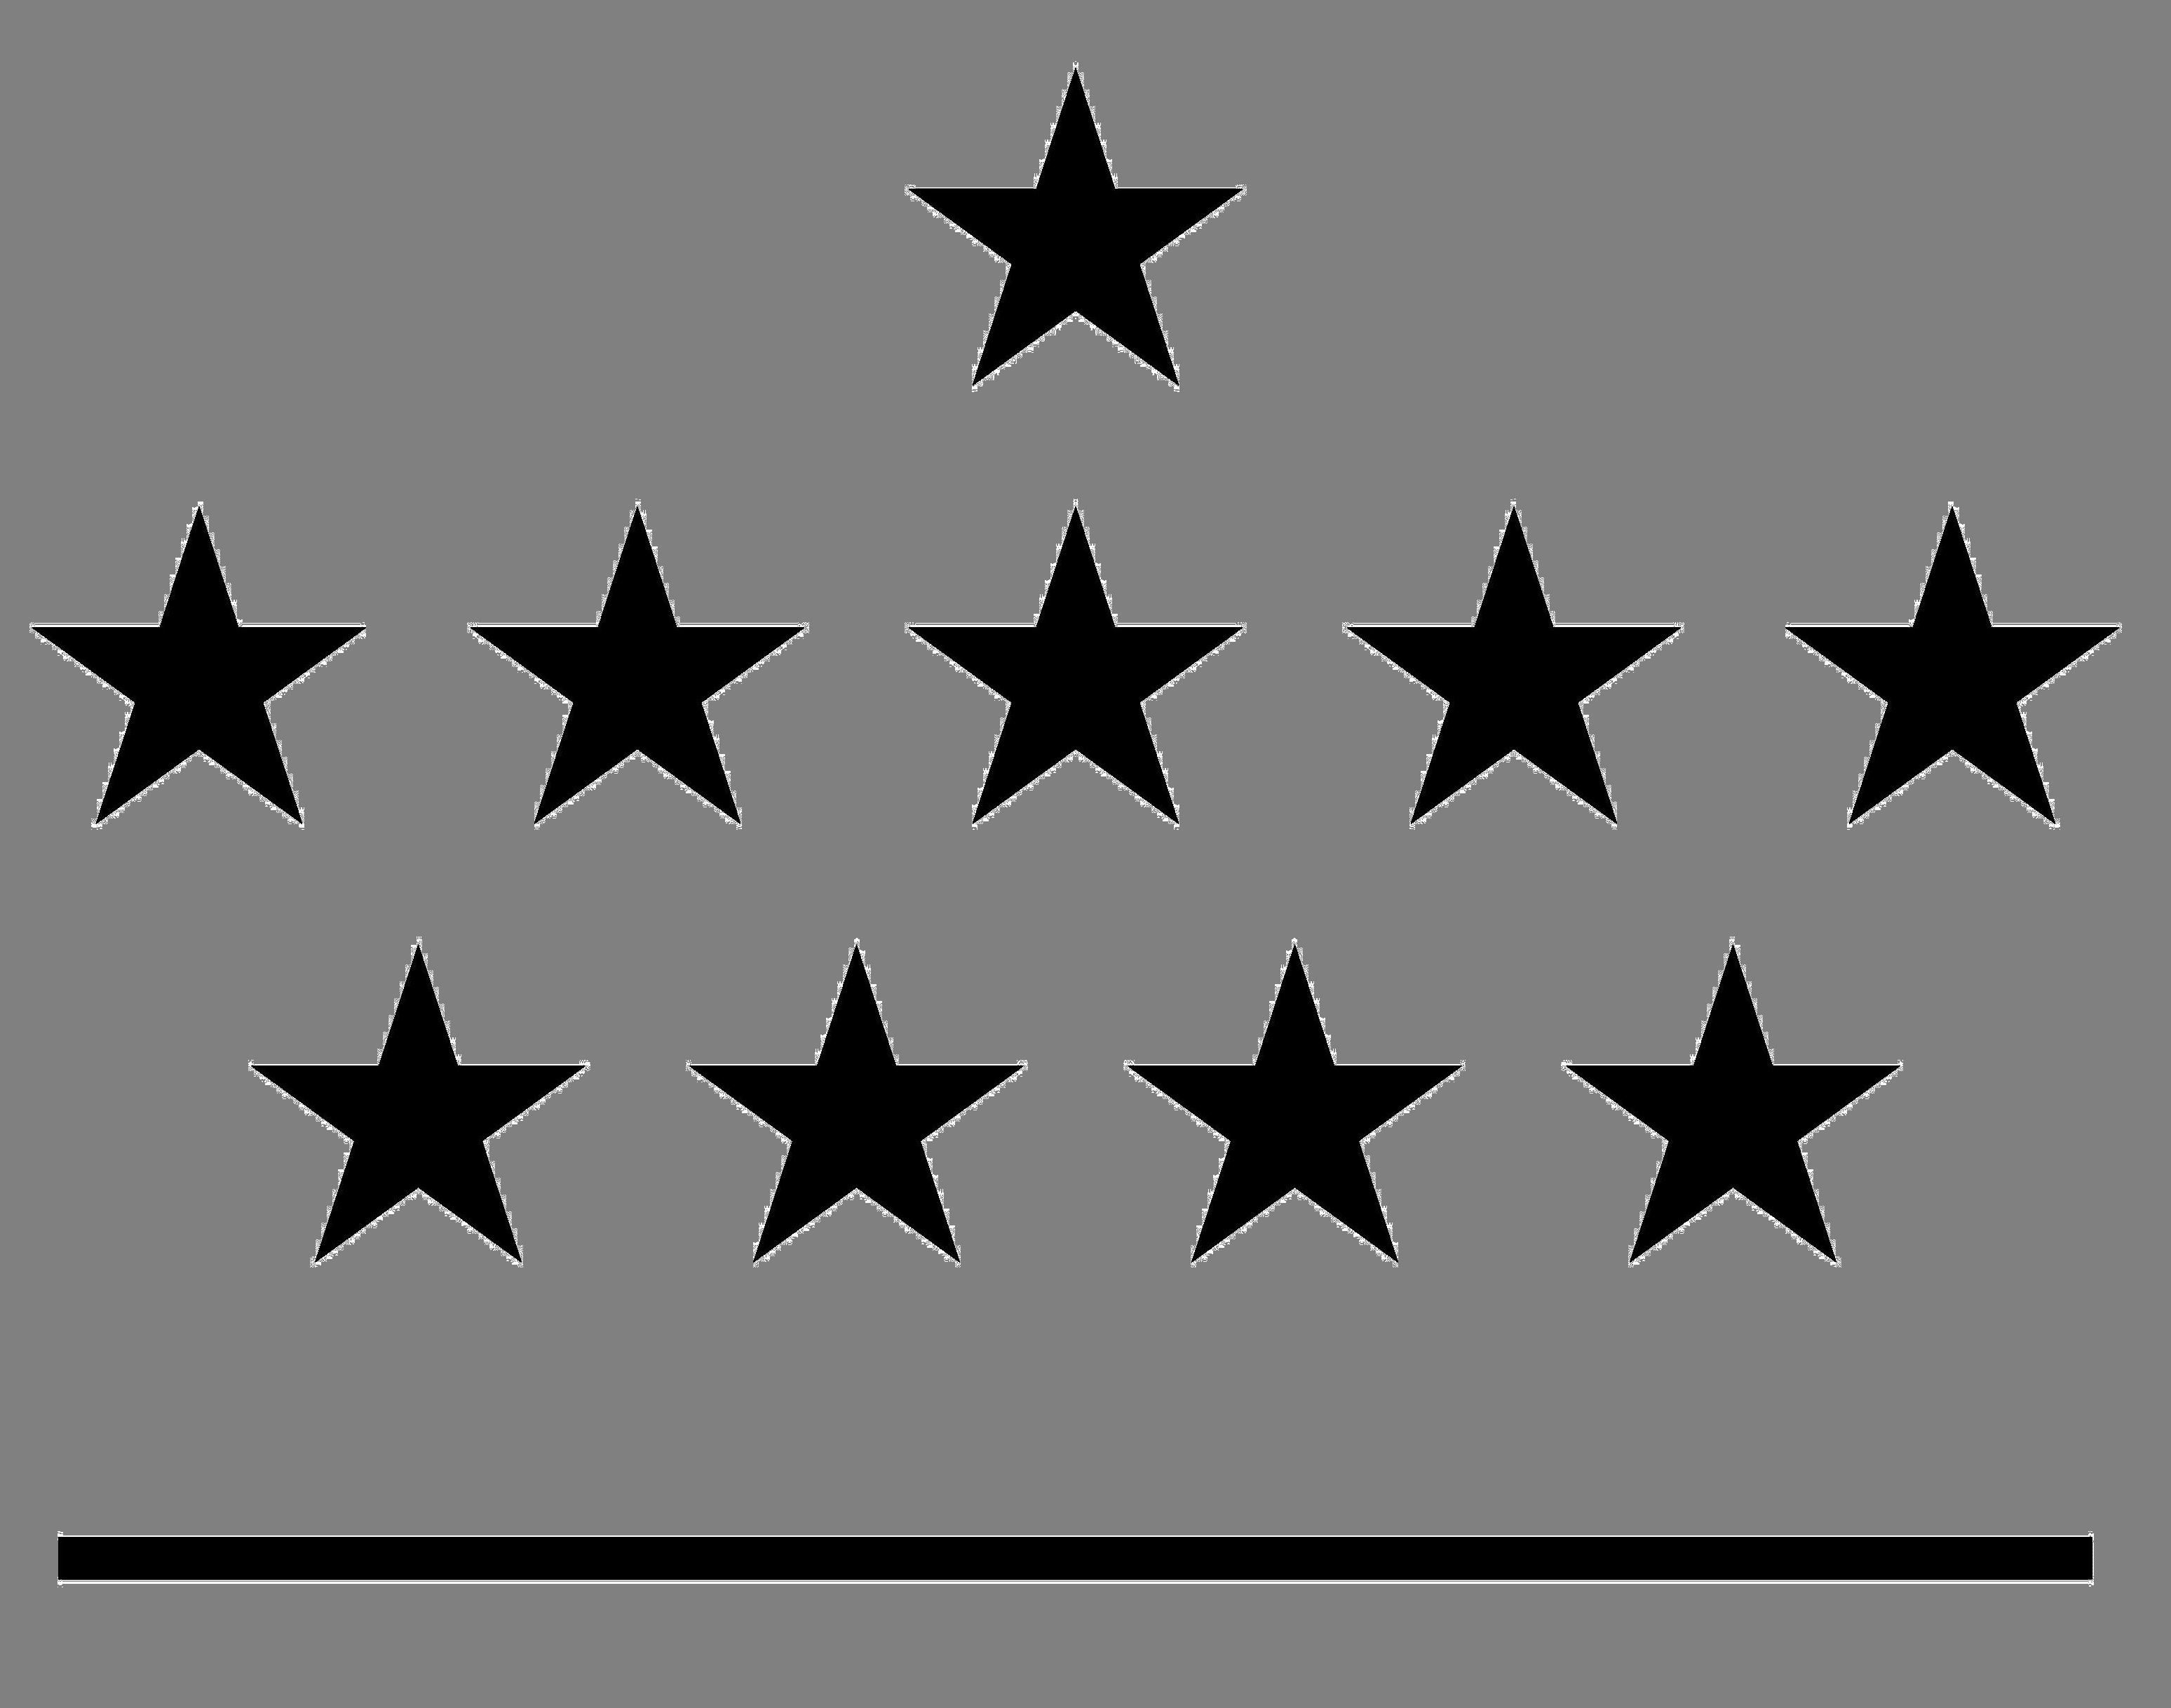



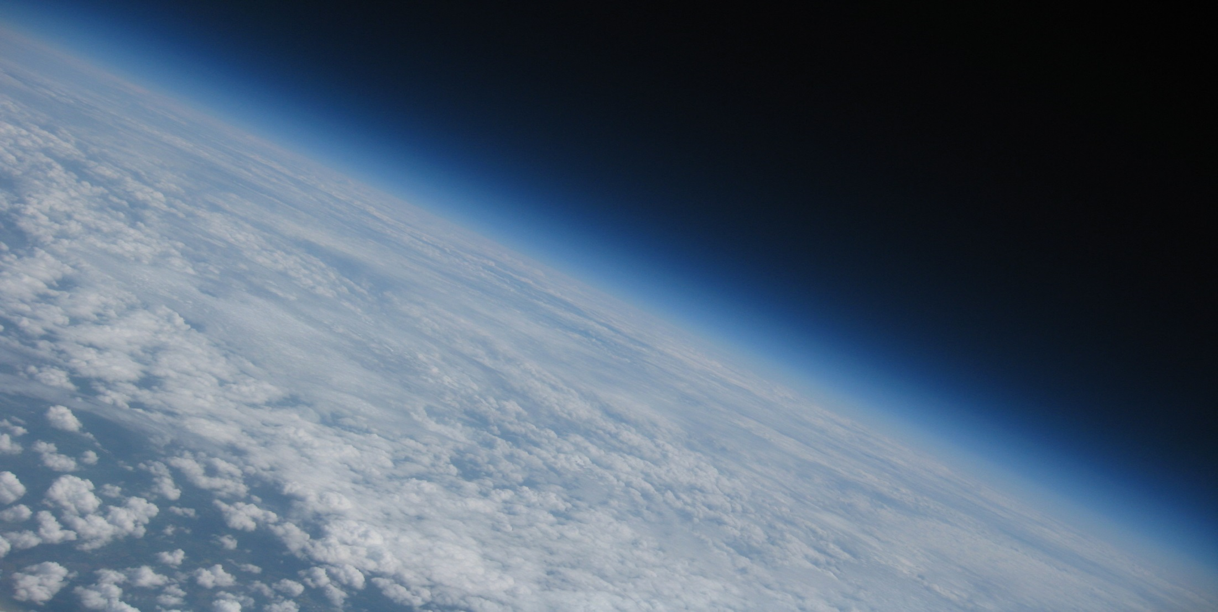
Royal Meteorological Institute of Belgium
Royal Observatory of Belgium
Belgian Institute for Space Aeronomy
Max Planck Institute for Chemistry
Solar-Terrestrial Centre of Excellence
1
2
3
4
5
Assessment of IGS repro1 IWV trends by comparison with ERA-interim and GOMESCIA satellite data
R. Van Malderen^{1,5}, E. Pottiaux^{2,5}, H. Brenot^{3,5}, S. Beirle⁴, T. Wagner ⁴, H. De Backer¹, and C. Bruyninx^{2,5}
GNSS4SWEC-WG3 workshop, Thessaloniki, 11-13/05/2015

Slide 2





ROB
Outline
Introduction: inter-technique comparison
Sensitivity analysis of meteorological variables
IWV trends and correlations
Conclusions and perspectives
GNSS4SWEC workshop
Thessaloniki, Greece 11-13 May 2015

Slide 3
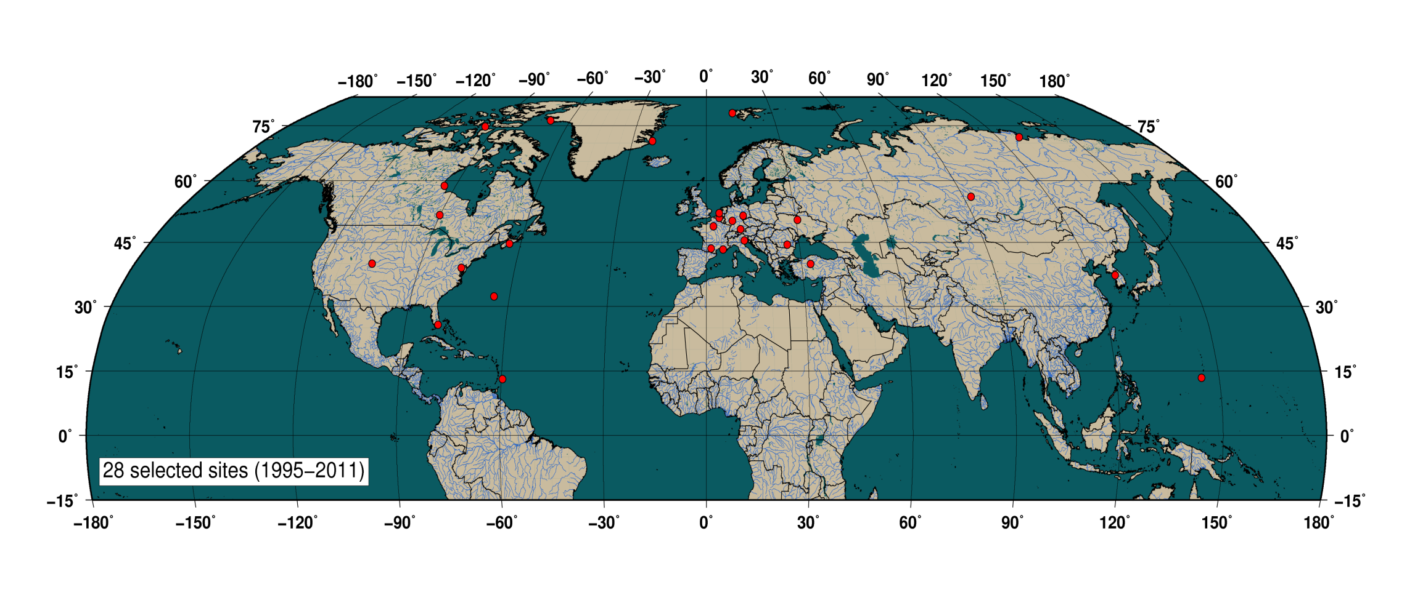
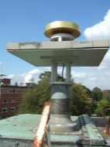
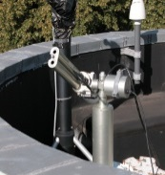
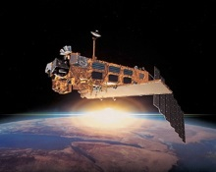
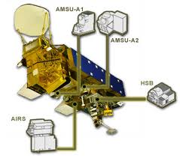
Introduction
Sensitivity analysis
IWV trends & correlations
Conclusions & perspectives
ROB
Van Malderen, R., Brenot, H., Pottiaux, E., Beirle, S., Hermans, C., De Mazière, M., Wagner, T., De Backer, H., and Bruyninx, C.: A multi-site intercomparison of integrated water vapour observations for climate change analysis, Atmos. Meas. Tech., 7, 2487-2512, doi:10.5194/amt-7-2487-2014, 2014.
IWV techniques intercomparison at 28 sites world-wide (NH)
IGS CIMEL radiosondes GOMESCIA AIRS
GNSS4SWEC workshop
Thessaloniki, Greece 11-13 May 2015

Slide 4
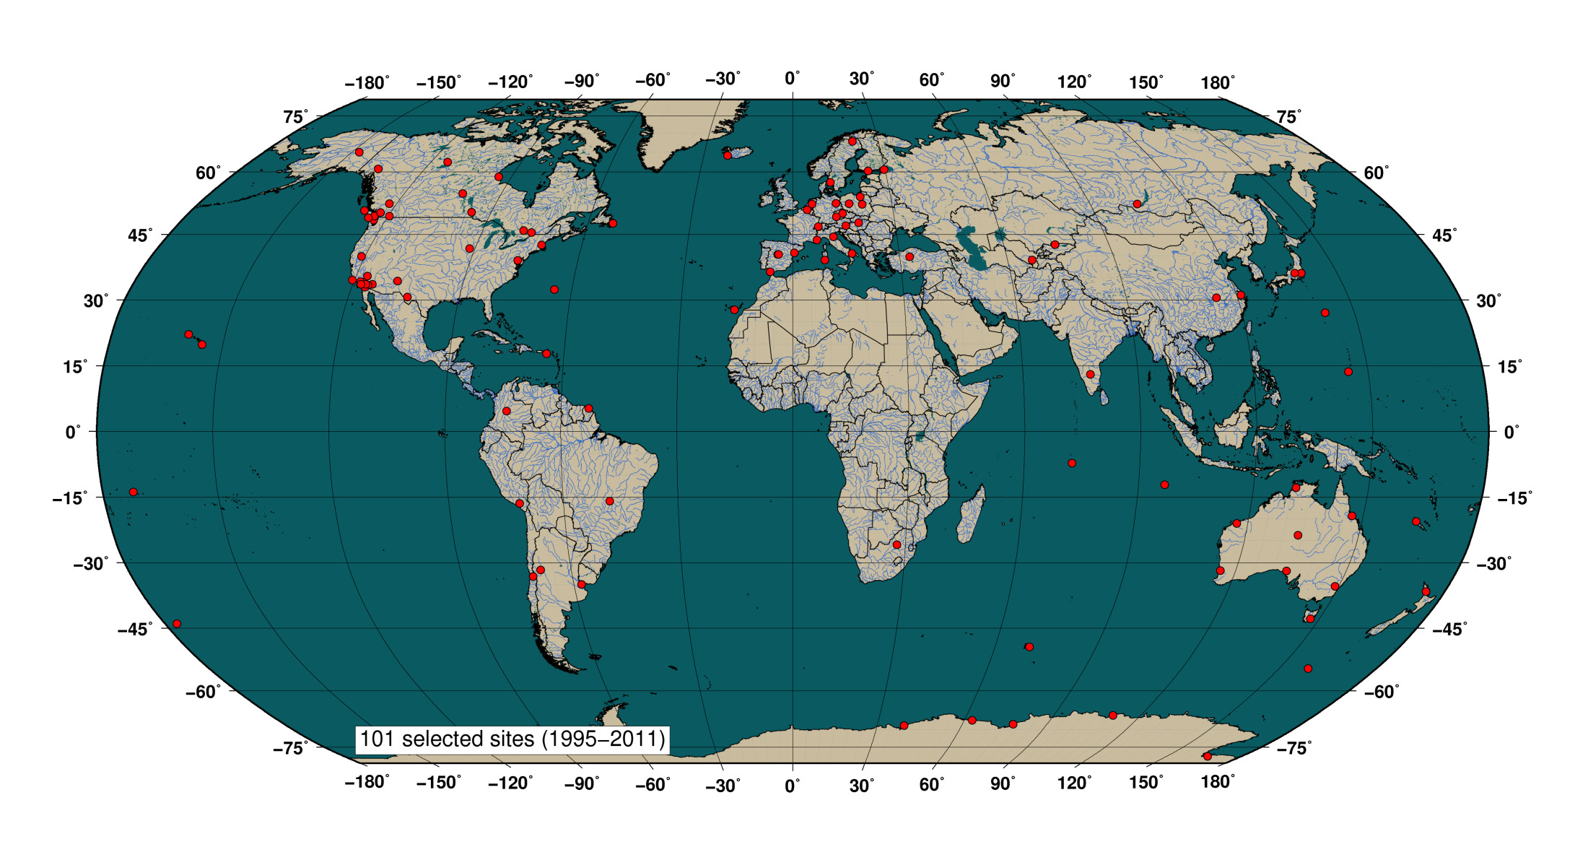
Introduction
Sensitivity analysis
IWV trends & correlations
Conclusions & perspectives
ROB
IGS stations selected (homogenous processing for data since 1995 to 2011)
GNSS4SWEC workshop
Thessaloniki, Greece 11-13 May 2015

Slide 5
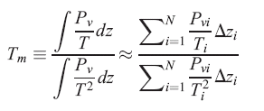
Introduction
Sensitivity analysis
IWV trends & correlations
Conclusions & perspectives
ROB
Zenith Total Delay (ZTD)
water-vapour-weighted atmospheric mean temperature
p_{s}
T_{m}
T_{s}
T_{m} = 70.2 + 0.72T_{s}
Bevis et al. 1992
Integrated water vapour (IWV)
NWP models (reanalyses)
NCEPNCAR (I+II)
ERA-interim
synop stations
reanalyses
➔ sensitivity analysis of p_{s}, T_{m}, T_{s} , and data sources by isolating the ➔ influence of a given parameter/dataset
GNSS4SWEC workshop
Thessaloniki, Greece 11-13 May 2015

Slide 6
Introduction
Sensitivity analysis
IWV trends & correlations
Conclusions & perspectives
ROB
 | bias (mm) | abs bias (mm) | SD | R² | trend (mm/dec) | abs trend (mm/dec)
[a] | Tm ERA: influence IGS data
IWV ERA | -0.313±1.011 | 0.669±0.818 | 3.807 | 0.962 | -0.102±0.457 | 0.322±0.338
[b] | Tm ERA: influence P_{s}
TmERA P synop* | -0.200±0.614 0.031±0.611 | 0.301±0.570 0.357±0.494 | 7.575 0.786 | 0.961 0.989 | -0.290±0.752 0.052±0.401 | 0.353±0.724 0.277±0.292
[c] | T ERA P synop: influence T_{s}
TP synop* | 0.009±0.025 0.267±0.622 | 0.020±0.017 0.503±0.447 | 0.029 2.878 | 1.000 0.979 | 0.013±0.244 -0.197±0.879 | 0.107±0.219 0.502±0.744
[d] | Tm ERA: influence Bevis et al. regression
TP ERA | 0.044±0.092 0.508±1.583 | 0.069±0.075 1.235±1.108 | 0.025 8.099 | 1.000 0.804 | -0.004±0.031 -0.101±0.213 | 0.018±0.025 0.188±0.140
[e] | Tm ERA P synop: influence Ts and Bevis et al. regression
TP synop* | 0.026±0.071 | 0.051±0.055 | 0.052 | 1.000 | 0.001±0.248 | 0.110±0.221
[f] | Tm ERA: influence reanalysis dataset
Tm NCEP | -0.034±0.286 | 0.168±0.233 | 0.154 | 0.995 | -0.015±0.144 | 0.083±0.118
[g] | Tm ERA: observational vs. reanalysis dataset
TP synop* | -0.073±0.403 | 0.223±0.342 | 4.705 | 0.971 | -0.210±0.667 | 0.259±0.649

Slide 7
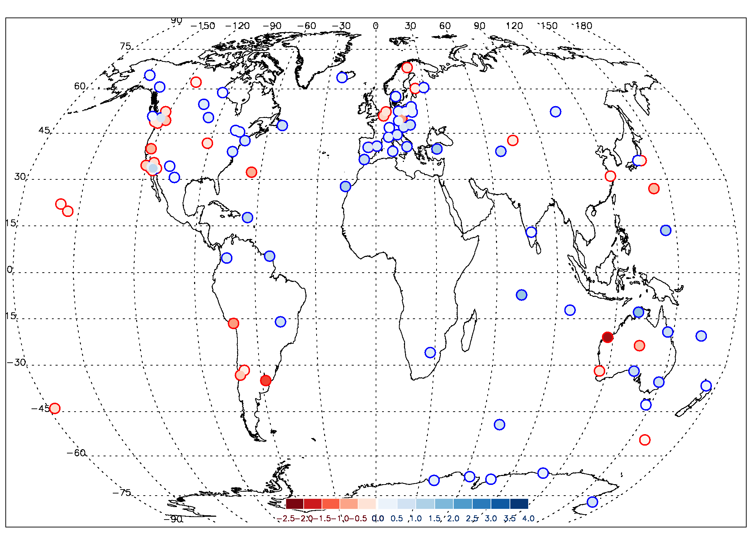
Introduction
Sensitivity analysis
IWV trends & correlations
Conclusions & perspectives
ROB
IWV trends [mm/dec] 1997-Mar 2011
IGS, T_{m} ERAinterim

Slide 8
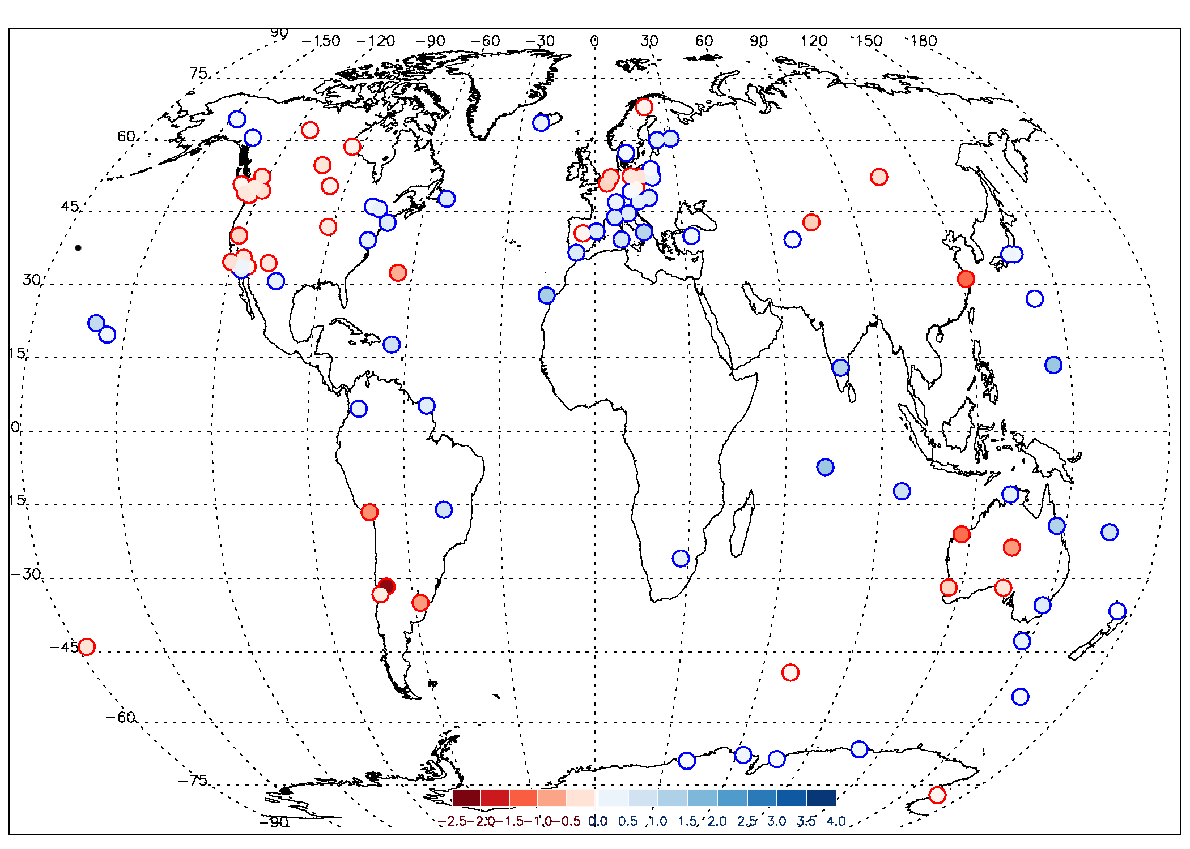
Introduction
Sensitivity analysis
IWV trends & correlations
Conclusions & perspectives
ROB
IWV trends [mm/dec] 1997-Mar 2011
ERAinterim

Slide 9
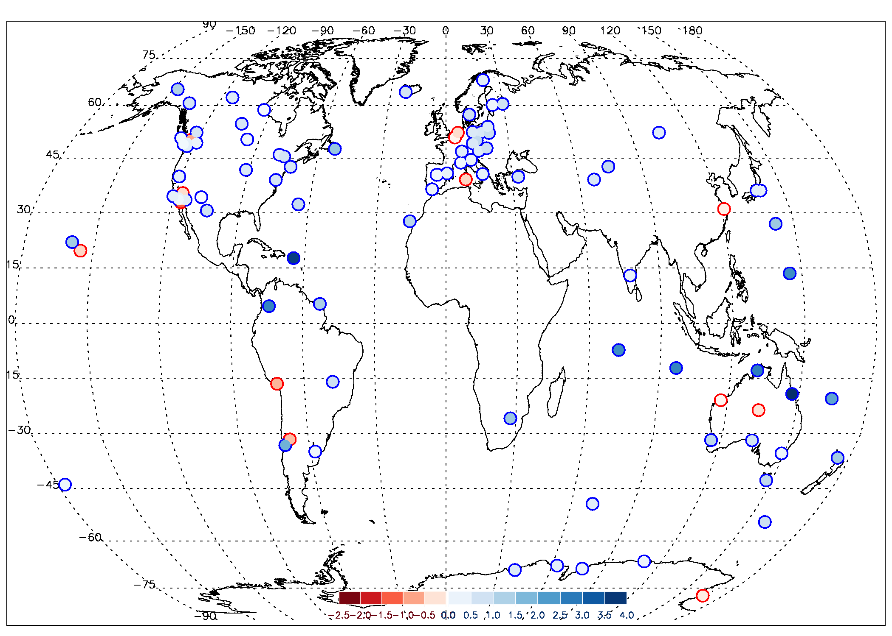
Introduction
Sensitivity analysis
IWV trends & correlations
Conclusions & perspectives
ROB
IWV trends [mm/dec] 1997-Mar 2011
GOMESCIA

Slide 10
Introduction
Sensitivity analysis
IWV trends & correlations
Conclusions & perspectives
ROB
IWV trends [mm/dec] 1997-Mar 2011
IGS, T_{m} ERAinterim

Slide 11
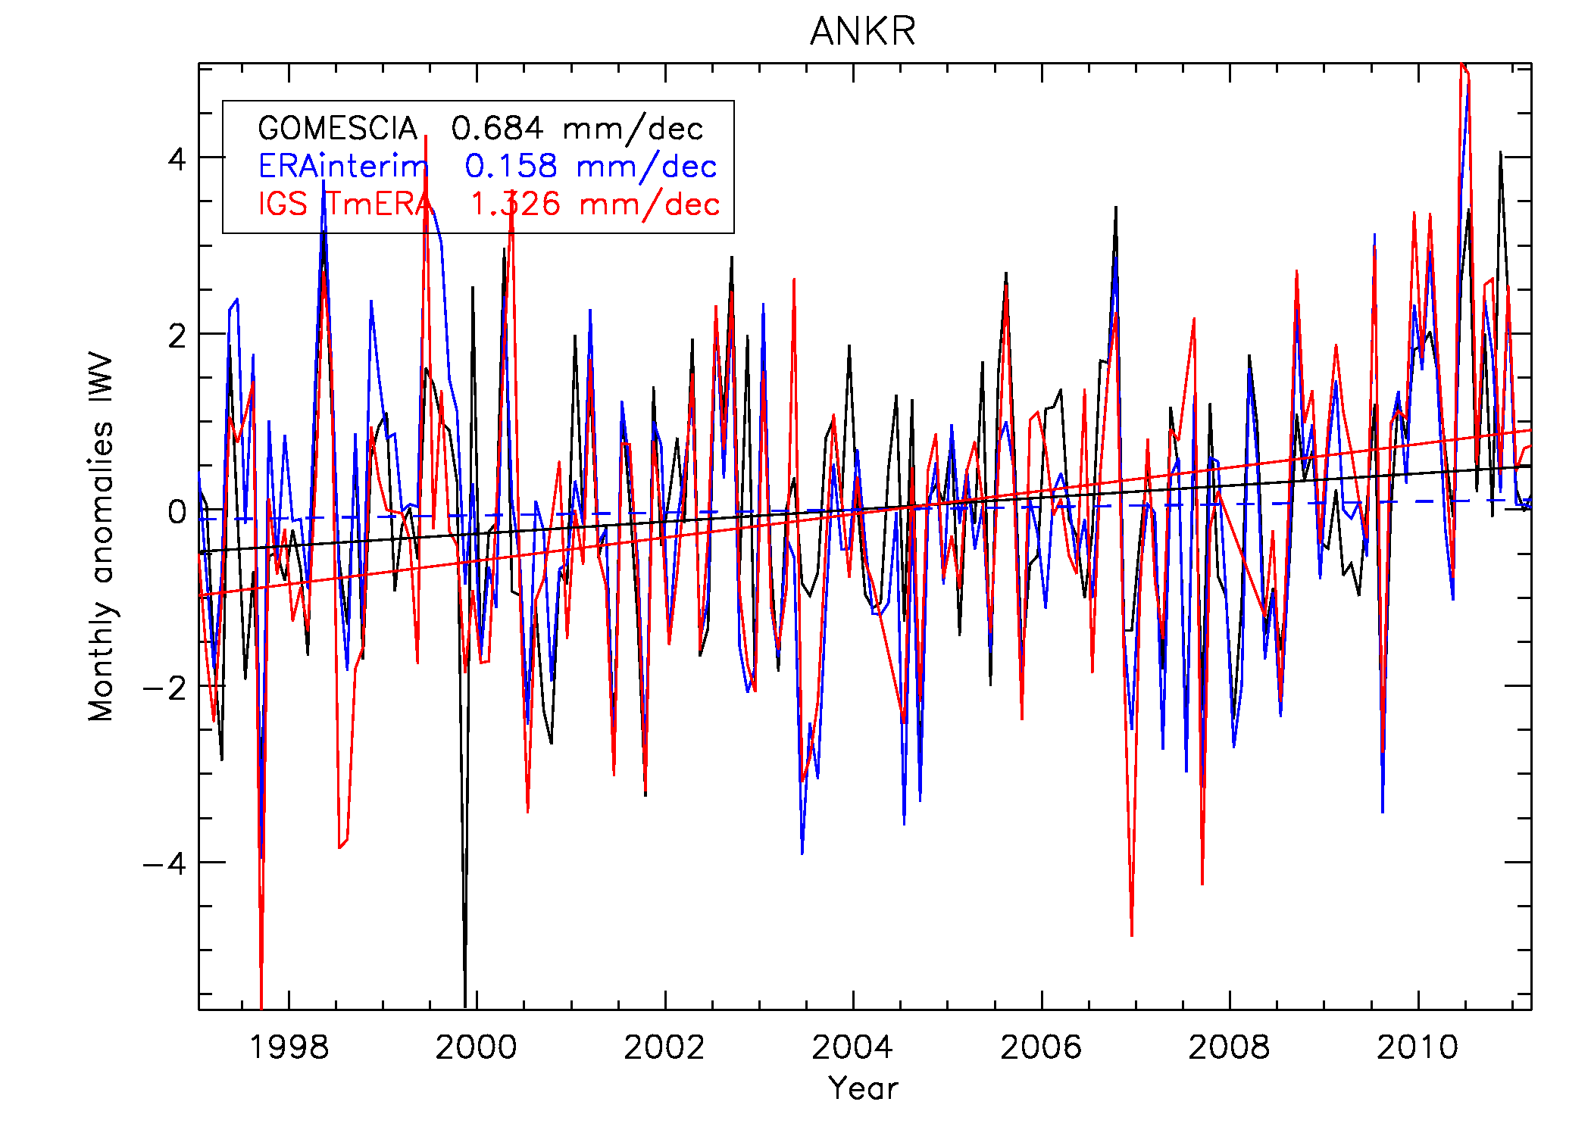
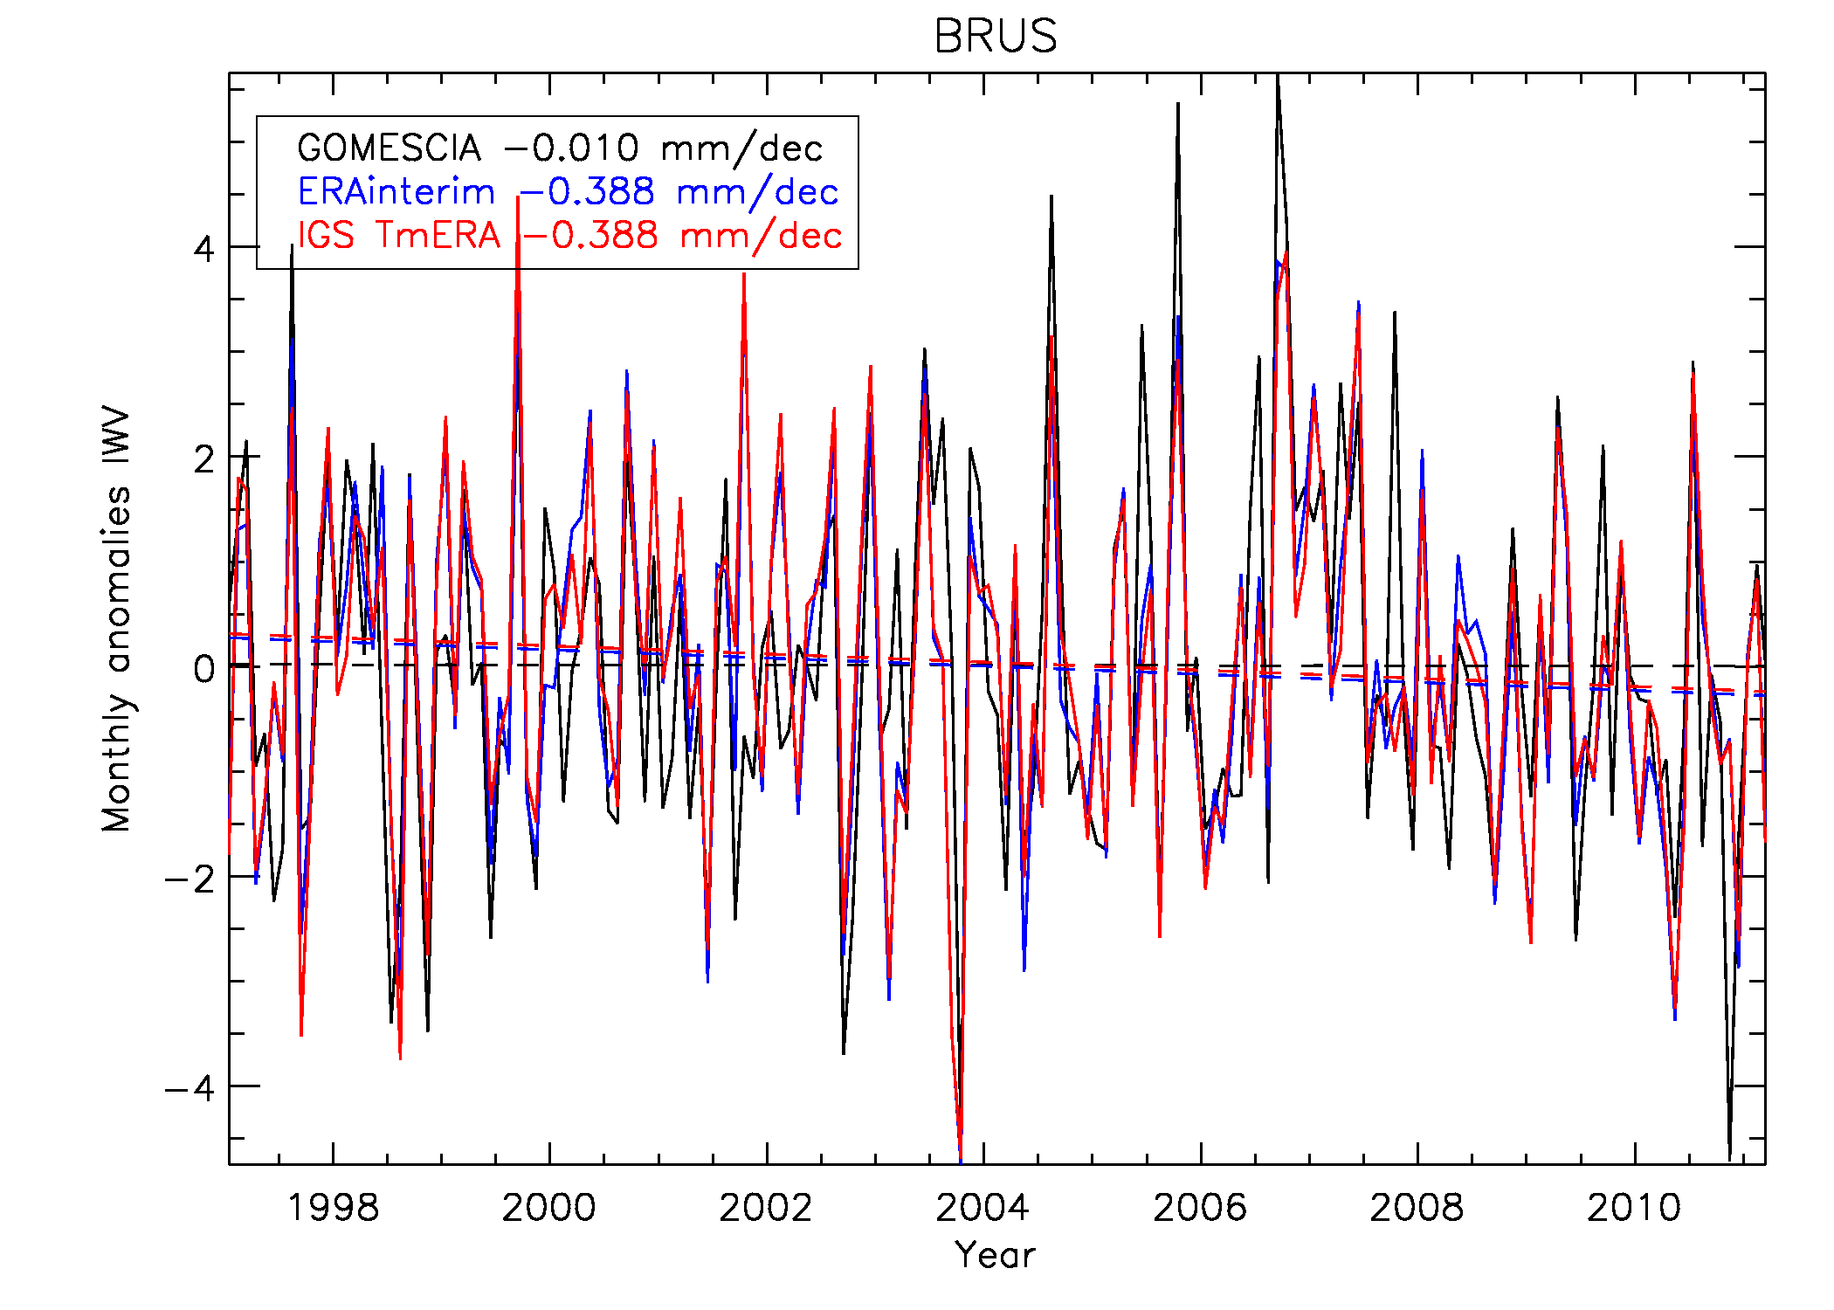
Introduction
Sensitivity analysis
IWV trends & correlations
Conclusions & perspectives
ROB
Trend examples
large differences in IWV trends between the data sources at a given site
site dependent!
homogeneity of the IWV data sources!?!
GNSS4SWEC workshop
Thessaloniki, Greece 11-13 May 2015

Slide 12
Introduction
Sensitivity analysis
IWV trends & correlations
Conclusions & perspectives
ROB
Homogeneity check
We calculated the “change points” of IWV differences of all stations of
IGS_TmERAinterim – ERAinterim
IGS_TmNCEPNCAR – NCEPNCAR
IGS_TmERAinterim – NCEPNCAR
IGS_TmNCEPNCAR – ERAinterim
… point-by-point and for monthly means @0h, 12h, 0h+12h
… by three different statistical tests (Pettitt-Mann-Whitney, Mann-Whitney-Wilcoxon, … Cumulative Sum technique*)
to be extended to GOMESCIA dataset
results are to be interpreted (identified change points should be linked to known changes in instrument, reanalysis changes)
we are open to compare/collaborate with other groups working on this, considering to host a GNSS4SWEC thematic sub-WG meeting @ Brussels!
GNSS4SWEC workshop
Thessaloniki, Greece 11-13 May 2015
*described in e.g. Van Malderen & De Backer, JGR, 2010

Slide 13
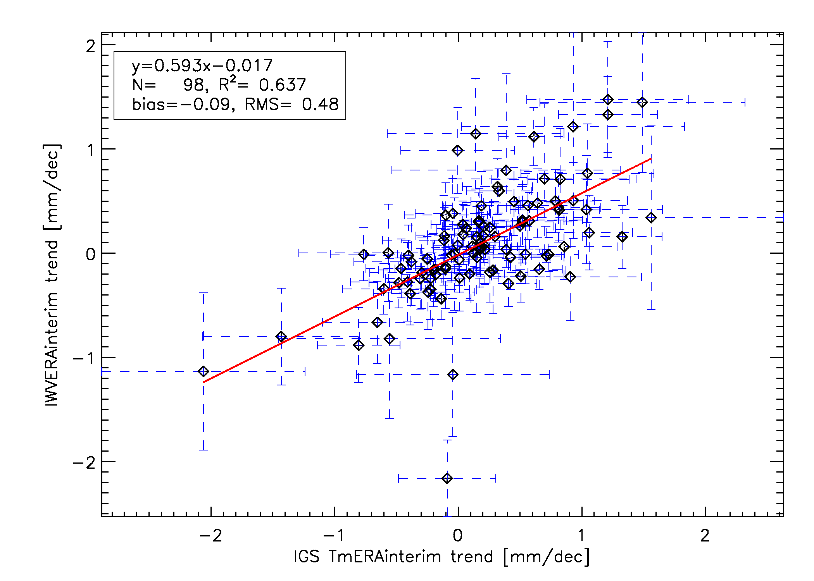
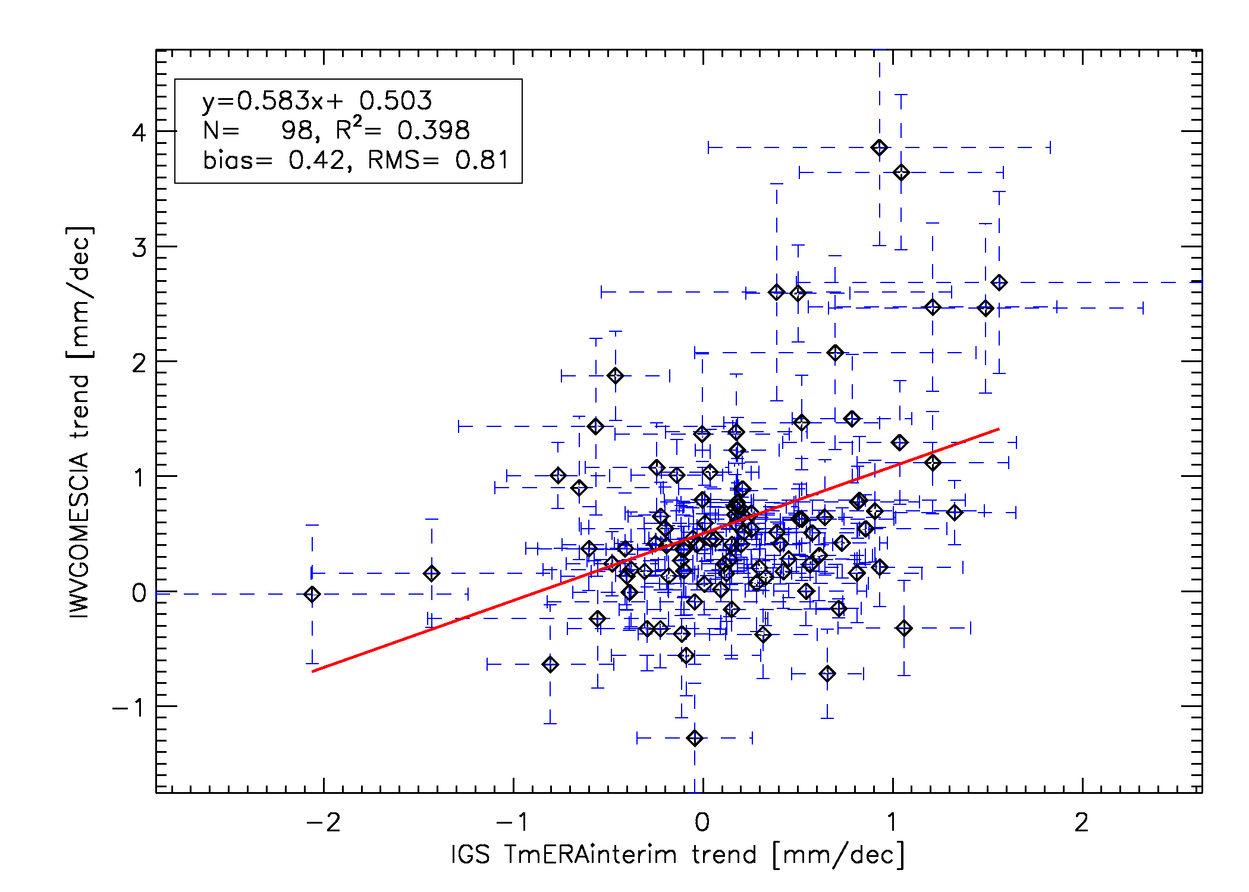
Introduction
Sensitivity analysis
IWV trends & correlations
Conclusions & perspectives
ROB
Trend correlations: between data sources
fair agreement between IGS and ERAinterim IWV trends
poorer agreement between IGS and GOMESCIA trends (stronger moistening in GOMESCIA): differences in observation times? Impact of weather observation bias (partly clear sky) of GOMESCIA? Data homogeneity issues?
GNSS4SWEC workshop
Thessaloniki, Greece 11-13 May 2015

Slide 14
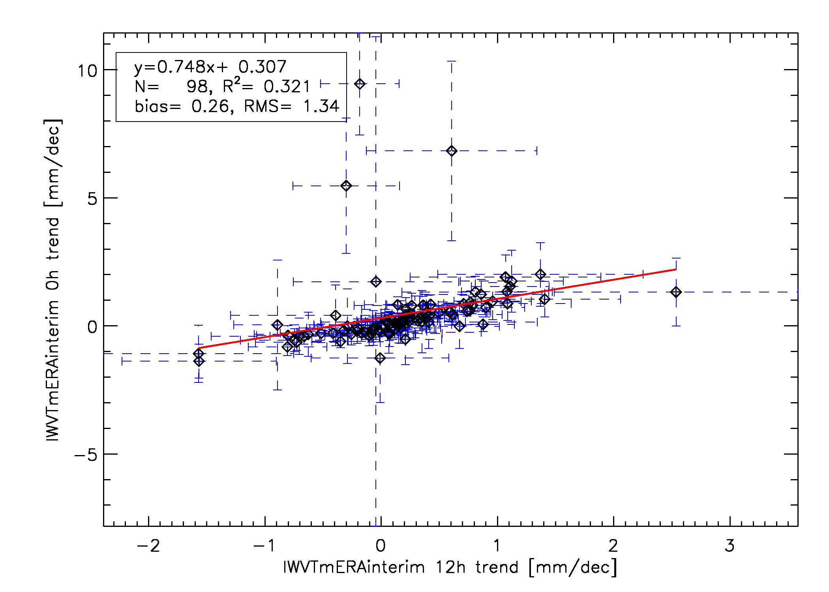
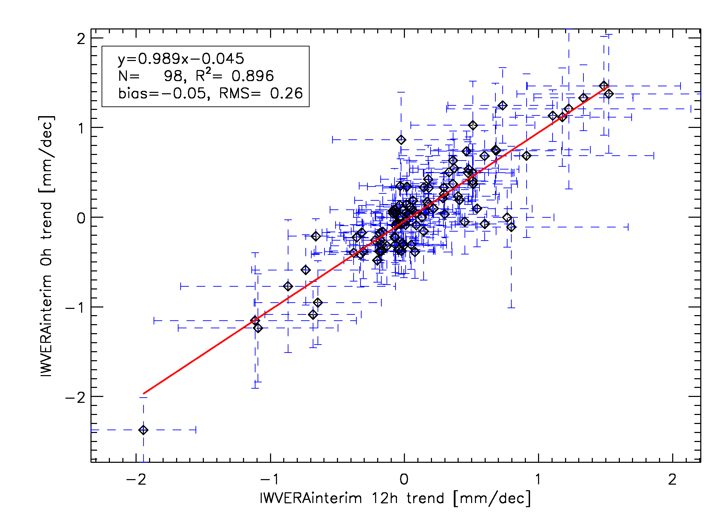
Introduction
Sensitivity analysis
IWV trends & correlations
Conclusions & perspectives
ROB
Trend correlations: between 0h and 12h
IGS
ERA-interim
very good agreement between IWV ERAinterim trends at 0h and 12h
a handful of IGS sites show unrealistic trends at 0h. Some additional filtering is needed here, to remove e.g. the ZTD day boundary jumps (→ IGS repro 2!)
GNSS4SWEC workshop
Thessaloniki, Greece 11-13 May 2015

Slide 15
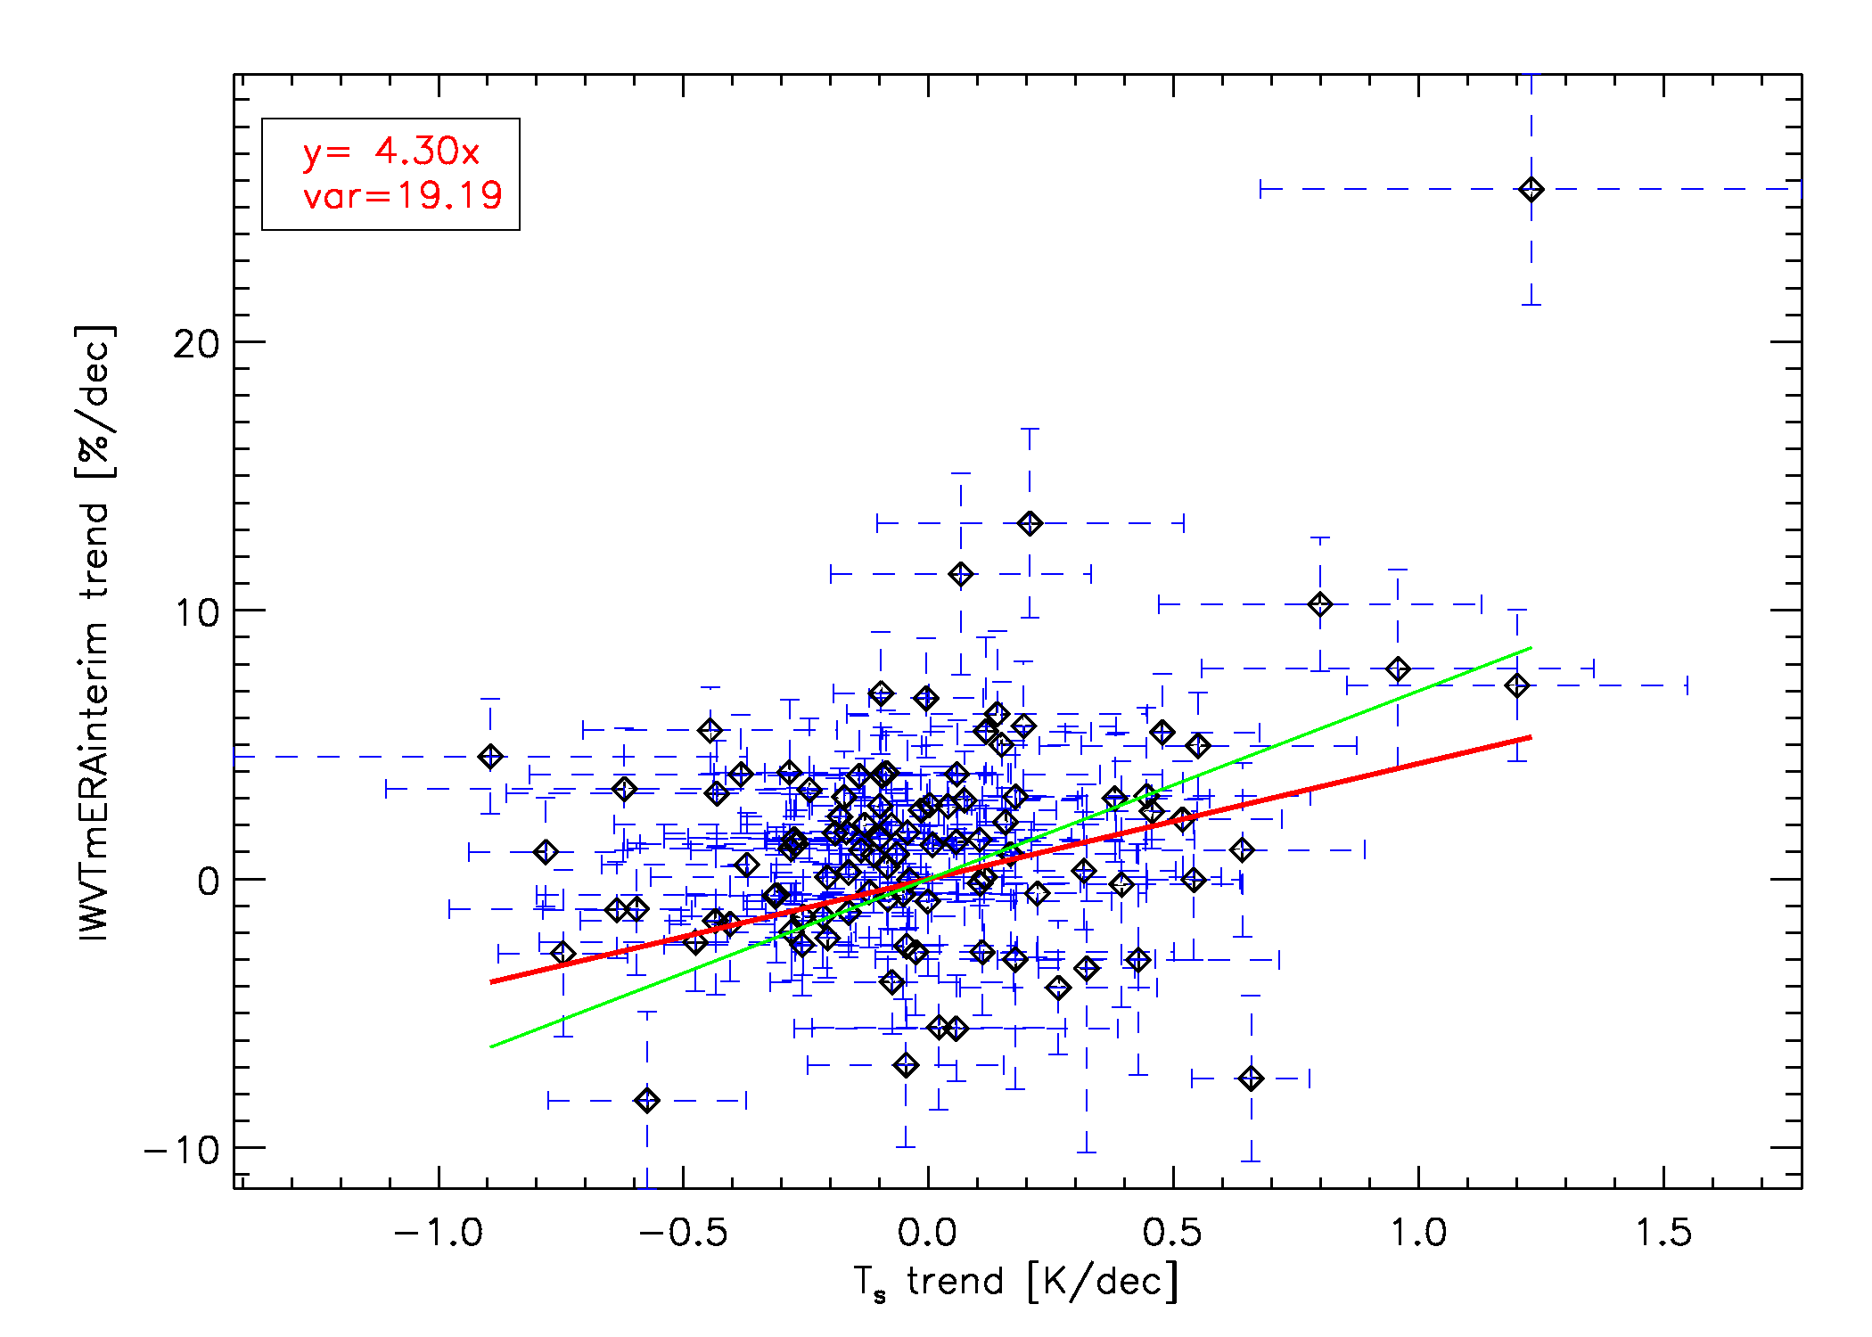
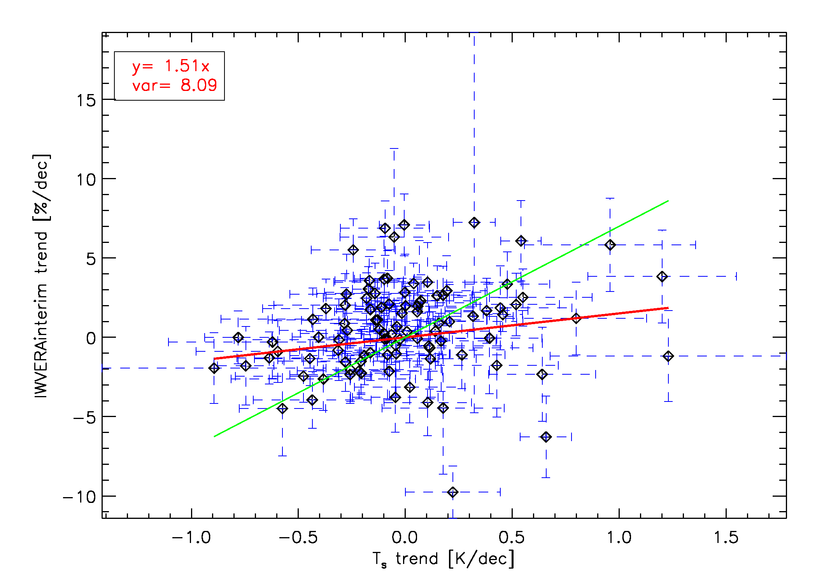
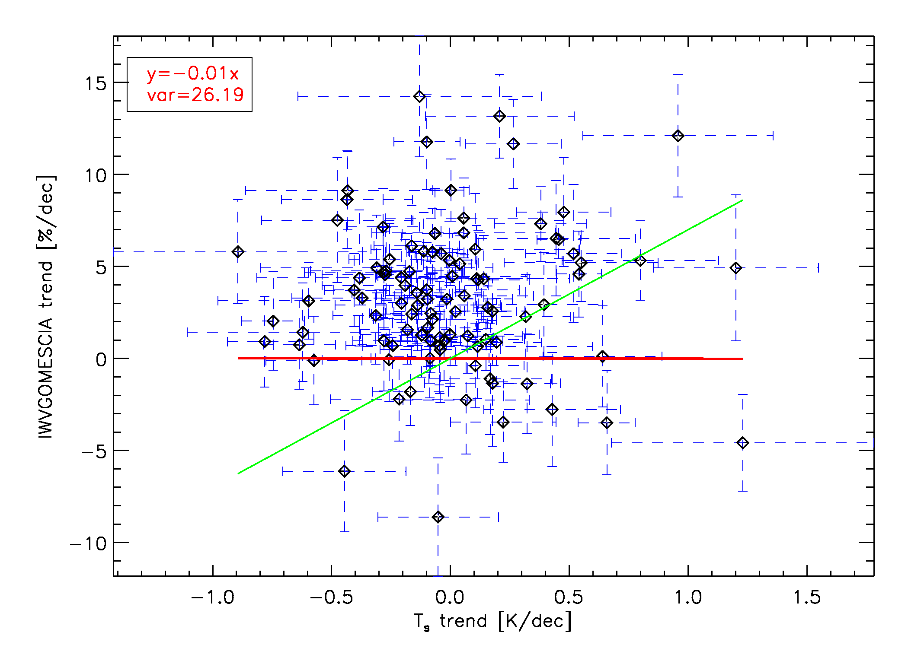
Introduction
Sensitivity analysis
IWV trends & correlations
Conclusions & perspectives
ROB
Trend correlations: between T_{s} and IWV
IGS
ERA-interim
GOMESCIA
A physical law (the Clausius-Clapeyron equation) tells us that the water holding capacity of the atmosphere goes up at about 7% per degree Celsius/Kelvin increase in temperature
This is not well established by our datasets, in particular for GOMESCIA!
GNSS4SWEC workshop
Thessaloniki, Greece 11-13 May 2015

Slide 16
Introduction
Sensitivity analysis
IWV trends & correlations
Conclusions & perspectives
ROB
GPS IWV trends are not too strongly affected by the used meteorological dataset
→ the trends are really in the Zenith Total Delay data
→ the surface pressure has the largest impact
Data screening (especially the 0h data at some stations) and homogenisation should be further developed.
The IWV trends based on the IGS ZTDs agree fairly well with model reanalysis trends, stronger deviations with completely independent GOMESCIA trends.
What is the impact of the cloud cover on the GOMESCIA trends?
Link between IWV trends and temperature trends as function of geographical location, altitude, etc.
GPS IWV trends are not too strongly affected by the used meteorological dataset
→ the trends are really in the Zenith Total Delay data
→ the surface pressure has the largest impact
Data screening (especially the 0h data at some stations) and homogenisation should be further developed.
The IWV trends based on the IGS ZTDs agree fairly well with model reanalysis trends, stronger deviations with completely independent GOMESCIA trends.
What is the impact of the cloud cover on the GOMESCIA trends?
Link between IWV trends and temperature trends as function of geographical location, altitude, etc.
GNSS4SWEC workshop
Thessaloniki, Greece 11-13 May 2015

Slide 17
painting by Jess Sutton
Thank you!
GNSS4SWEC workshop
Thessaloniki, Greece 11-13 May 2015

