Slide 1







The homogenization of GPS Integrated Water Vapour time series: methodology and benchmarking the algorithms on synthetic datasets
R. Van Malderen¹, E. Pottiaux², A. Klos³, O. Bock⁴, J. Bogusz³, B. Chimani⁵, M. Elias⁶, M. Gruszczynska³, J. Guijarro⁷, S. Zengin Kazancı⁸ and T. Ning⁹
1
2
3
4
5
6
7
8
9
Royal Observatory
of Belgium

Slide 2
Outline
Motivation and introduction
Methodology
Synthetic dataset generation
Assessment of the performance of the homogenization tools on the synthetic dataset
Outlook

Slide 3

Motivation & introduction
Methodology
Synthetic datasets
Performance of homogen tools
Outlook
Motivation
COST action GNSS4SWEC ‘Advanced Global Navigation Satellite Systems tropospheric products for monitoring severe weather events and climate’
WG3: Use of GNSS tropospheric products for climate monitoring
From different presentations at different GNSS4SWEC workshops, it turned out that different groups were showing results from time series analyses, sometimes based on the same datasets.
They were dealing/struggling with the homogenization of their datasets.
➔ common activity, on a reference IWV dataset.

Slide 4
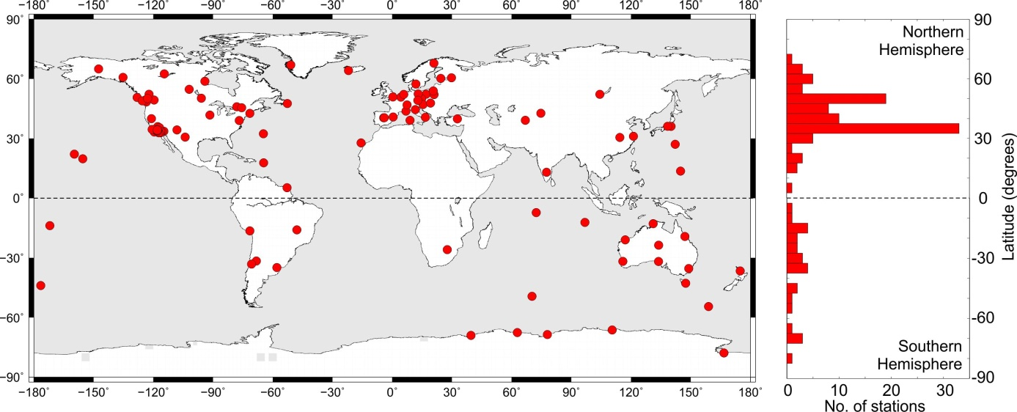

Motivation & introduction
Methodology
Synthetic datasets
Performance of homogen tools
Outlook
Introduction: the reference IWV dataset
From A. Klos
120 sites worldwide, with homogeneous reprocessing from 1995 – 2010
IGS repro 1: International GNSS Service, first reprocessing
screened, outlier removed, and ZTD converted to IWV by O. Bock

Slide 5
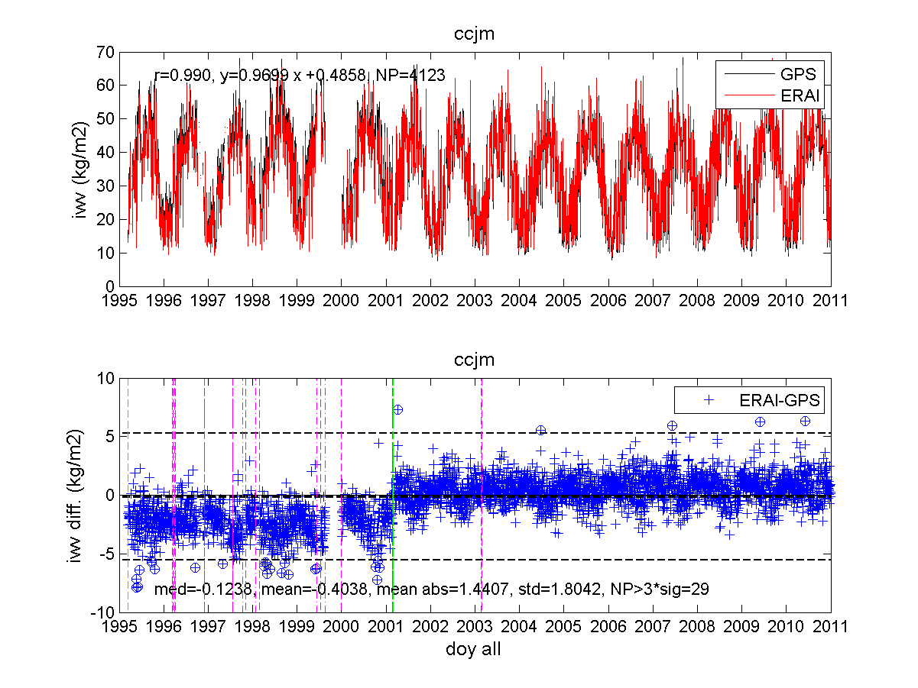
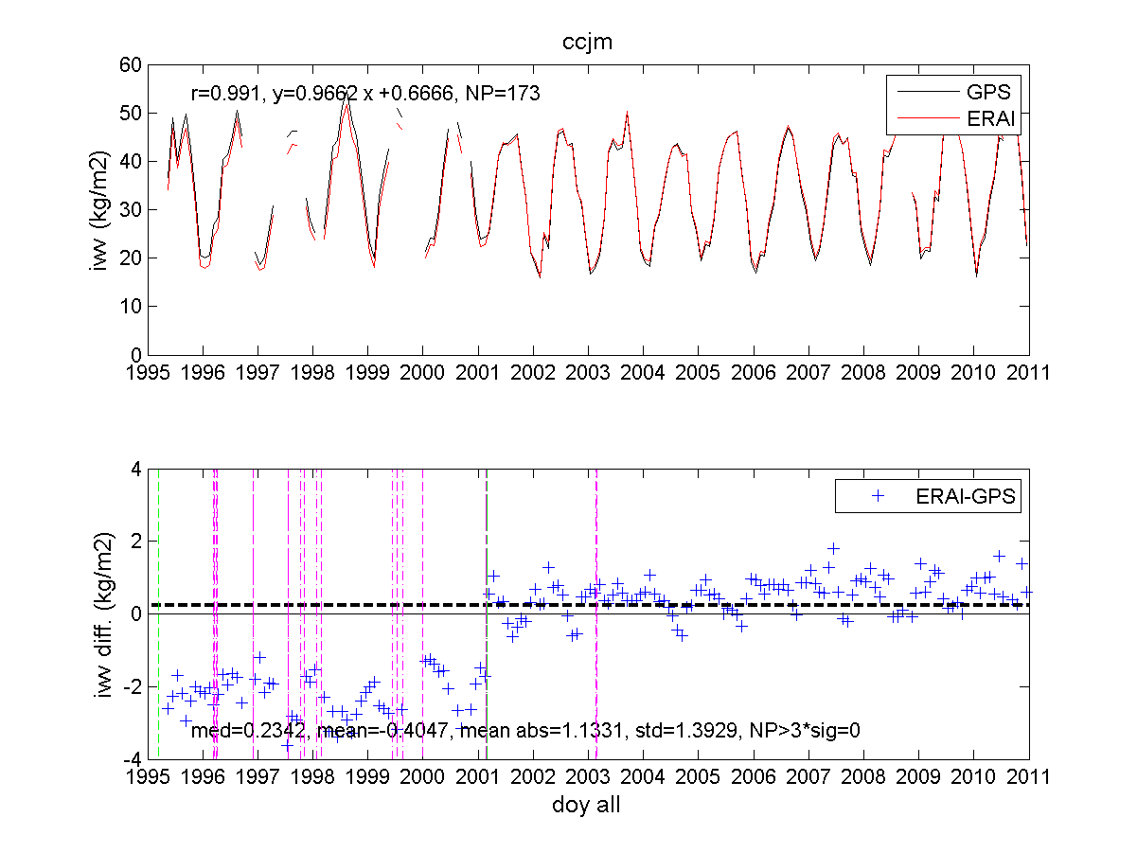
Motivation & introduction
Methodology
Synthetic datasets
Performance of homogen tools
Outlook
Methodology: use of a reference IWV dataset (ERA-interim)
daily
monthly
From O. Bock
We will look for break points/change points in the GPS – ERA-interim IWV differences series.

Slide 6
Motivation & introduction
Methodology
Synthetic datasets
Performance of homogen tools
Outlook
Generation of synthetic dataset: how?
based on the comparison of the epochs identified by different tools , we decided to build synthetic datasets with known inserted offsets for
  the assessment of the performance of the different tools
  a sensitivity analysis of this performance on the properties of the datasets
synthetic datasets of the IWV differences,
1. based on the characteristics of the offsets in the real IWV differences:
  number
  typical amplitudes
2. based on the characteristics of the real GPS – ERA-interim IWV differences:
  analysis of significant frequencies
  noise model
  linear trends
  gaps
around 1000 epochs of instrumental changes, reported in the stations metadata, were manually checked in the IWV differences (164 confirmed + 57 new ones, applied on the IWV time series!)
computations were performed with Maximum Likelihood Estimation (MLE) in the Hector software (Bos et al., 2013).

Slide 7
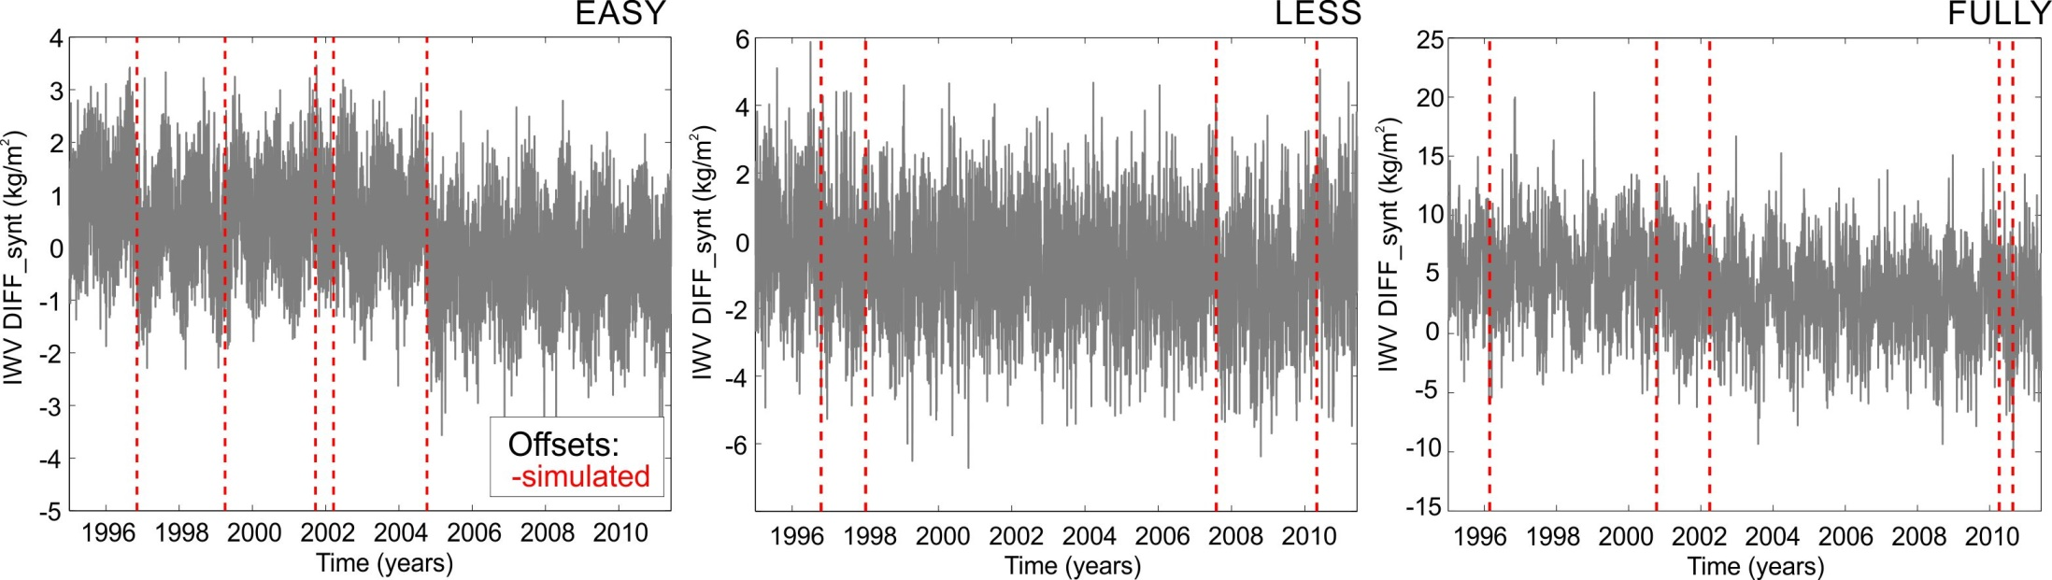
Motivation & introduction
Methodology
Synthetic datasets
Performance of homogen tools
Outlook
3 variants of synthetic time series of IWV differences
For each of the 120 stations, 3 time series of different complexity were created:
‘easy’ dataset: seasonal signals (annual, semi-annual, ter- and quater-annual, if present for a particular station) + offsets + white noise (WN).
‘less-complicated’ dataset: same as 1. + autoregressive process of the first order (noise model = AR(1)+WN).
‘fully-complicated’ dataset: same as 2. + trend + gaps (up to 20% of missing data).
Notes:
Suggestion: I replaced the original sentence “For every station (120 stations!), 3 variants of synthetic time series were created:“ by “For each of the 120 station, 3 time series of different complexity were created:“

Slide 8
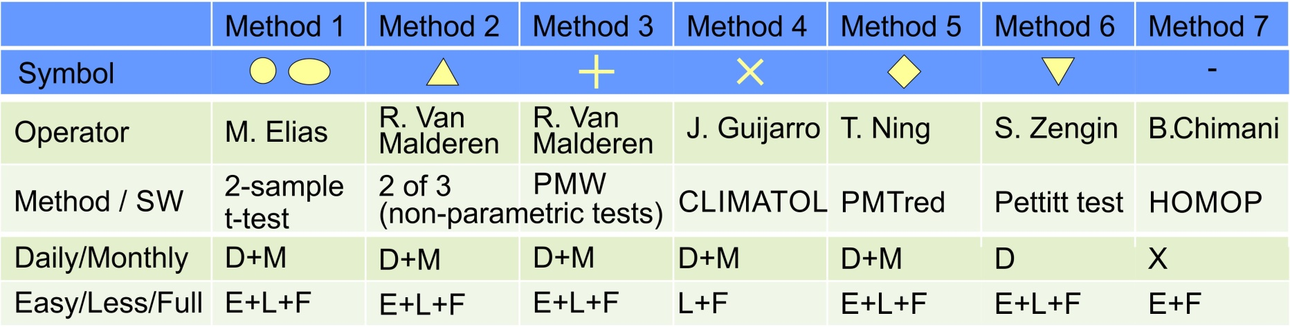
Motivation & introduction
Methodology
Synthetic datasets
Performance of homogen tools
Outlook
Which homogenization tools?
Assessment of the performance of tools on…
… the identification of the epochs of the inserted breakpoints (+ sensitivity analysis) in the synthetic datasets.
… the estimation of the trends that were or were not imposed to the 3 sets of synthetic IWV differences.
Notes:
HOMOP: PRODIGE+SPLIDHOME
PMTred: a penalized maximal t test (PMT) to empirically construct a penalty function that evens out the U-shaped false-alarm distribution over the relative position in the time series being tested. PMTred accounts for first-order autoregressive noise.

Slide 9
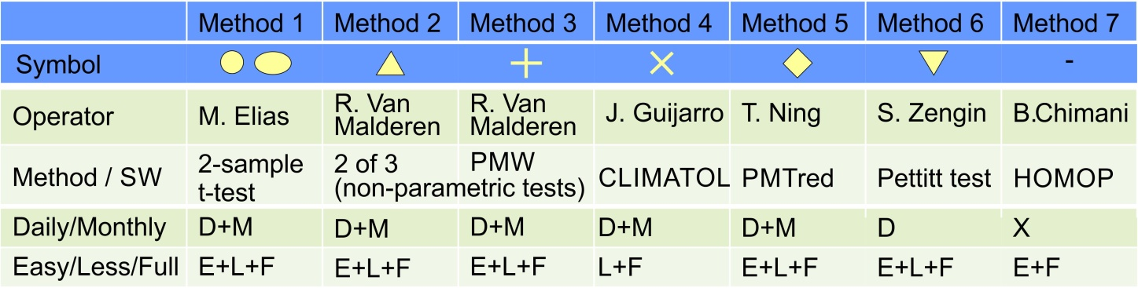
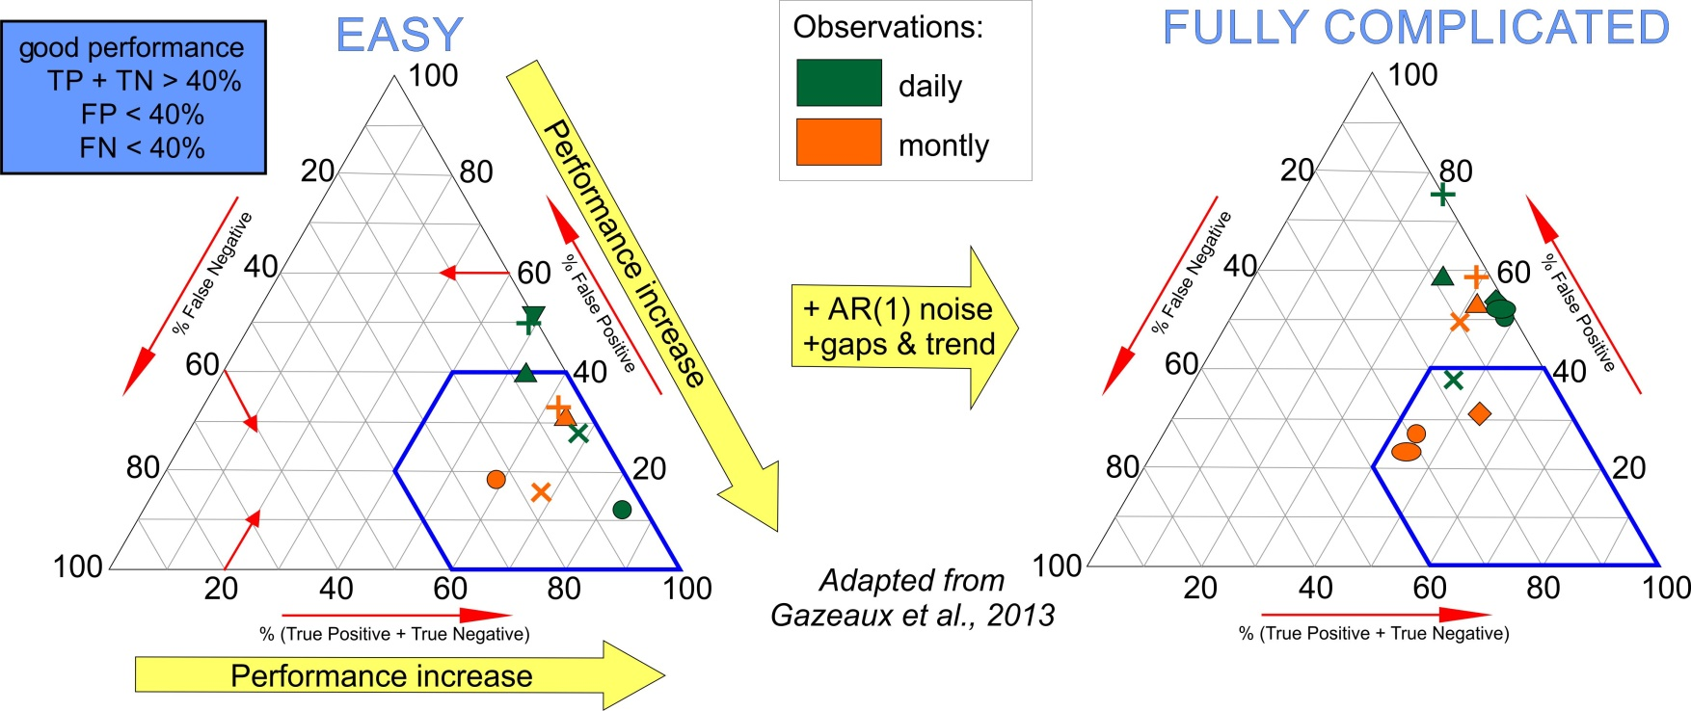
Motivation & introduction
Methodology
Synthetic datasets
Performance of homogen tools
Outlook
1. Identification of epochs of offsets: detection scores
time window = 2 months

Slide 10
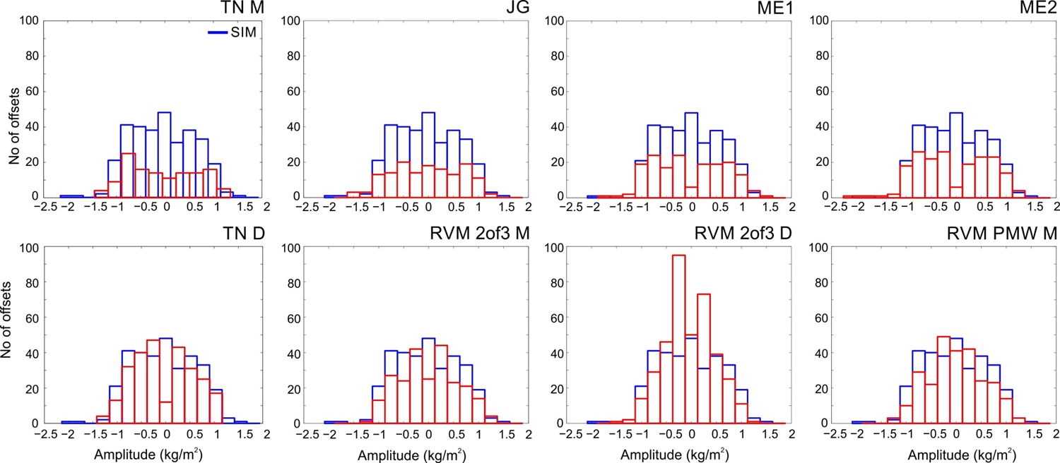
Motivation & introduction
Methodology
Synthetic datasets
Performance of homogen tools
Outlook
1. Identification of epochs of offsets: amplitudes of offsets
Method 5, M
Method 4
×
Method 1
Method 1
FULLY COMPLICATED
+
Method 5, D
Method 2, M
Method 2, D
Method 3, M
depending on the method: over/underestimation of low-amplitude offsets (→ fine-tuning?)

Slide 11
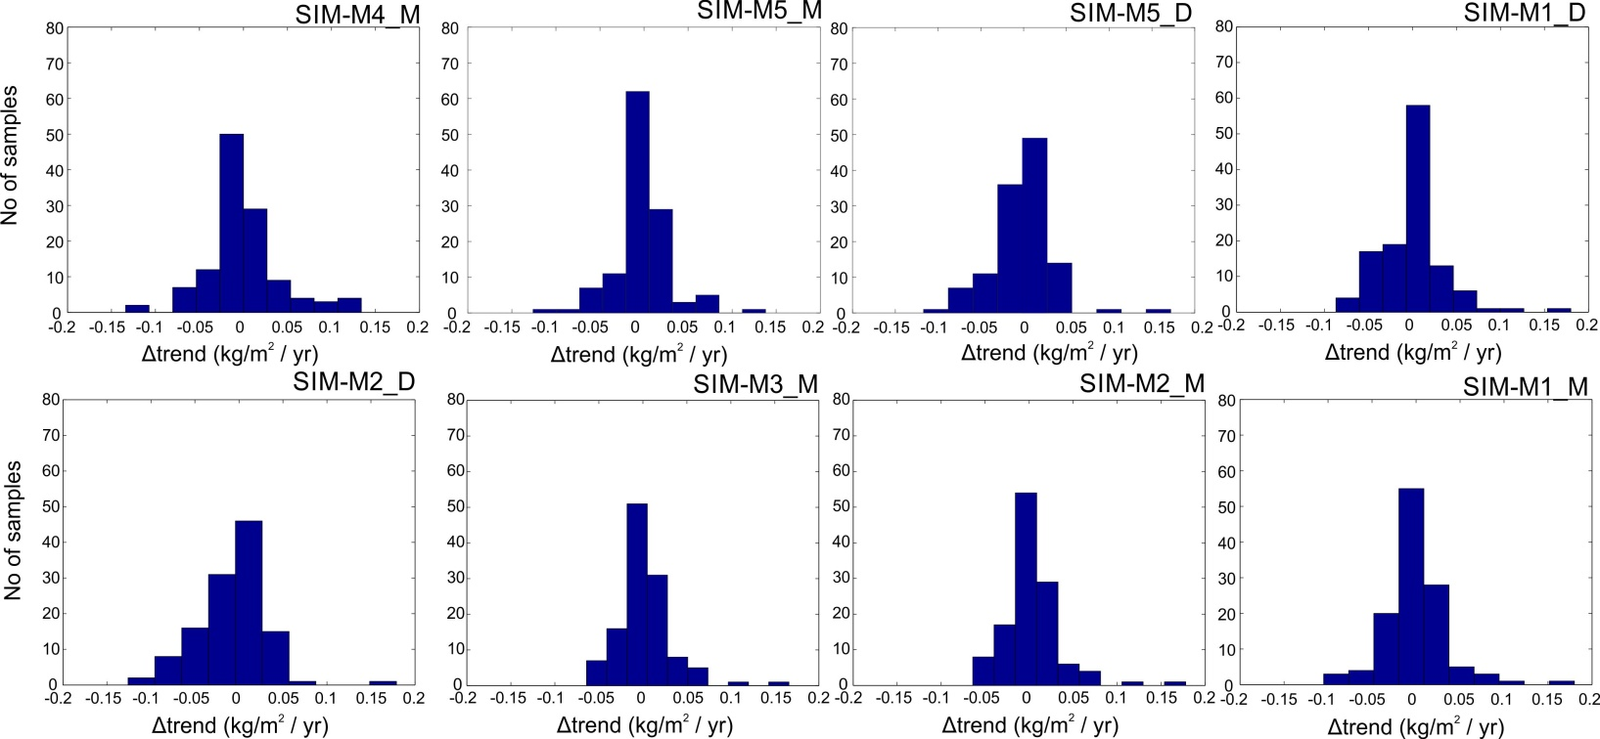
Motivation & introduction
Methodology
Synthetic datasets
Performance of homogen tools
Outlook
2. Trend estimation
FULLY COMPLICATED

Slide 12
Motivation & introduction
Methodology
Synthetic datasets
Performance of homogen tools
Outlook
Workplan
more detailed assessment of the performance of the different tools (and sensitivity analysis): CRMSE, …
The epochs and amplitudes (and feedback) of the offsets in the synthetic datasets is given to the participants who already provided their solutions → fine-tuning of their tools
We highly welcome other contributions (tools, solutions) in our activity! Interested? Please contact me at roeland@meteo.be.
A next generation of a fully complicated synthetic dataset will be generated (based on the GNSS IWV time series, not the differences).
A second round of blind homogenization on this next generation dataset(s) will be undertaken, before applying (some of the) tools on the real GNSS IWV datasets.

Slide 13

Motivation & introduction
Methodology
Synthetic datasets
Performance of homogen tools
Outlook
Workplan
IAG JWG 4.3.8:
“GNSS tropospheric products for Climate” (chaired by R. Pacione and E. Pottiaux)
http://iag-gnssclimate.oma.be/index.php

Slide 14
Thank you for your attention

