Slide 1
Inventory of IWV intercomparison sites
Roeland Van Malderen

Slide 2

IWV intercomparison
2 objectives
assess homogeneity of long GPS time series, → compare GPS ZTD/IWV to other ZTD/IWV data that are homogeneous on long term
evaluate the precision and accuracy of the GPS IWV estimates → sensitivity studies and intercomparisons with reference data → campaign data over short periods
first focus on 2nd objective
to have data consistency among similar instruments (e.g. RS, MWR, FTIR) at different sites, we might rely on networks like GRUAN (= their core business) and NDACC (FTIR working group, microwave working group, etc.)
focus on “supersites”: sites with at least 3 instruments measuring IWV
➔ these criteria give a list 29 sites (EU: 15, non-EU: 14)
GNSS4SWEC workshop Varna 11-12 Sept. 2014

Slide 3
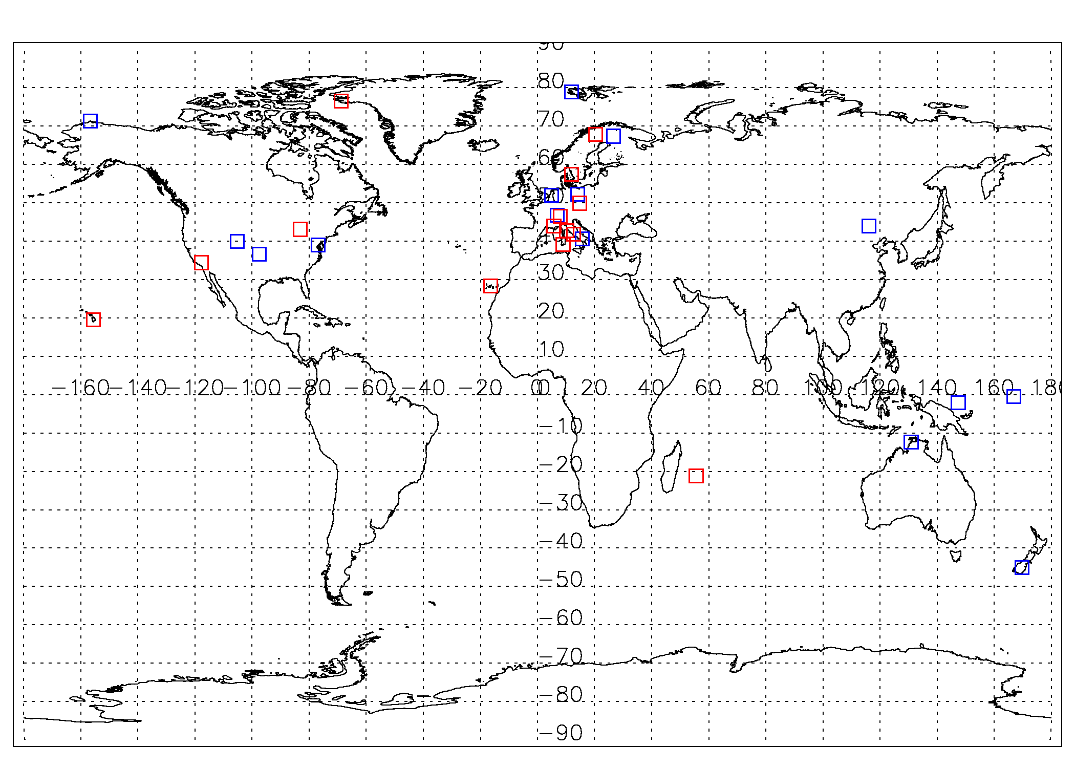
Geographical distribution
GNSS4SWEC workshop Varna 11-12 Sept. 2014
GRUAN sites

Slide 4
Europe
sun photometer
Supersite |  | GNSS | RS | MWR | SPM | FTIR | LIDAR | VLBI DORIS | SYNOP
Ny-Alesund (Spitsbergen) | NOR | * | * | * | * | * | * | VL & DO | *
Sodankylä | FIN | * | * |  | * | * | * | ? | *
Kiruna | SWE | * | * | * |  | * |  | ? | *
Onsala | SWE | * | * | * |  |  |  | VLBI | *
Lindenberg | DEU | * | * | * |  |  |  | ? | *
Cabauw | NL | * | * | * |  |  | * | ? | *
Pecny (Ondrejov) | CZE | * | * | * |  |  |  | ? | *
Payerne | CH | * | * | * |  |  | * | ? | *
Jungfraujoch | CH | * |  |  |  | * |  | ? | *
Observatoire Haute Provence | FRA | * | * |  | * |  | * | ? | ?
Elba Island | ITA | * | * | * |  |  |  | ? | *
Rome | ITA | * | ? | * | * |  | * | ? | *
Potenza | ITA | * | * | * | * |  | * | ? | *
Cagliari | ITA | * | * | * |  |  |  | ? | *
Izaňa (Tenerife) | ESP | * | * |  | * | * |  | ? | *
GNSS4SWEC workshop Varna 11-12 Sept. 2014
GRUAN sites
? = TBC

Slide 5
Outside EU
supersite |  | GNSS | RS | MWR | SPM | FTIR | LIDAR | VLBI/DORIS | SYNOP
Barrow (Alaska) | USA | * | * | * | * | * |  | ? | *
Beltsville | USA | * | * | * | * |  | * | VLBI | *
Boulder | USA | * | * |  |  | * |  | ? | ?
Lamont | USA | * | * | * | * | * | * | ? | *
Table Mountain | USA | * | * | * | * | * | * | ? | *
Mauna Loa (Hawai) | USA | * | ? | * | * | * | * | VLBI | ?
London | CAN | ? | ? |  |  |  | * | ? | *
Thule (Greenland) | GRL | * | * |  | * | * |  | DORIS | *
Manus (Papua New Guinea) | PNG | * | * | * | * | * |  | ? | *
Nauru | NRU | * | * | * | * | * |  | ? | *
Xilin Hot | CHI | * | * | * |  |  |  | ? | *
Lauder | NZL | * | * |  |  | * |  | ? | ?
Darwin | AUS | * | * | * | * | * | * | ? | *
La Réunion | REU | * | * |  | * | * |  | DORIS | *
GNSS4SWEC workshop Varna 11-12 Sept. 2014
GRUAN sites
? = TBC

Slide 6
First steps of road map
data collection
How will we get the BEST data from the data providers?
First address to the network PIs (GRUAN, NDACC working group leaders)? Do we make therefore an official COST GNSS4SWEC letter asking for data/collaboration? If so, what can we offer them in return?
Second option: contact station PIs → station PIs willing to contribute with data: please contact us!
How do we guarantee the use of homogeneous datasets?
How do we guarantee homogeneous processing of the data of the same type of instrument at different sites? For instance, will we do the GPS processing ourselves? Has GRUAN a homogeneous ZTD processing?
data storage
Where do we store the data to be used for intercomparison? Jan Dousa’s database?
What about the metadata storage? Version number? Homogenisation method?
Who wants to contribute to the analysis? Please contact us!
GNSS4SWEC workshop Varna 11-12 Sept. 2014

Slide 7
Inventory of IWV intercomparison papers
Roeland Van Malderen

Slide 8
Literature review
45 entries in table, a new column (Journal) added
latest entries (2014):
Bock et al., JGR, 2014: world-wide IWV comparisons of DORIS (79) vs. ERA-interim, GPS (96), radiosondes, and satelllites (SSMI, SSMIS, and AMSR-E)
Van Malderen, Brenot, Pottiaux et al., AMT, 2014: world-wide IWV comparisons of GPS (28) vs. radiosondes, sun photometer, and satellites (GOME, SCIAMACHY, GOME-2, AIRS).
Pérez-Ramirez et al., JGR, 2014: IWV intercomparison for GPS, MWR, RS, sun photometer at 3 ARM (Atmospheric Radiation Measurement) “super”sites
Shall we continue collecting references for updating this table ?
Initiate similar exercise for other topics (e.g. GNSS data processing studies) ?
GNSS4SWEC workshop Varna 11-12 Sept. 2014

Slide 9
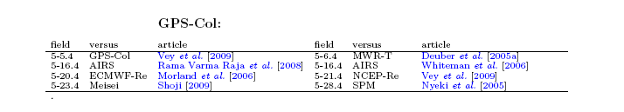
Literature review
Suggestions:
include the Impact Factor
comments on the strength/pertinence or weakness/limitations of each paper?
ranking delivered by a reviewer board to help the less experienced researchers to find easily the most pertinent/consensual papers to cite?
create an interactive clickable pdf-file survey of intercomparisons of IWV with direct links to the articles? E.g.: http://www.iapmw.unibe.ch/research/collaboration/h2odb/
GNSS4SWEC workshop Varna 11-12 Sept. 2014

Slide 10
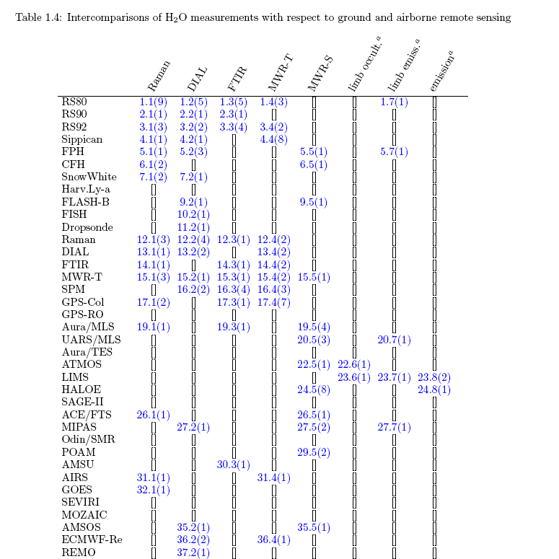
Literature review
GNSS4SWEC workshop Varna 11-12 Sept. 2014

