Slide 1
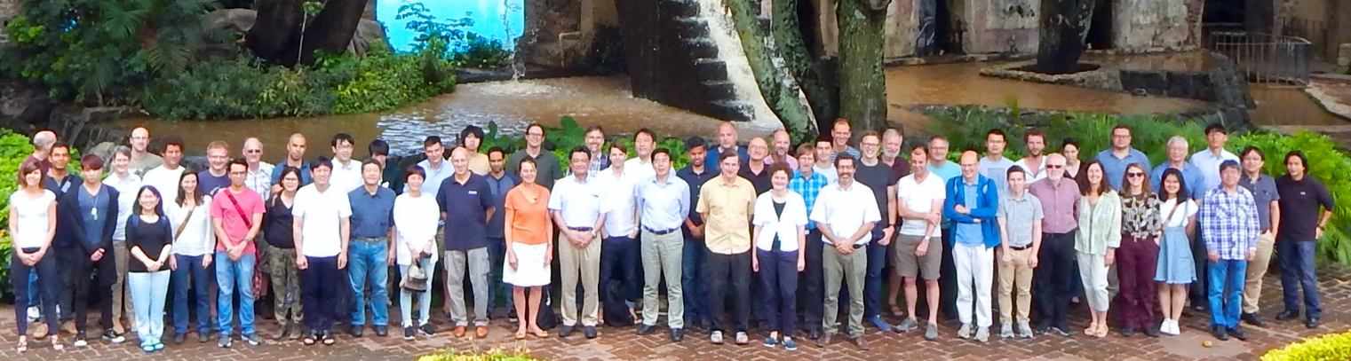
FTIR measurements for TOAR-II
Corinne Vigouroux (corinne.vigouroux@aeronomie.be)
For the IRWG of NDACC (https://www2.acom.ucar.edu/irwg)
1. Harmonization
2. Uncertainties
3. Data flagging

Slide 2
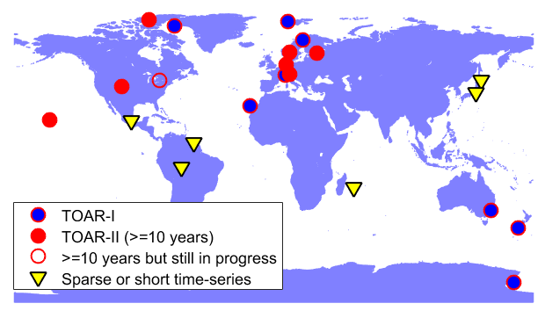
1. Harmonization
23 FTIR sites (16 time-series >= 10 years) measuring ozone
For TOP/OPT WGs: at least 29 FTIR sites measure HCHO, CO, CH₄,…
Most of these sites are part of NDACC. All follow the IRWG requirements:
  High-resolution spectrometers: most are from the same manufacturer Bruker, and usually same instrument 120/5HR.
  Alignment continuously checked by calibration cell measurements.
  Harmonization of ozone retrievals (spectral windows, spectroscopy, a priori profiles,…) follows the same common reference: Vigouroux et al., ACP, 2015.

Slide 3
2. Data format and uncertainties
FTIR remote sensing measurements: Optimal Estimation used (Rodgers, 2000), low vertical resolution profiles obtained, with good sensitivity from the ground up to about 40-45 km.
Archived in NDACC: geoms format files with profiles (fine grid > 40 layers), random & systematic uncertainty covariance matrices, a priori profiles and averaging kernel matrices.
The uncertainty covariance matrices are built following Rodgers (2000), see e.g. García et al., 2012. Theoretical budget was found close to empirical one (bias / std from comparison with sondes).
The smoothing error is not included in geoms files assuming that the users will make use of the averaging kernels when making comparisons.
FTIR ozone data in NDACC database are ready for use: for careful users !

Slide 4
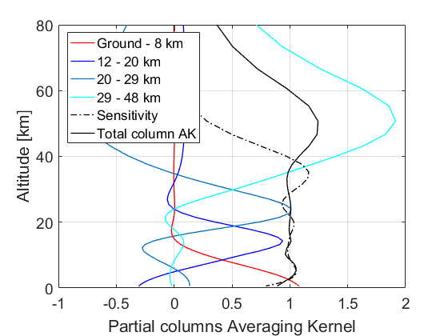
2. Data format and uncertainties
For TOAR-I, I provided “easy-to-use” tropospheric data for trend analysis (Gaudel et al.):
Integrated partial columns (ground- 8km): for which at most sites DOFS >1
Example of Averaging Kernels at Lauder.
4 -5 independent vertical layers (DOFS):
- 1 tropospheric (TOAR)
- 3 stratospheric up to 45 km (LOTUS/SPARC)
Foreseen in 2021 for TOAR-II:
  Check status/consistency of uncertainty in geoms NDACC files; Interact with PIs if not good/not harmonized.
  Provide random & systematic uncertainty associated to the integrated partial columns. Smoothing uncertainty (not included in NDACC files) dominates the random uncertainty in the troposphere (~5%): so will be added.

Slide 5
3. Flagging
In principle, only good quality FTIR data are archived in NDACC: no quality flag is used / foreseen.
Outliers are checked “manually” for HEGIFTOM/LOTUS and reported to PIs (usually very few; a “bad profiles” site and a too low DOFS site were noticed, PIs work on reprocessing…)
Some automatized quality check are performed, but only for dedicated projects (CAMS validation, ACTRIS), so not including all NDACC sites at present.

