Slide 1
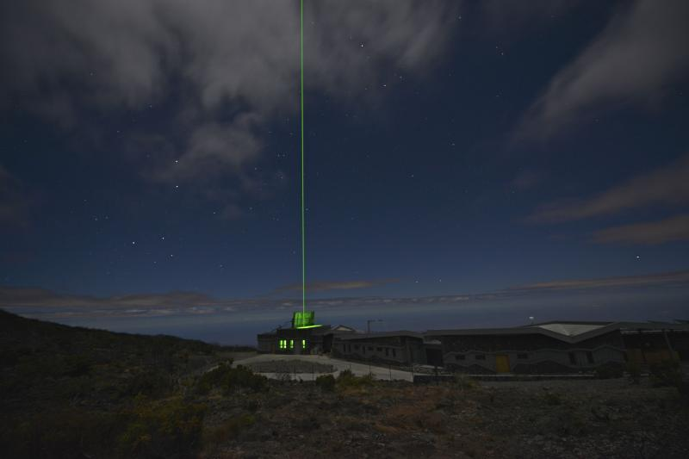
Lidar
The NDACC and TOLNet Lidar PIs:
G. Ancellet, T. Berkoff, V. Duflot, S. Kuang,
A. Langford, T. Leblanc, T. McGee, M. Newchurch,
C. Senff, K. Strawbridge, and J. Sullivan
Photo: Maido Obs., Reunion Island (source: G. Payen, OSU-R)

Slide 2
NDACC and TOLNet
Tropospheric Ozone Differential Absorption Lidars
NDACC only:
OHP, France: NH mid-lat 1990-present 1.8 - 13 km a.g.l. *
Reunion Island: SH tropics 1998-present 4.0 - 17 km a.g.l. *
(Southern Indian Ocean)
NDACC and TOLNet:
JPL-TMF, California: NH mid-lat 1999-present (0.7) - 22 km a.g.l. *
UAH, Huntsville, Alabama: NH mid-lat 2004-present (0.5) - 15 km a.g.l.
TROPOZ, NASA-GSFC: Mobile 2013-present (0.5) - 15 km a.g.l.
TOLNet Only:
TOPAZ NOAA-Boulder: Mobile 2012-present 0.03 - 10 km a.g.l.
LMOL, NASA-LaRC: Mobile 2014-present (0.1) - 12 km a.g.l.
AMOLITE, ECCC Toronto: Mobile 2014-present 0.2 - 15 km a.g.l.
* OHP, Reunion, TMF: Strato. O3 DIAL available for altitudes above 12 km a.g.l.

Slide 3
Is uncertainty reported consistently
for the NDACC and TOLNet lidars?
It is reported consistently, following Leblanc et al., AMT, 2016 guidelines,
when the following variables in the NDACC and TOLNet files in HDF (GEOMS)
format contain non-missing values:
Total uncertainty: quadratic sum of all components (random and systematic)
Random uncertainty: Signal detection noise
Systematic uncertainty: quadratic sum of the following systematic components:
Signal saturation
Background noise extraction
Ozone absorption cross-section (use of so-called “BDM”)
and the following minor components:
Molecular extinction cross-section
Ancillary air density/temperature/pressure profile
NO₂ absorption cross-sections
Ancillary NO₂ profile
SO₂ absorption cross-sections
Ancillary SO₂ profile
In the HDF (GEOMS) files, when the uncertainty is not estimated following the guidelines
of Leblanc et al., AMT, 2016, a fourth uncertainty variable named “originator” is used
Uncertainty is not reported consistently in the NDACC files
in ASCII (Ames) format

Slide 4
On Systematic Uncertainties…
The term “systematic uncertainty”, in the NDACC and TOLNet lidar case,
refers to components that are highly correlated in the vertical dimension
as well as in the time dimension.
Their behavior (magnitude, altitude dependence, etc.) might change in time,
for example if there is a change in data processor, or a change in the choice of
ancillary data source
A typical example is:
Using the ozone absorption cross-sections of Paur and Bass during the
first 10 years of measurements, and then the BDM dataset for the next 10 years
There is no mechanism in the NDACC and TOLNet reporting system that allows
a clear identification of correlation lengths for systematic components

Slide 5
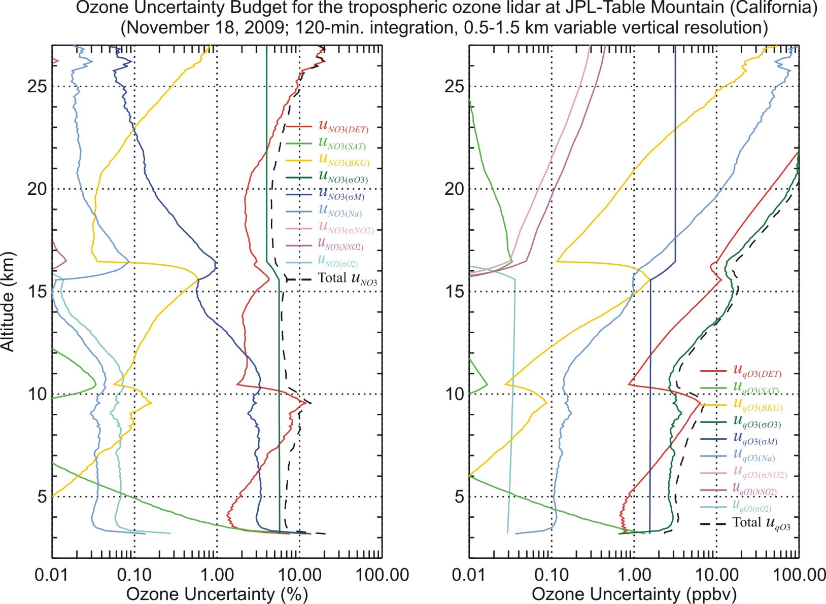
Internal Consistency: Standardized uncertainty budget
(Leblanc et al., AMT, 2016)
Total uncertainty:
in black, dash curve
Random uncertainty
in red:
Depends on instrument
hardware
Cross-sec. uncertainty
in green:
Standardized within
NDACC and TOLNet
Mol. ext. uncertainty
in blue:
Depends on the source
of ancillary data

Slide 6
Data Flagging
There is no data flagging in the NDACC and TOLNet reporting system
Many years ago, it has been agreed within both the NDACC and TOLNet
lidar communities that data quality is essentially determined by the reported
uncertainty
Nevertheless, for the sake of a proactive TOAR-II involvement, it is planned
to explore the options of designing a flag that can address the TOAR-II needs
See “Proposed Harmonization Activities for 2021” slide
One exception to the rule:
The HDF files produced by NDACC (and TOLNet) lidar PIs have a global
attribute that can be set to “RD” to indicate that the profiles have been
produced for Rapid Delivery (RD)
“RD data” are archived in a separate server at NDACC

Slide 7
Meta Data / Ancillary Data / A priori Data
For proper lidar data processing, the following “ancillary data”
are needed:
Temperature-dependent ozone absorption cross-sections
As part of the NDACC and TOLNet lidar networks homogenization,
the consensus is to use the results of University of Reims, a.k.a. BDM
(Brion-Daumont-Malicet, 1993-1998)
Air density and temperature profile at the time of measurement
There is no consensus within the networks on which data source to use
NO2 and SO2 profiles and absorption cross-sections
Required only for PBL measurements, if lidar operates at certain wavelengths
in the Hartley band
There is no consensus within the networks on which data source to use

Slide 8
Traceability
Are the NDACC and TOLNet O3 lidars traceable to a common reference?
Are the instruments internally consistent?
At hardware level: No
Lasers and optical filters often come from the same manufacturers,
but the instrument design is typically custom-made, rarely repeated.
At data processing level: Yes partially
Three elements of data processing are standardized for all NDACC and
TOLNet lidars: the ozone absorption cross-sections (BDM), vertical resolution,
and the methodology to compute uncertainty budgets (Leblanc et al., 2016)
Several NDACC and TOLNet lidar data have been analyzed systematically,
or on a case-by-case basis, by the same data processor (GLASS from JPL).
This effort can be extended for TOAR-II if individual lidar PIs interested.
At programmatic level: Yes, through campaigns
The TOLNet SCOOP (2016) inter-comparison campaign is the best example
NDACC campaigns typically involve multiple techniques, but the comparison
of multiple tropospheric O3 DIAL did not happen yet

Slide 9
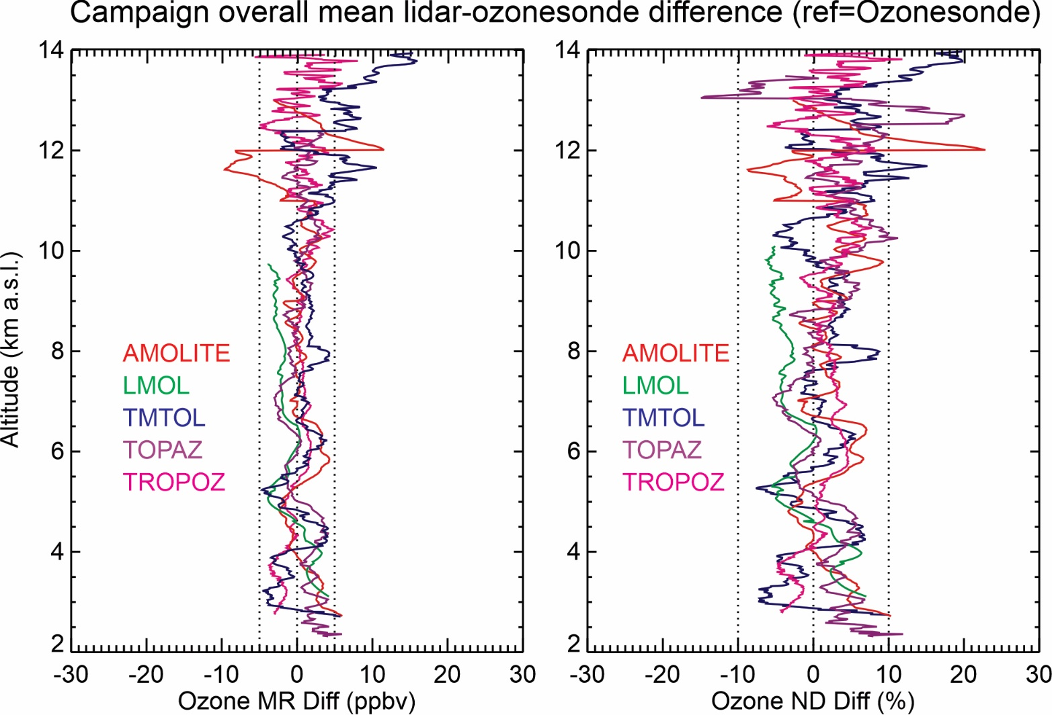
Example of internal and external consistency:
the TOLNet inter-comparison campaign SCOOP
When: August 2016
Where: JPL-TMF
Average difference
of 18 ozonesonde
coincident profiles
Lidar measurements
taken during the
first 30-min of
ECC flights
All lidars agree
within +/-3 ppbv
(or 4%)

Slide 10
Foreseen Harmonization Activities in 2021
1) Creation of a “TOAR-II” Lidar meta-database
Purpose: To list, for each lidar, the status of data, metadata and other metrics
relevant to TOAR-II harmonization and analysis efforts.
2) Creation of a TOAR-II-dedicated flag, design is yet TBD
Option 1: Implement a generic flag for the entire profile, for example:
flag = 0 Quality not assured
flag = 1 Excellent/good/nominal
flag = 2 Fair/sub-nominal
Option 2: Implement an altitude-dependent flag to help identify specific issues
in the profile, for example:
flag = 1 No identified issue
flag = 2 Data point impacted by cloud
flag = 3 Data point possibly impacted by mis-alignment
flag = 4 Data point possibly impacted by background noise interference
etc…
3) New incentives using the standardized data processor GLASS
Purpose: Assess/ensure the level of standardization of specific datasets

Slide 11
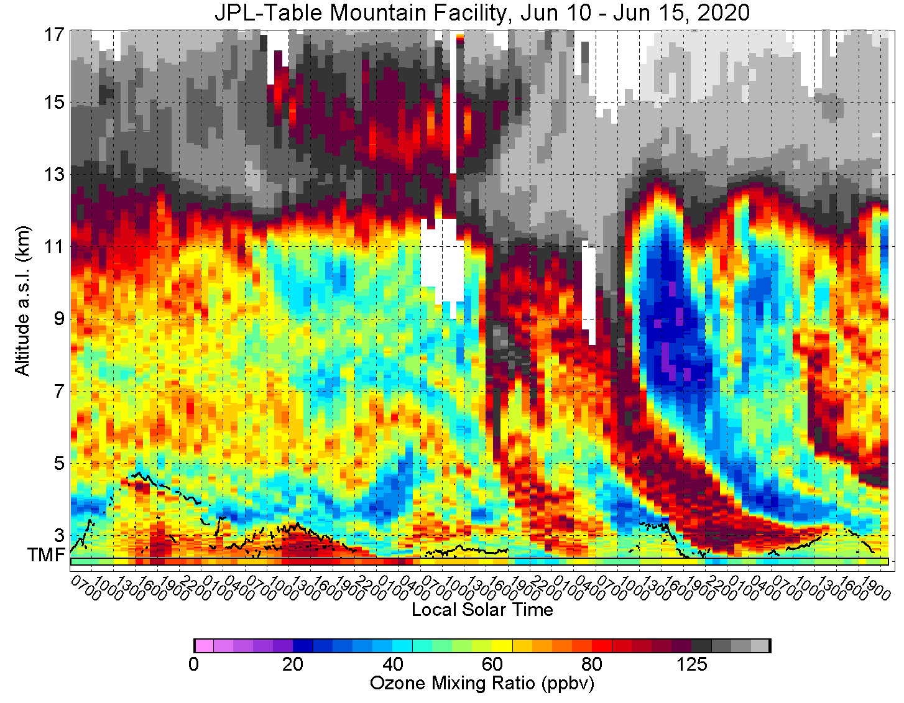
What lidar can do, that other techniques can’t...
Tunable temporal
sampling and
resolution
Tracking of
geophysical
features at
given location
Objective
assessment of
geophysical
temporal
variability
THANK YOU

