Slide 1

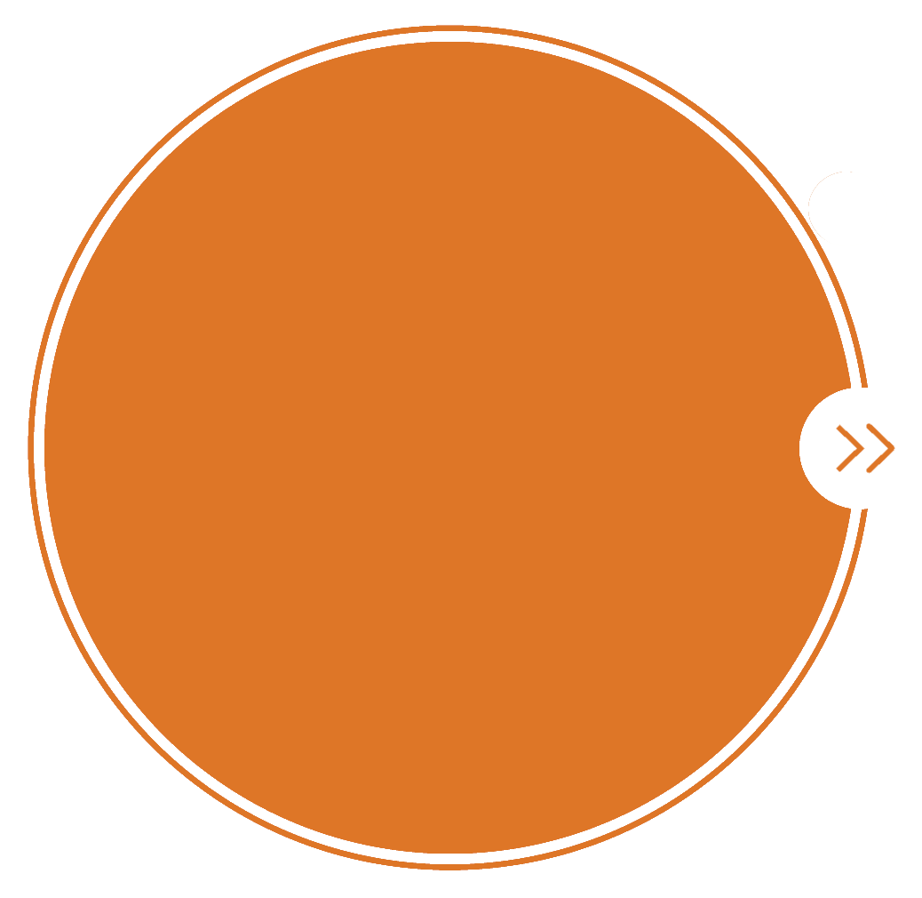
Integrated use of satellite and network data to derive local to global distributions and trends
HEGIFTOM
Kick Off Meeting
25 March 2021
D. Hubert, A. Keppens, J.-C. Lambert, C. Vigouroux,
D. Poyraz, R. Van Malderen, C. Wespes, P. Coheur
BIRA-IASB, KMI-IRM, ULB
daan.hubert@aeronomie.be, arno.keppens@aeronomie.be

Slide 2


Science objectives
Remaining questions after TOAR I…
Why do present-day distributions differ?
Why do past trends differ?
(Gaudel et al., 2018)

Slide 3
Methodology
Collect homogenised data records ← SOWG, HEGIFTOM input
Harmonize tropospheric ozone data records (where possible)
by removing or reducing discrepancies in representation
Intercompare harmonized data records
Investigate remaining sources of discrepancies
Infer present-day distributions & past trends ← SOWG, STAT input

Slide 4
Tropospheric ozone data records
Satellite : profile retrieval
  UV-Vis : GOME, SCIAMACHY, OMI, GOME-2A/B/C, TROPOMI, CrIS, OMPS-NP, …
  IR : IASI-A/B/C
  IR + UV-Vis : IASI + GOME-2
Satellite : residual technique
  Convective Cloud Differential : GOME, SCIAMACHY, OMI, GOME-2, TROPOMI, merged GOME-type, TOMS
  Limb/nadir : OMI-MLS, OMPS-MERRA, TROPOMI-BASCOE, TROPOMI-limb
Ground-based measurement techniques
  Ozonesonde
  FTIR
  Lidar, IAGOS (depending on resources)

Slide 5
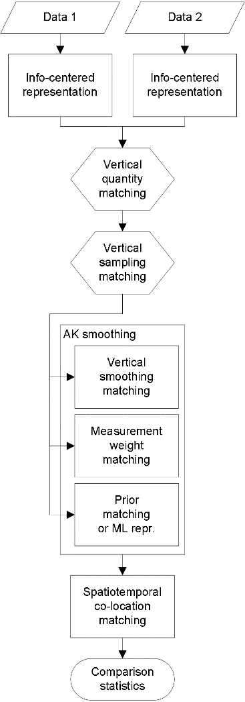
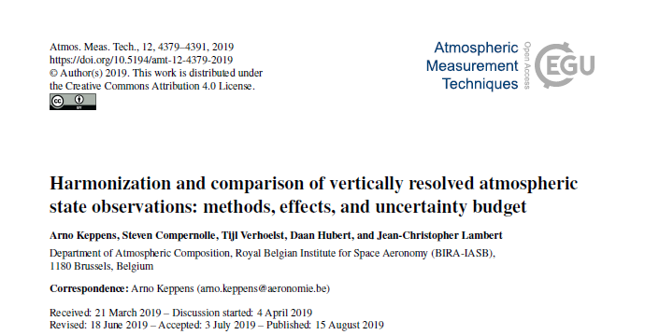
Vertical harmonisation: Methodology
Based on Keppens et al. (2019)
part of the TUNER special issue in AMT
https://amt.copernicus.org/articles/12/4379/2019

Slide 6
Vertical harmonisation: Uncertainty budget
(Keppens et al., 2019)
(Keppens et al., 2015)
(von Clarmann and Grabowski, 2007)

Slide 7
Vertical harmonisation: Practice
Information-centered representation to independent levels/layers + mass-conserving regridding
OR
Re-optimized prior matching to common prior and grid (for low DFS)
FOLLOWED BY
Profile integration up to common tropopause (part of target grid)
WITH common climatology (same as for hor./temp. harmonization) as
Source for tropospheric column extension
Source for new prior
Auxiliary data source for tropopause calculation
Auxiliary data source for vertical quantity matching

Slide 8
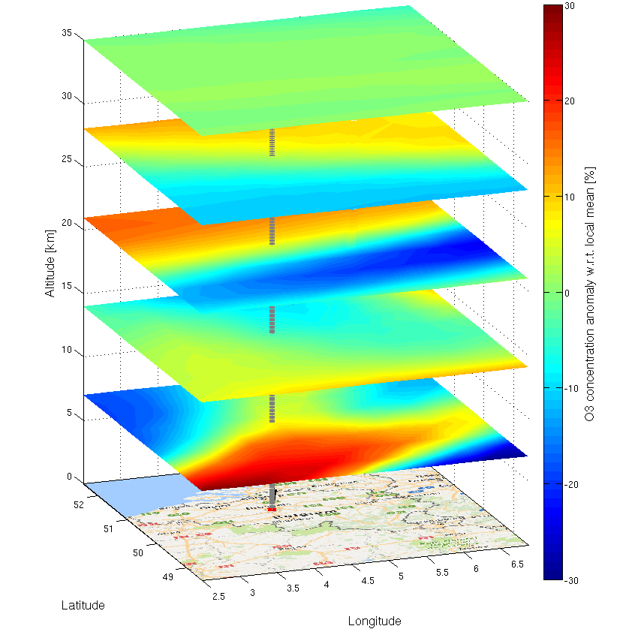
Horizontal & time domain
Differences in horizontal and temporal sampling…
(set of) geolocation(s) vs grid cell mean
(set of) timestamp(s) vs temporal mean
Harmonisation scheme
Subsample climatology/reanalysis data
Compare to fully sampled data
(T. Verhoelst, priv. comm.)

Slide 9
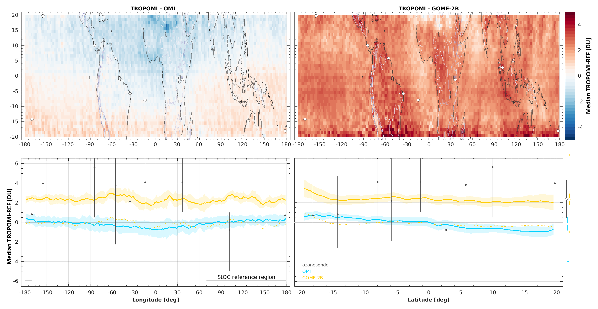
Intercomparison of harmonised data
Compare all harmonised satellite and ground-based data records
Overall statistics (mean, dispersion, correlation)
Time series
Focus on known potential issues highlighted by data providers ← HEGIFTOM, SOWG input
Document remaining discrepancies, identify possible sources
(Hubert et al., 2020)

Slide 10
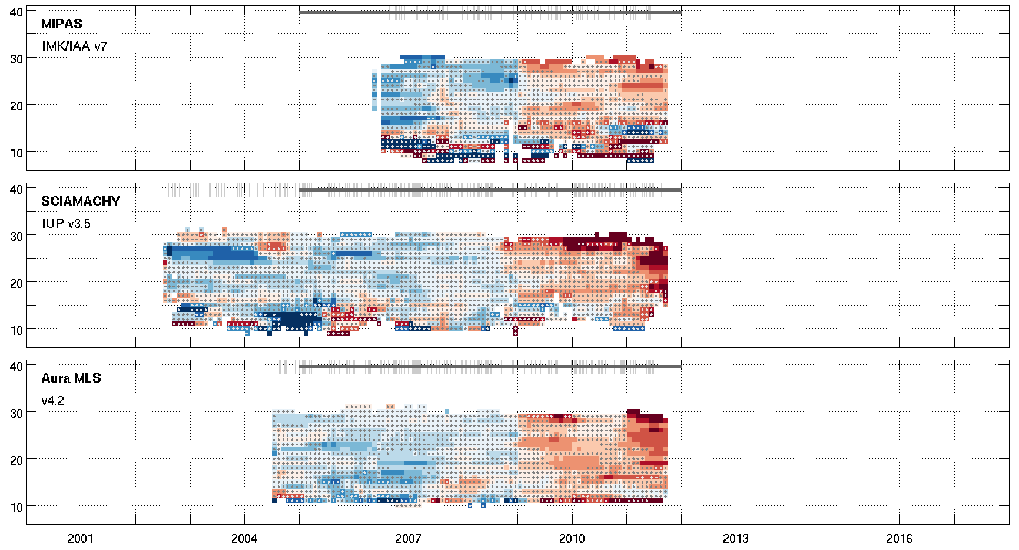
Feedback to HEGIFTOM
Intercomparisons to multiple complementary satellite data records has the potential to unveil
Temporal artefacts at sites in ground-based network
Differences between sites in ground-based network
Difference between sonde, FTIR and satellite data
Was homogenisation successful?
Are reported uncertainties realistic?
(SPARC/IO3C/GAW, 2019)
(Hubert et al., 2020)

