Slide 1
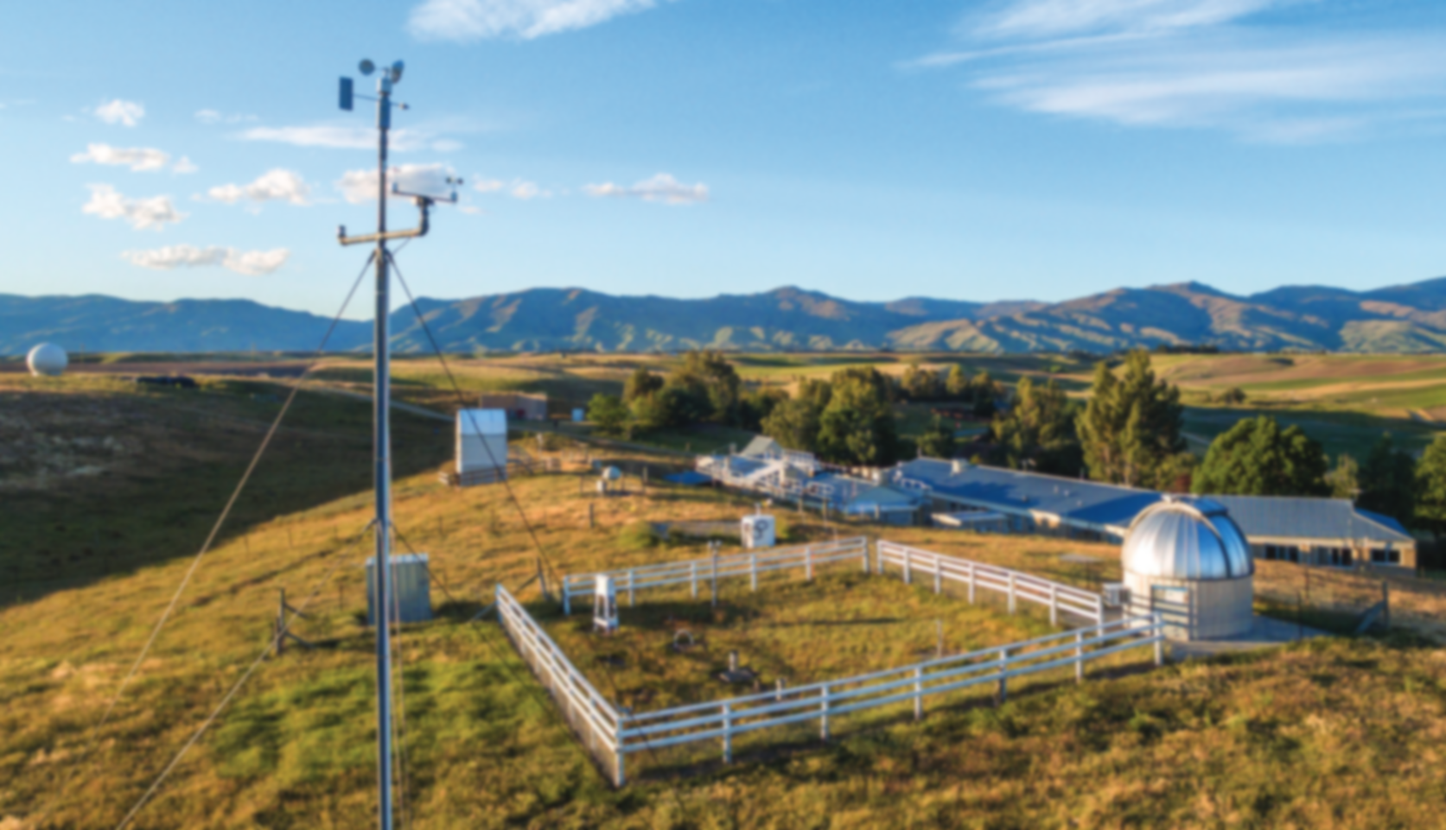
Intercomparison of long-term ozone measurements from ground-based techniques
FTIR + Umkehr + LIDAR + O₃ sondes + MWR at Lauder super site
Robin Björklund
HEGIFTOM meeting
30/08/2022
In collaboration with: Corinne Vigouroux, Bavo Langerock, Dan Smale, Peter Effertz, Irina Petropavlovskikh, James Hannigan, Richard Querel, Ivan Ortega, Miyagawa Koji, John Robinson, Penny Smale, Mike Kotkamp, Gerald Nedoluha, Roeland Van Malderen, Deniz Poyraz

Slide 2

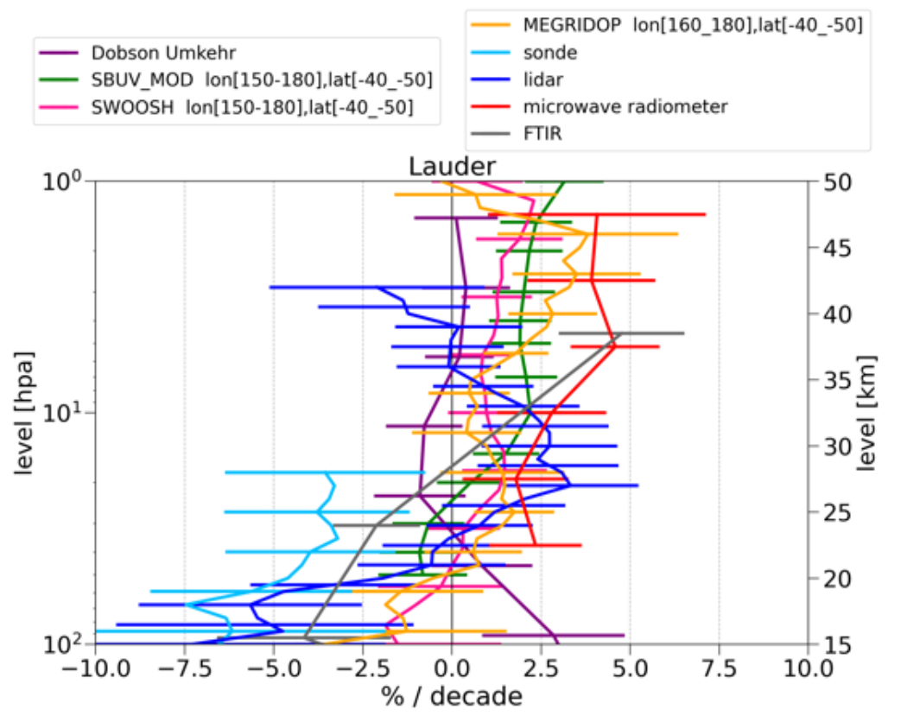

Motivation and context
Need for a comprehensive intercomparison and evaluation of various ozone measurements
Analyse long term trends and potential drift between techniques
→ aim to study data at supersites: Lauder / Mauna Loa / Boulder for 20+ years
Contain information for many observations: FTIR / O₃ sonde / LIDAR / Umkehr / MWR /…
/ HEGIFTOM
troposphere
LOTUS
stratosphere
Figure from Godin-Beekmann et al. 2022, ACPD

Slide 3
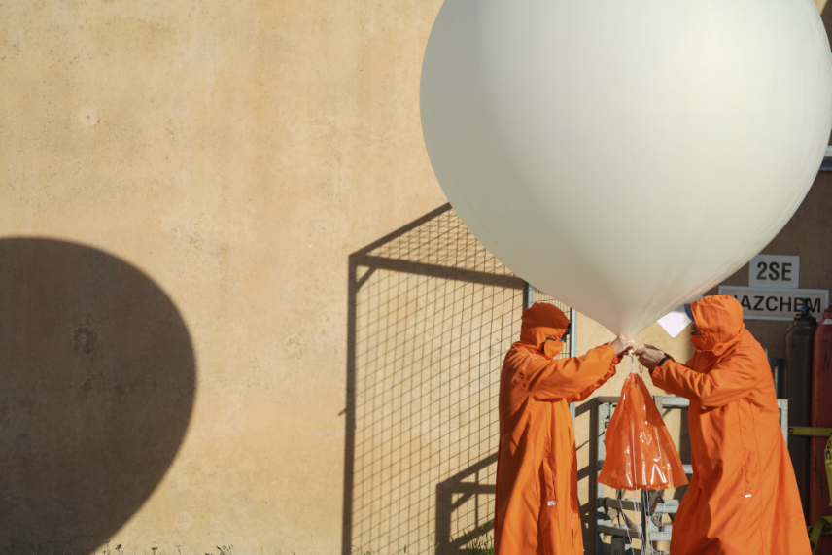
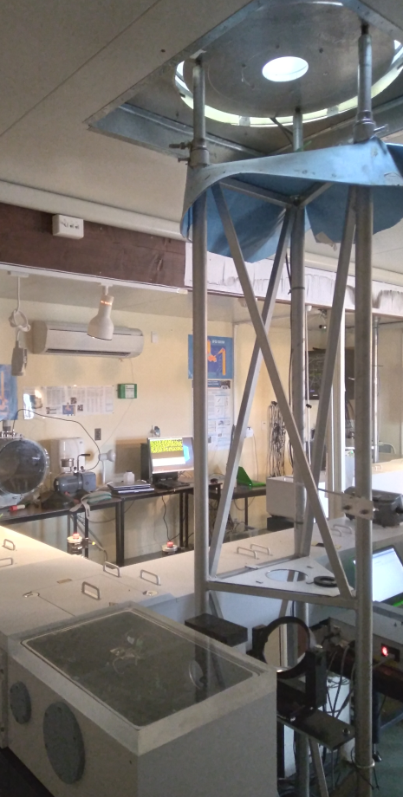
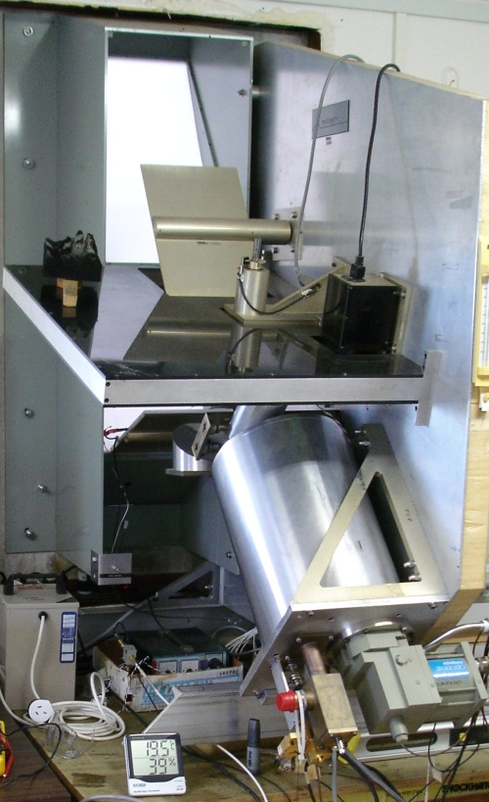
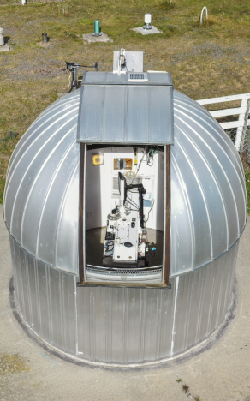
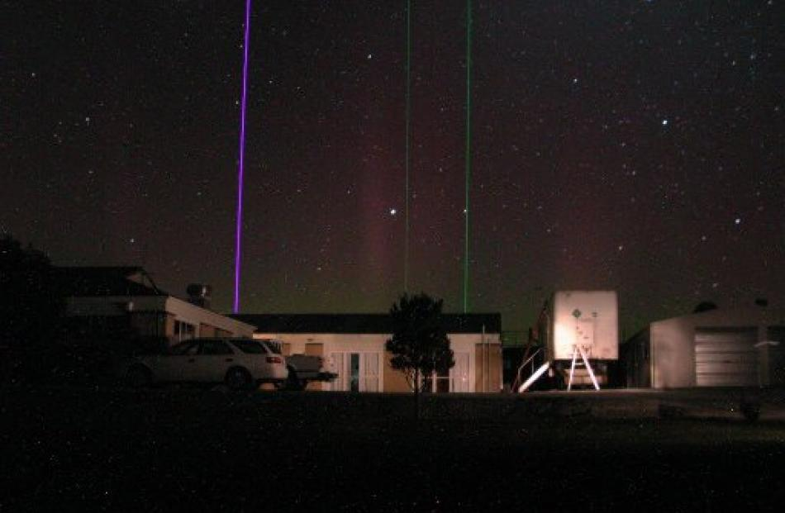
Ground-based techniques
Low vertical resolution using a priori/AVK
Vertically resolved
Ozone sonde
Microwave
radiometer
Dobson
Umkehr
FTIR
LIDAR
Photos by
NIWA

Slide 4
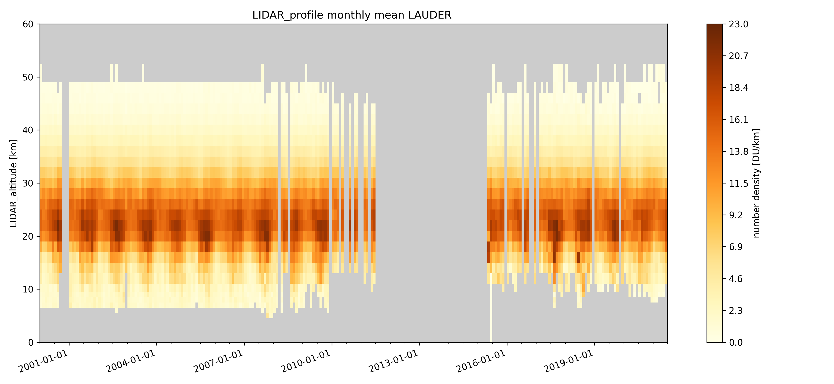
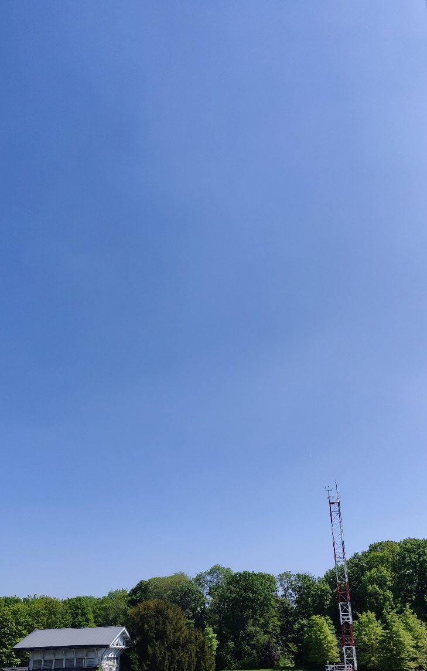
Validation
Choose partial columns based on overlap of measurements with ~1 DOFS of FTIR
Following Rodgers and Connor 2003 to validate techniques (smoothing / a priori)
LIDAR
MWR
42
1.1
2.2
‘High’ stratosphere
DOFS
29
0.7
1.1
‘Mid’ stratosphere
DOFS
21.7
0.7
‘Low’ stratosphere
14
10.9
0.5
Troposphere
FTIR
Umkehr
Sonde

Slide 5
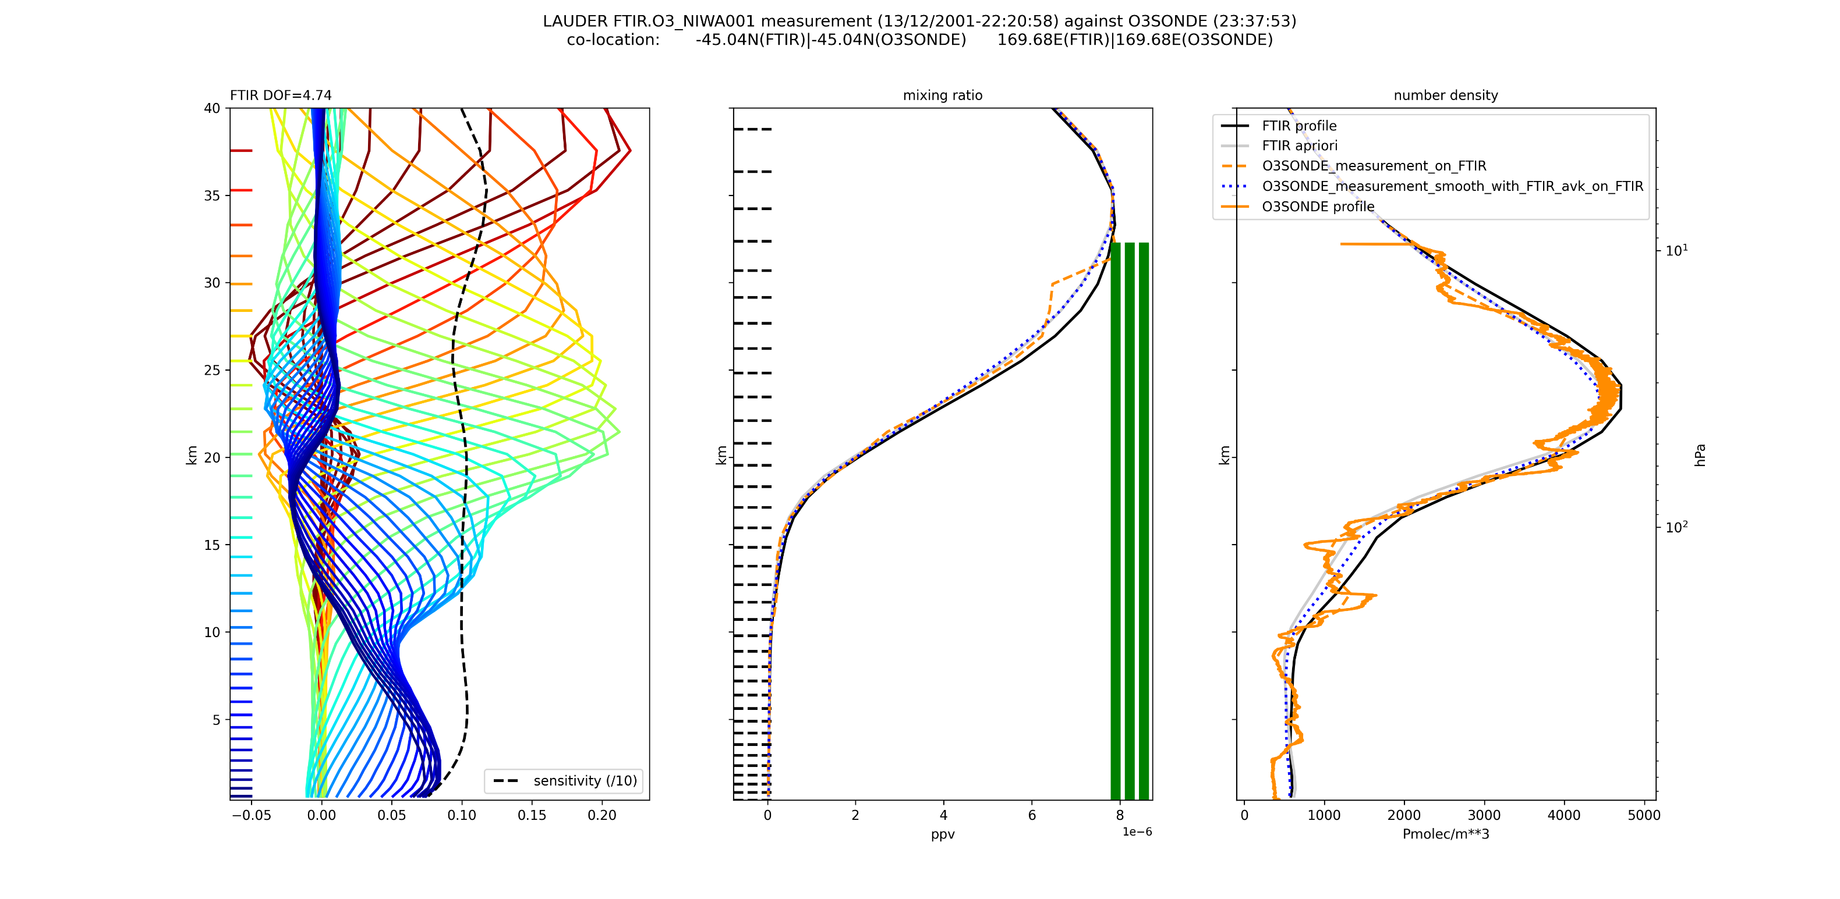
Validation: smoothing

Slide 6
Validation results: columns
MAD: Median Absolute Deviation
equivalent to std, but for median
FTIR-M2 M2 | Median [%] | MAD [%] | Smoothed: Median [%] | Smoothed: MAD [%]
Sonde surf – 29 km | 9.24 | 5.11 | 9.14 | 3.76
LIDAR 14 – 42 km | 6.21 | 3.92 | 5.94 | 3.63
Umkehr surf – 42 km | 5.59 | 3.79 | 5.46 | 2.69
MWR 21.7 – 42 km | 6.28 | 5.25 | 5.04 | 5.12

Slide 7
Validation results: columns
FTIR-M2 M2 | Median [%] | MAD [%] | Smoothed: Median [%] | Smoothed: MAD [%]
Sonde surf – 29 km | 9.24 | 5.11 | 9.14 | 3.76
LIDAR 14 – 42 km | 6.21 | 3.92 | 5.94 | 3.63
Umkehr surf – 42 km | 5.59 | 3.79 | 5.46 | 2.69
MWR 21.7 – 42 km | 6.28 | 5.25 | 5.04 | 5.12
Smoothing measurement gives improvement
Similar bias for all: FTIR has higher ozone columns
  Assumed spectroscopy affects derived ozone column
  Change from Hitran2008 to Hitran2020 reduces FTIR column by 2-3%

Slide 8
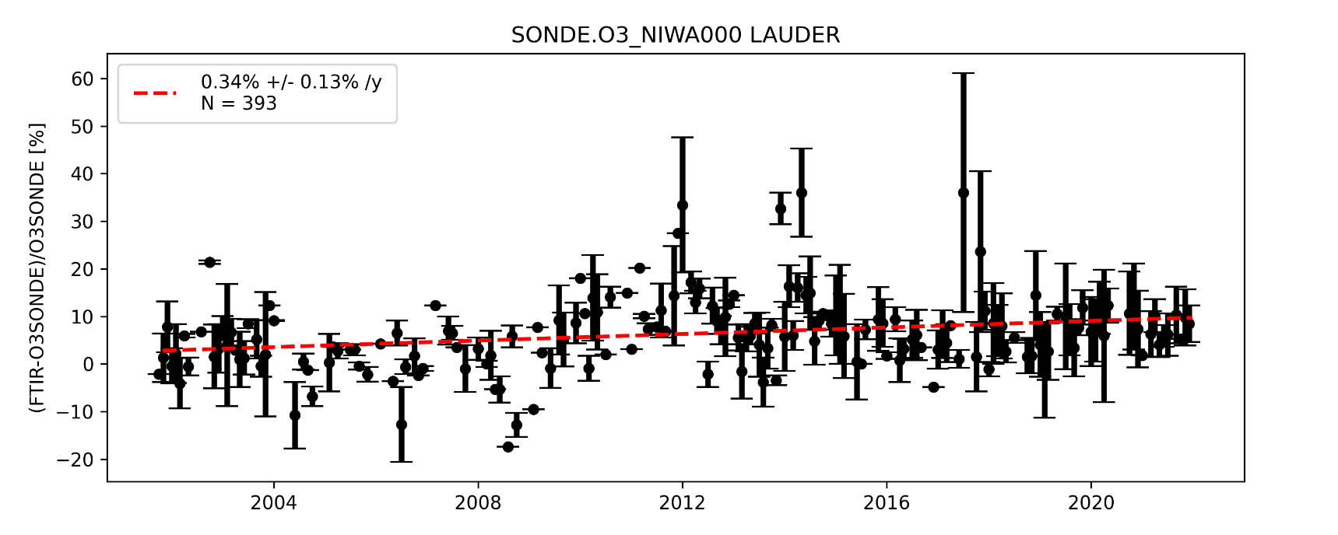
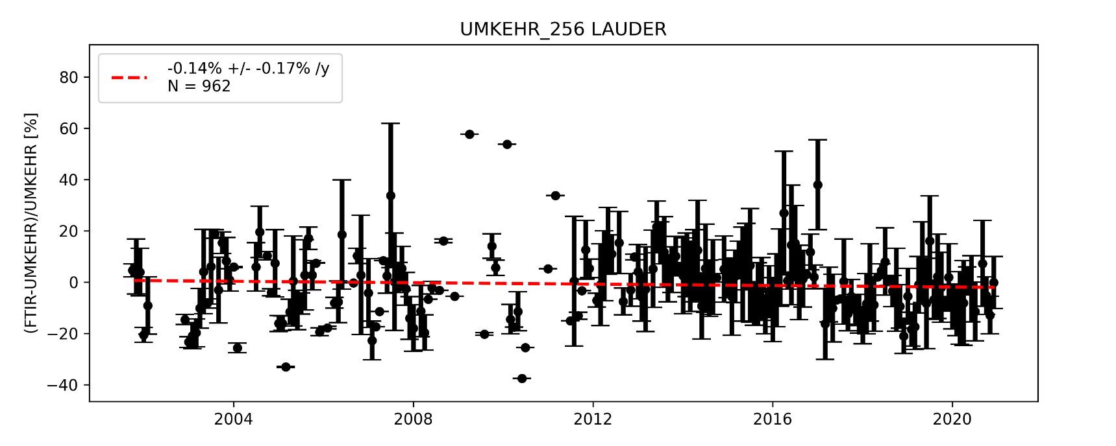
Validation results: troposphere (0 – 10.9 km)
Background and seasonal cycle are fitted to obtain simple drift analysis of rel. differences:
FTIR vs SONDE
Rel. difference
6.5 ± 6.3 %
Drift:
3.2 ± 2.3 %/decade
Rel. difference
-4.6 ± 13.1 %
Drift:
0.0 ± 4.2 %/decade
FTIR vs Umkehr
Trends including components:
Seasonal cycle
QBO
Solar cycle
ENSO

Slide 9
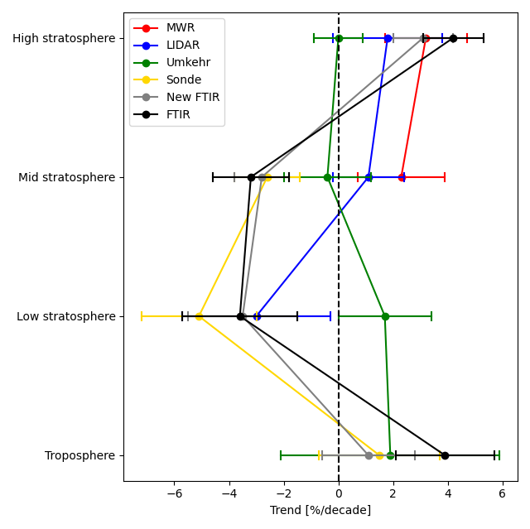
Conclusions of intercomparison
Trend per technique
29-42 km
22-29 km
14-22 km
Trends in agreement with LOTUS
But we see the effect of partial columns vs profile
0-11 km

Slide 10
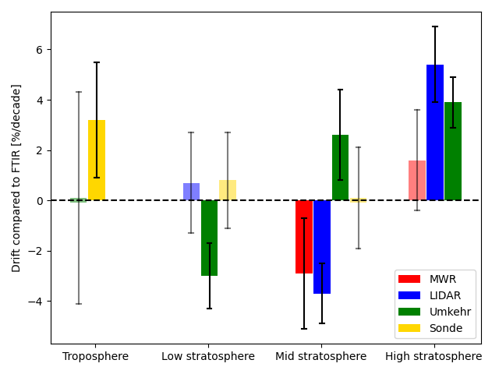
Conclusions of intercomparison
Trends mostly in agreement with drift
→ Trends found in LOTUS are usually from real observed trends
Sometimes effect of sampling? → LIDAR
29-42 km
Drift with respect to (archived) FTIR
22-29 km
14-22 km
0-11 km
0-11 km
14-22 km
22-29 km
29-42 km

Slide 11
Outlook + future plans
Bias are between 4-10% and MAD 5-13%
  → quite good considering FTIR (and probably other instrument) uncertainties
Hard to pinpoint origin of drifts
  New FTIR data (regularization,…)
  Sampling? → fill gap of LIDAR
  Umkehr homogenization study
  Ozonsonde pressure bias correction
Plans to submit a paper about Lauder (+ Mauna Loa,…) intercomparison

Slide 13
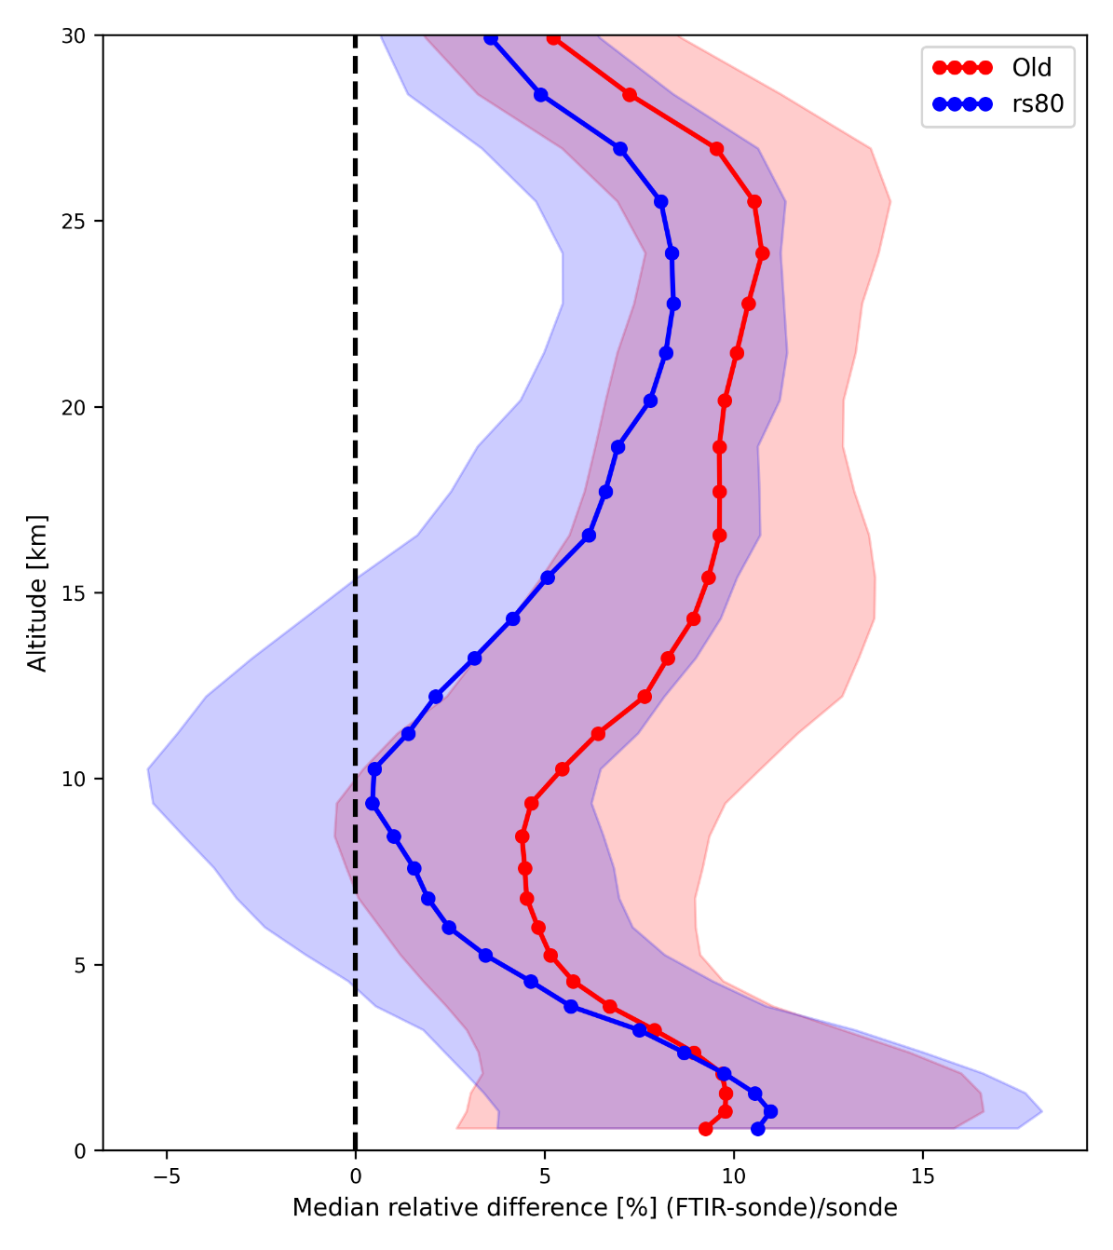
Extra: RS80 bias correction

